Slide 1
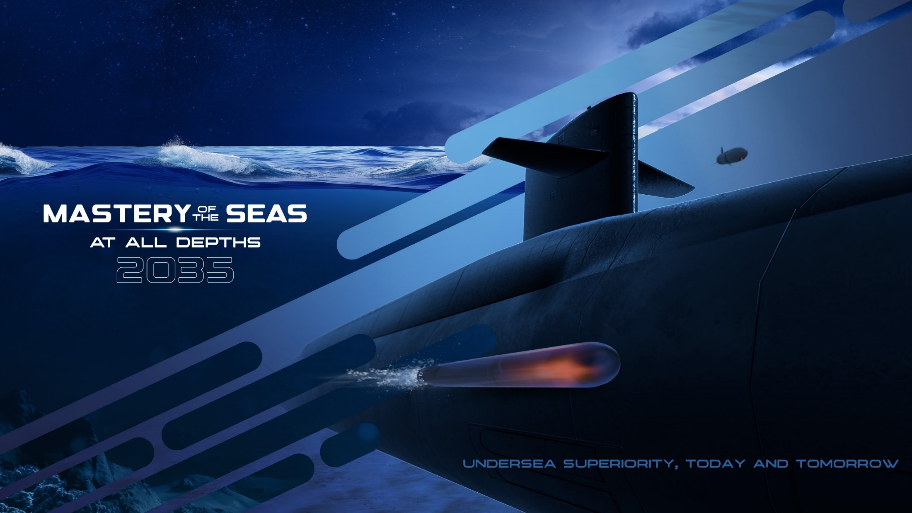

Contracting Professionals: The Silent Architects of the Deep
Presented to:
NCMA Ocean State Workshop
Stephen T. O’Grady
NUWC Division Newport Deputy Technical Director
January 27, 2026
DISTRIBUTION A: Distribution is Unlimited

Slide 2
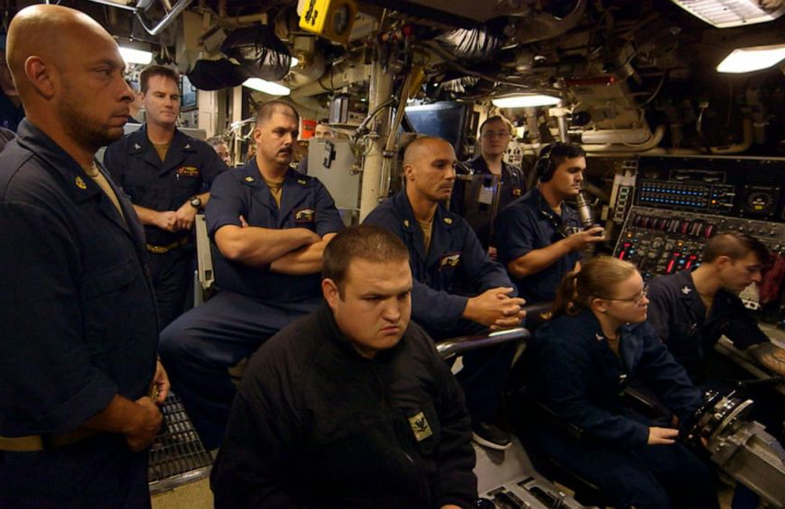

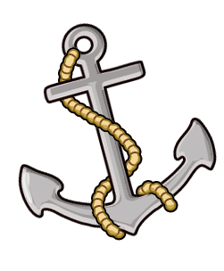
Ready for the Fight Tonight
DISTRIBUTION A: Distribution is Unlimited

Slide 3

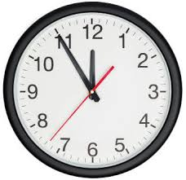
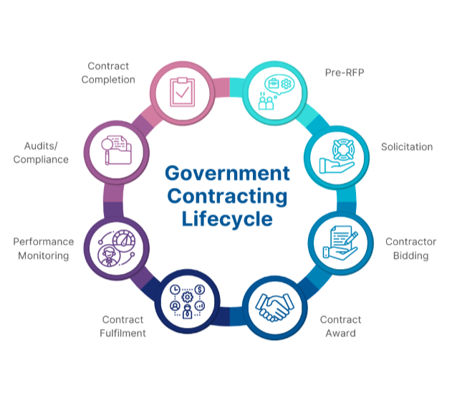
The New Currency of Competition
3
DISTRIBUTION A: Distribution is Unlimited

Slide 4
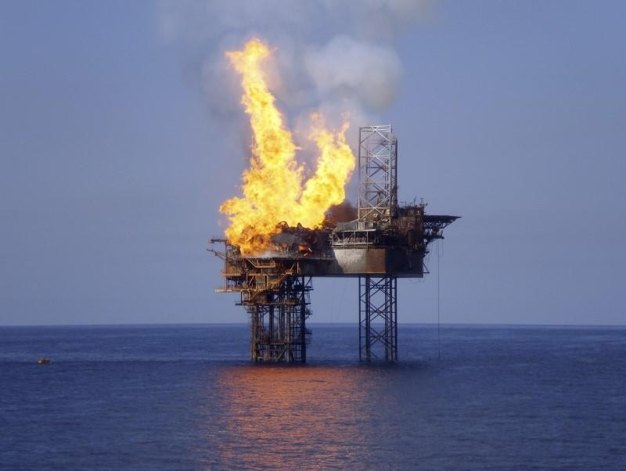
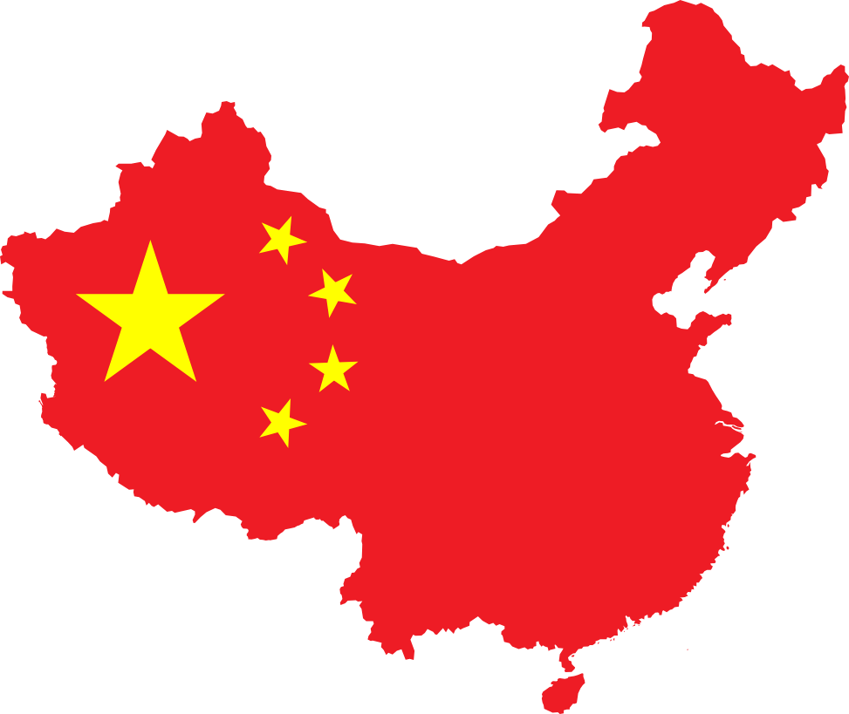
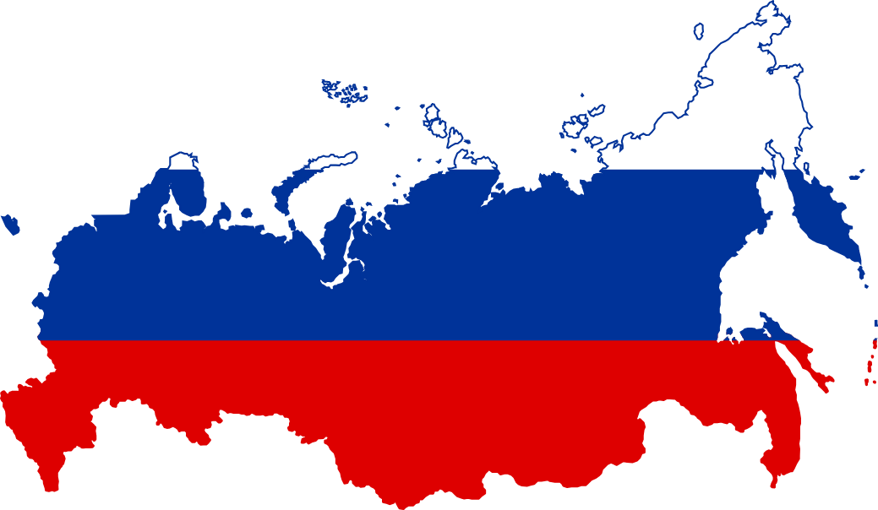
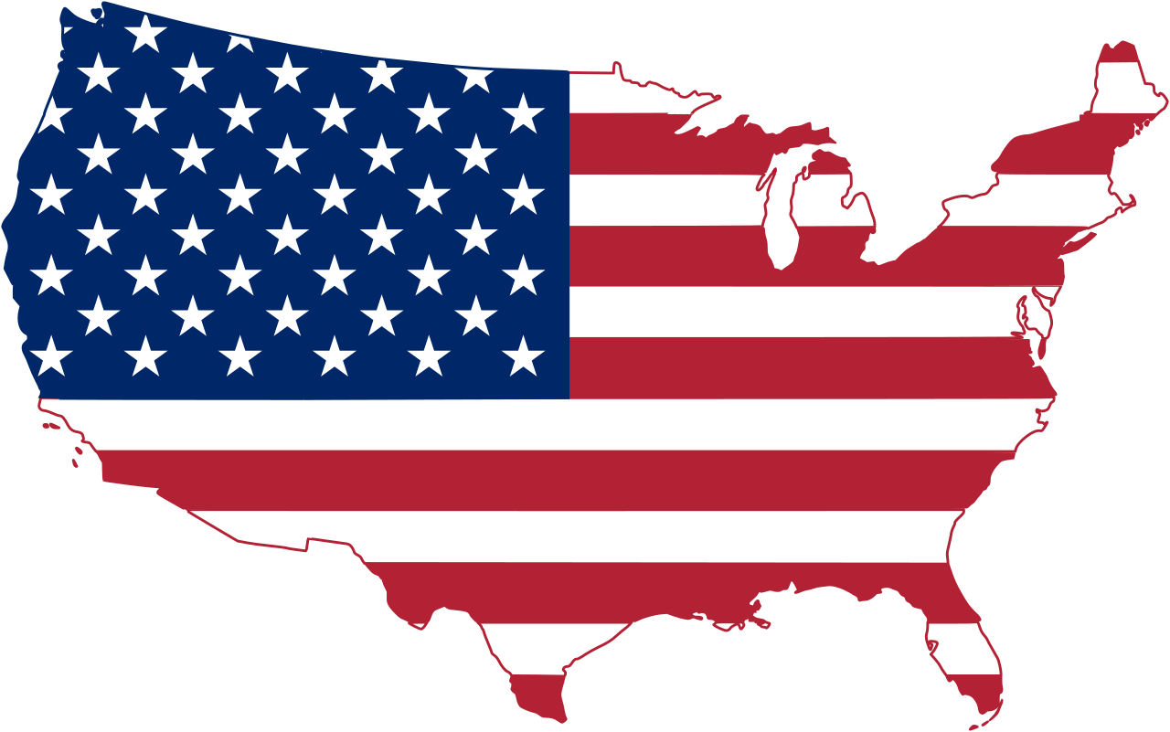
The Burning Platform of Defense Acquisition
China (Military-Civil Fusion)
Russia (State Control)
United States (FAR-based)
WARP &
Wartime Acquisition System (WAS)
4
DISTRIBUTION A: Distribution is Unlimited

Slide 5
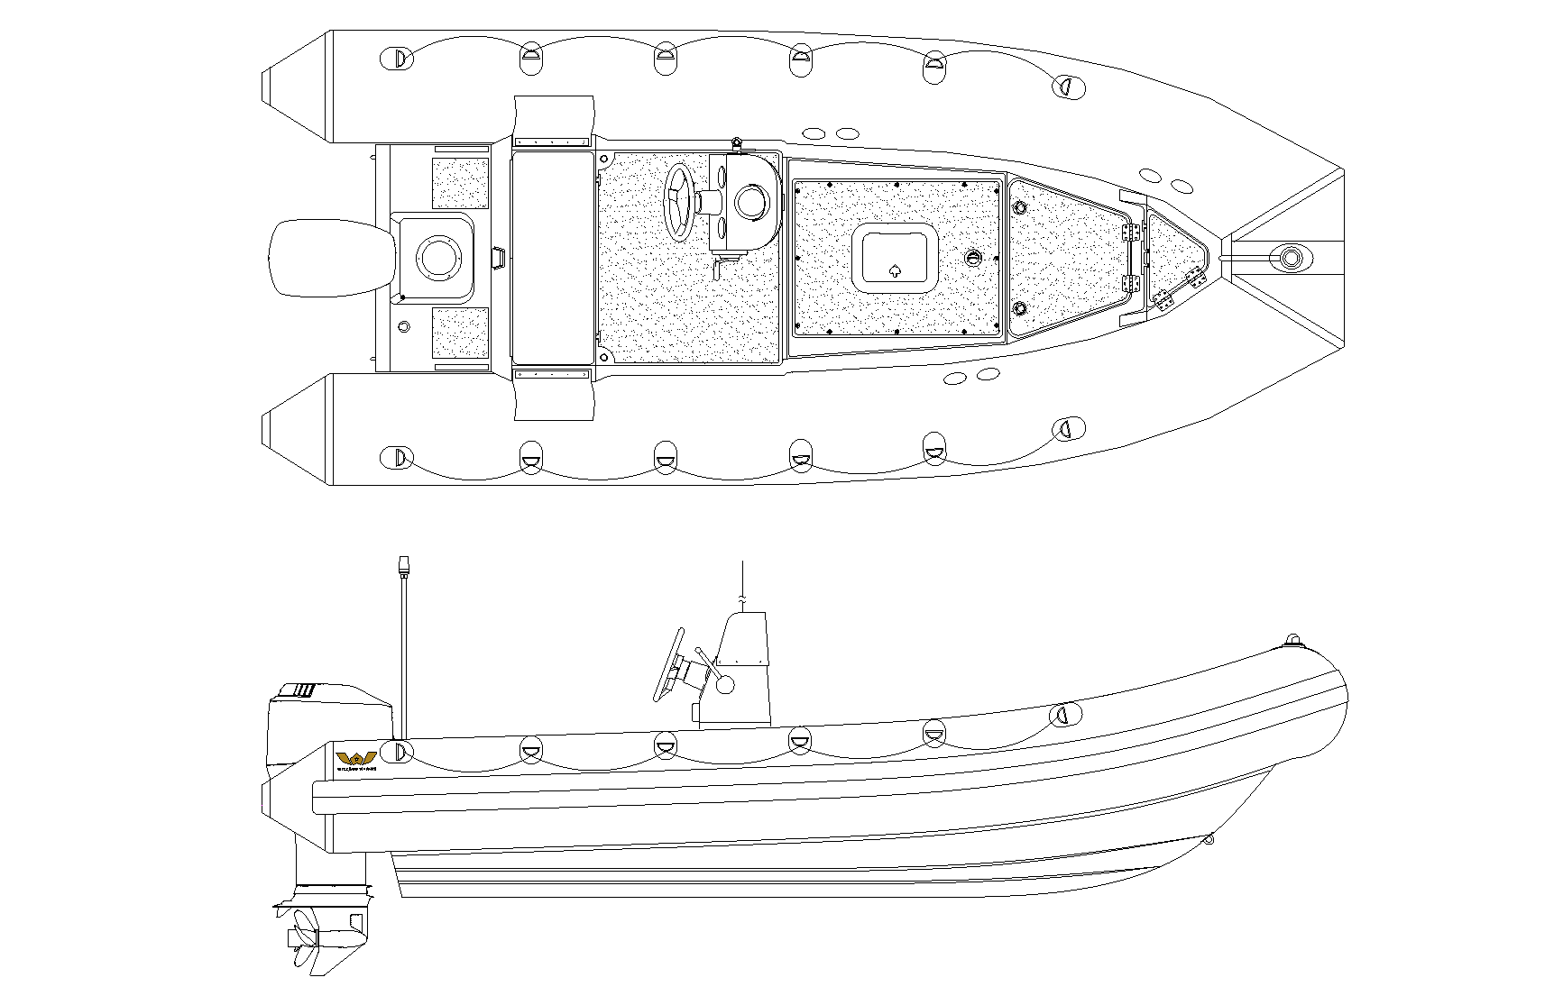
The 6.5 Hour Miracle
“Odd request, might need the big guns”
“We’re gonna need a smaller boat”
5
DISTRIBUTION A: Distribution is Unlimited

Slide 6
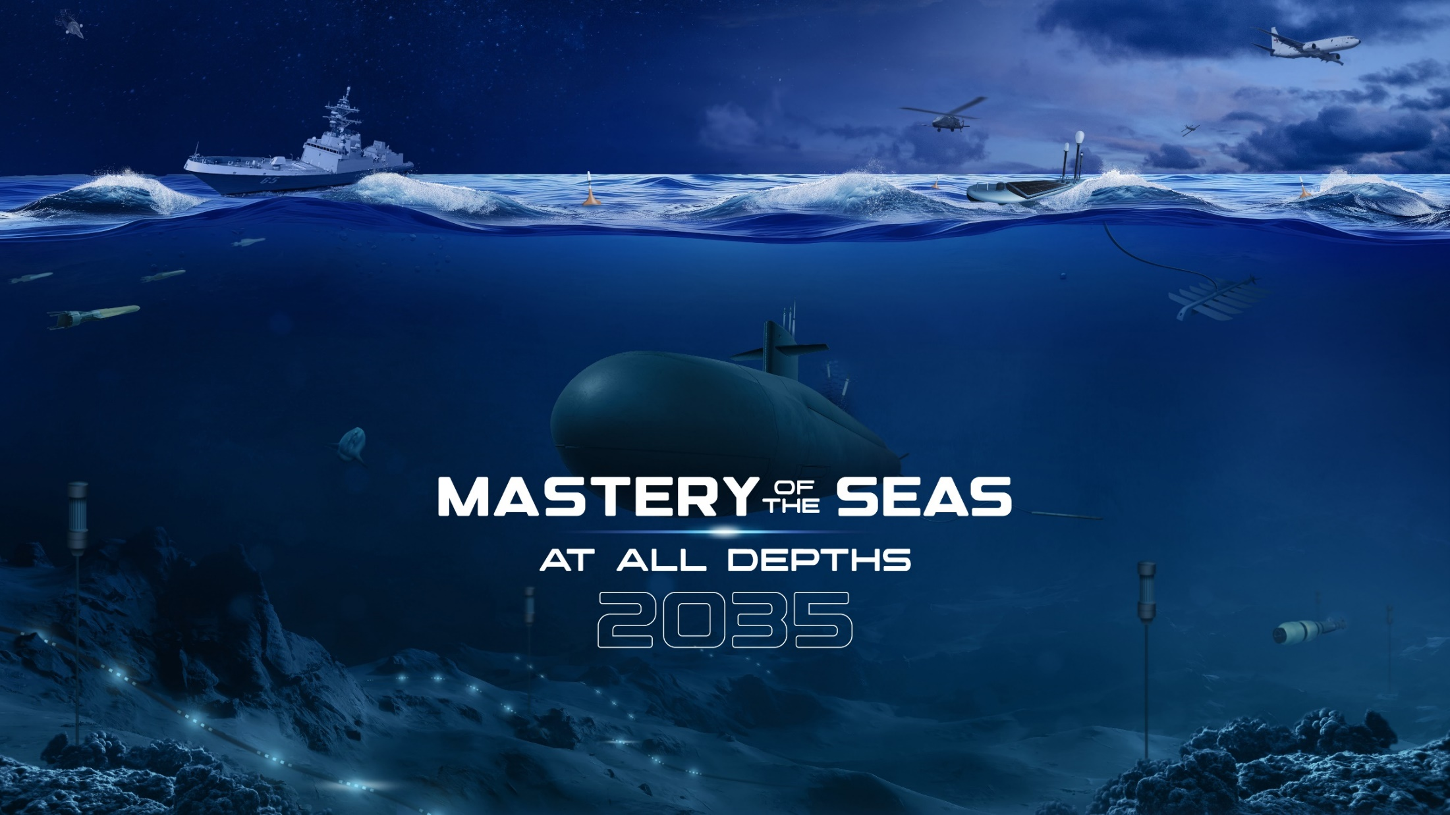
SV 2035
6
DISTRIBUTION A: Distribution is Unlimited

Slide 7
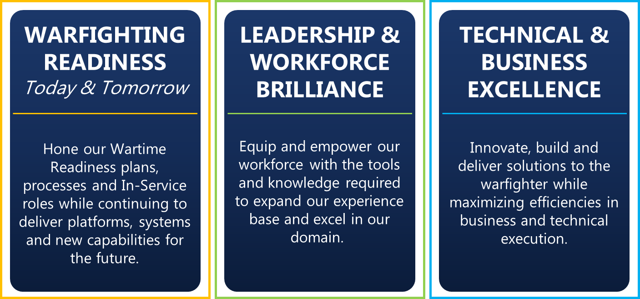
Strategic Priorities
7
DISTRIBUTION A: Distribution is Unlimited

Slide 8
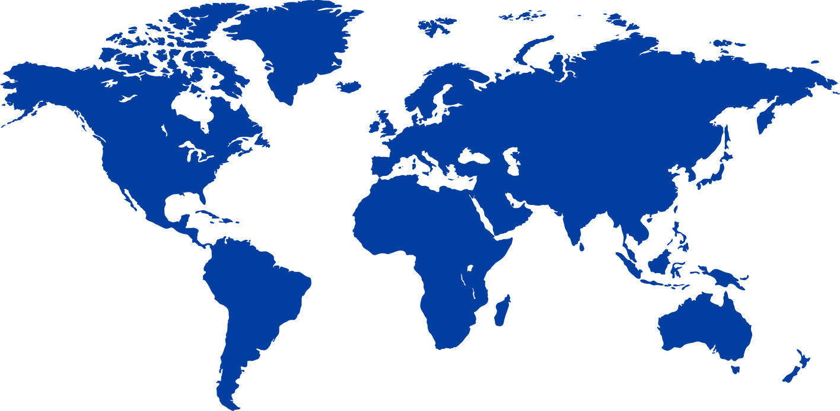








Mastery Framework
THEATER
HOMELAND DEFENSE
PROJECTION OF POWER
MISSIONS
M1
M2
M3
M4
M5
M6
M1
M2
M3
M4
M5
M6
KILL CHAINS
CAPABILITIES
8
DISTRIBUTION A: Distribution is Unlimited

Slide 9
Mastery Framework
CAPABILITIES
Products
Warfigthers
Tactics, Techniques, Procedures
Projects
Warfare Development (TACDEV/CAPDEV)
Acquisition (Resource, PMs,etc)
Requirements
Raw Technology
Contracts
Workforce
DISTRIBUTION A: Distribution is Unlimited
9
DISTRIBUTION A: Distribution is Unlimited

Slide 10
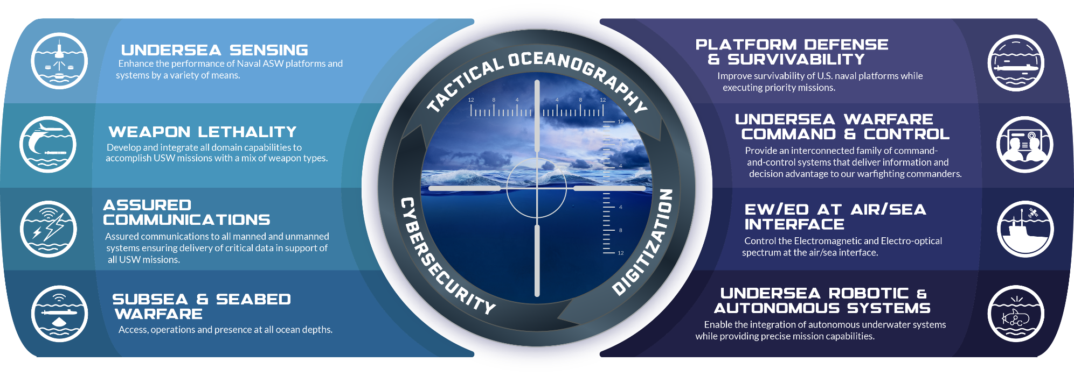
Capability Focus Areas
Tactical Oceanography: Apply increased knowledge of the environment to improve tactical use of all undersea warfare systems.
Cybersecurity: Protect our network of USW systems and communication paths from advancing cyber threats.
Undersea Data Science & Digitization: Create and utilize a digital USW environment and employ advanced AI/ML to further understanding of undersea data.
10
DISTRIBUTION A: Distribution is Unlimited

Slide 11
The Trident Manifesto
THE CORE BELIEF
Time is the Currency of Competition - a perfect contract delivered too late is a technical failure.
The FAR is a Playbook, Not a Rulebook. It defines what is possible. Mastery of its authorities is a front-line capability.
We Forge the Trident. Engineers design the weapon, and Sailors fire it, but Contracting Professionals are the architects who make it a physical reality.
THE 6.5-HOUR MINDSET
Reject the "Anchor“ - Stop "business-as-usual" habits that pin us to the pier.
Embrace the Sprint - Treat every acquisition as a WARP (Wartime Readiness Planning) drill.
Eliminate Friction - If a step doesn't add legal value or mission velocity, it is a
vulnerability..
11
DISTRIBUTION A: Distribution is Unlimited

Slide 12
The Trident Manifesto
TRIDENT HONING TASKS
Sharpen the Tines (The Friction Audit) - Identify a habitual step that adds 10+ days to the cycle. Challenge it. Streamline it. Kill it.
Extend the Reach (Master the Authorities) - Don’t wait for a request. Propose the "Fast Lane." Master OTAs, CSOs, etc. Be the subject matter expert on speed.
Master the Steel (Technical Literacy) - Spend one hour a month in the lines to understand the Business of USW.
Spear the Award (Wargames) - Build your "Ready-to-Execute" templates now. Anticipate the crisis so that when the call comes, you aren't drafting, you’re deploying.
12
DISTRIBUTION A: Distribution is Unlimited

Slide 13
Questions?
13
DISTRIBUTION A: Distribution is Unlimited

