Slide 1
Warfighting Readiness Brief NCMA 27 Jan 2026
Unclassified; Distribution is Unlimited

Slide 2

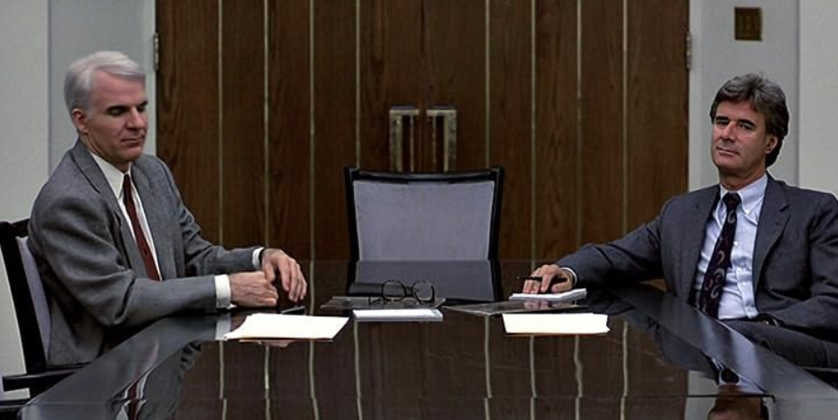
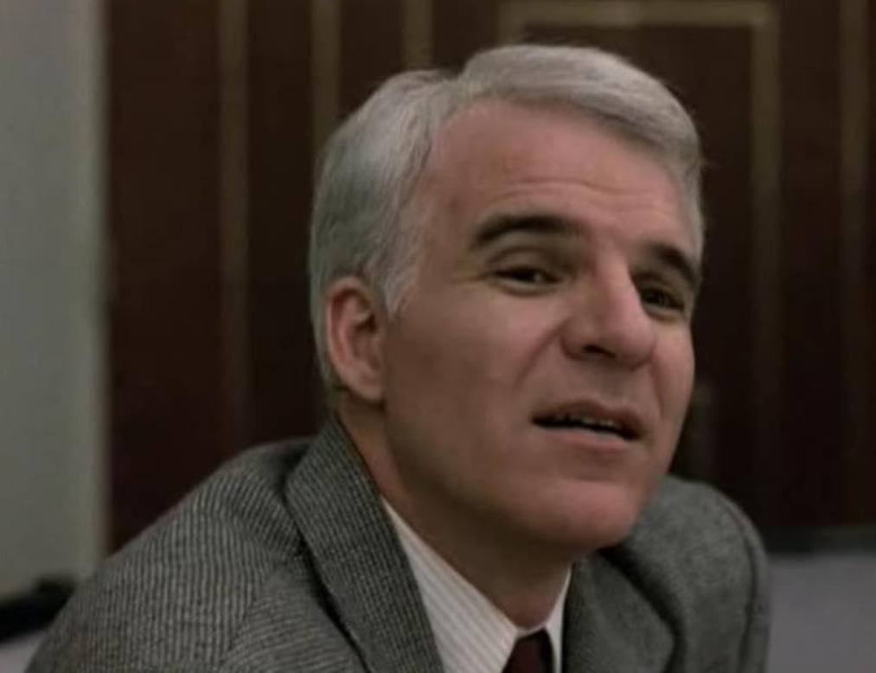

Fast Acquisition
Unclassified; Distribution is Unlimited
Notes:
Famous Movie. Give context that systems are being put into place but….we are only going to change by implementation.

Slide 3
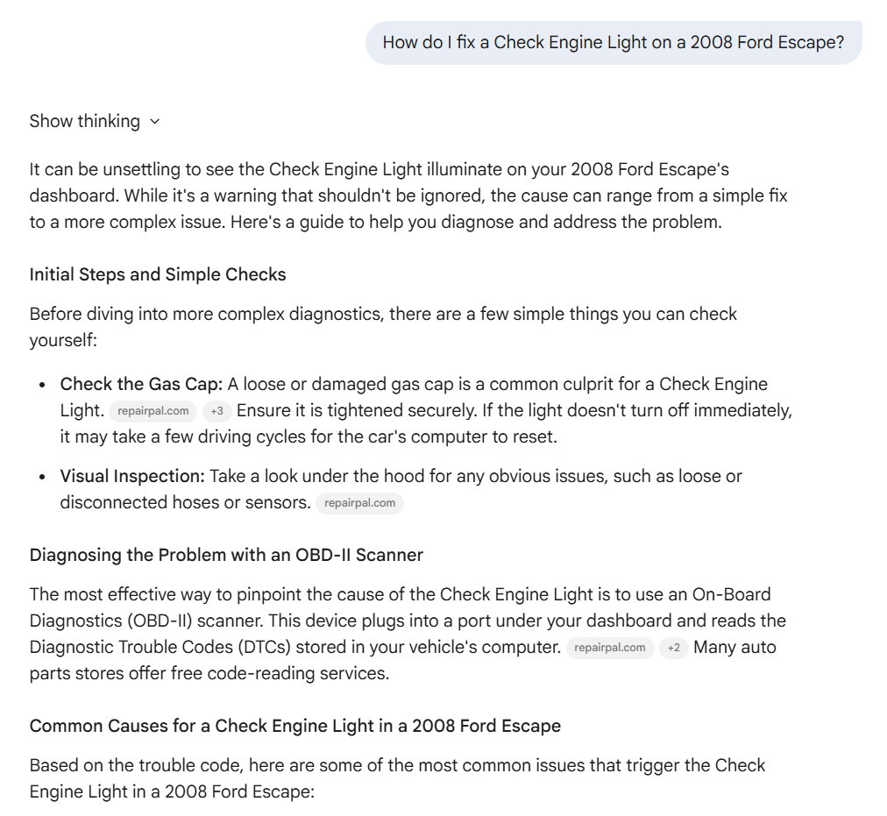
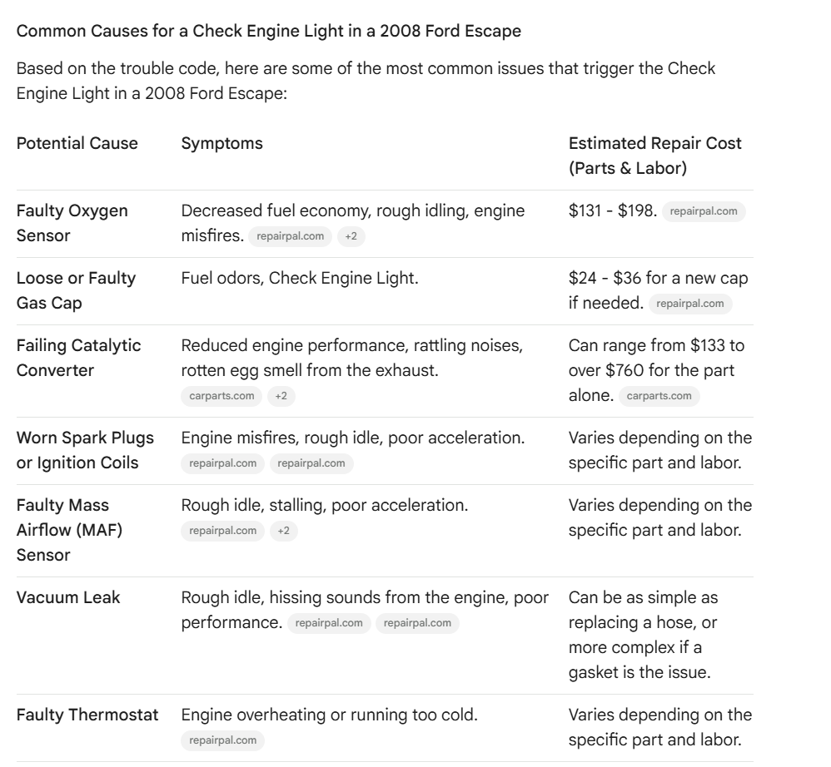
Artificial Intelligence
Unclassified; Distribution is Unlimited

Slide 4
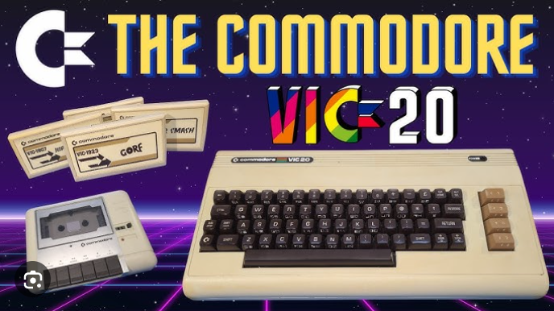
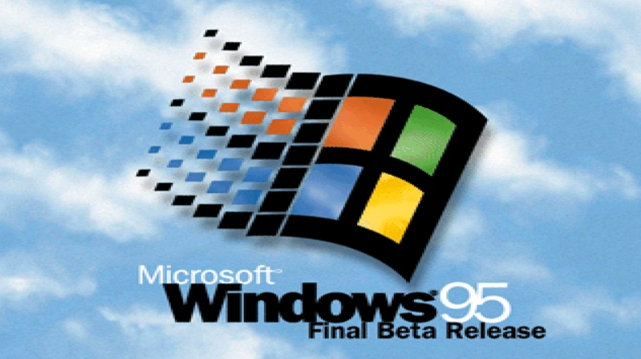
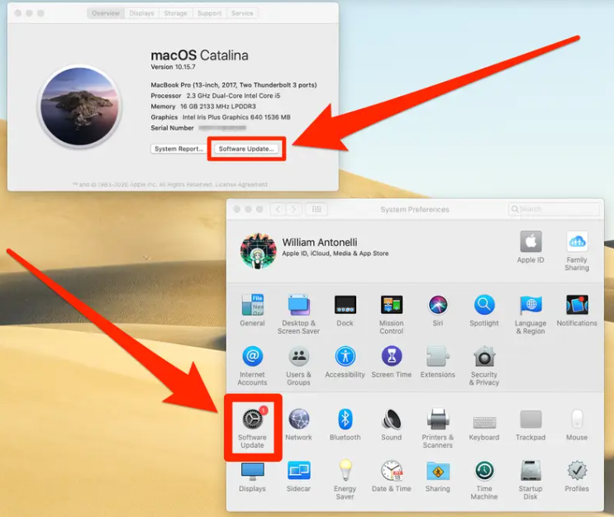
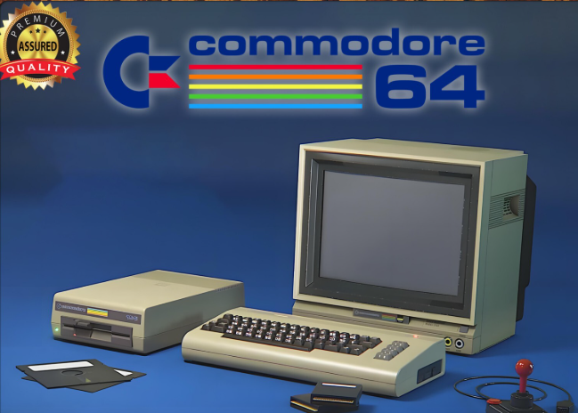
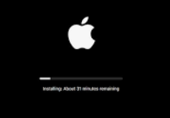
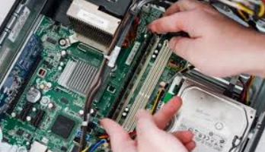



Remote Support
Unclassified; Distribution is Unlimited

Slide 5
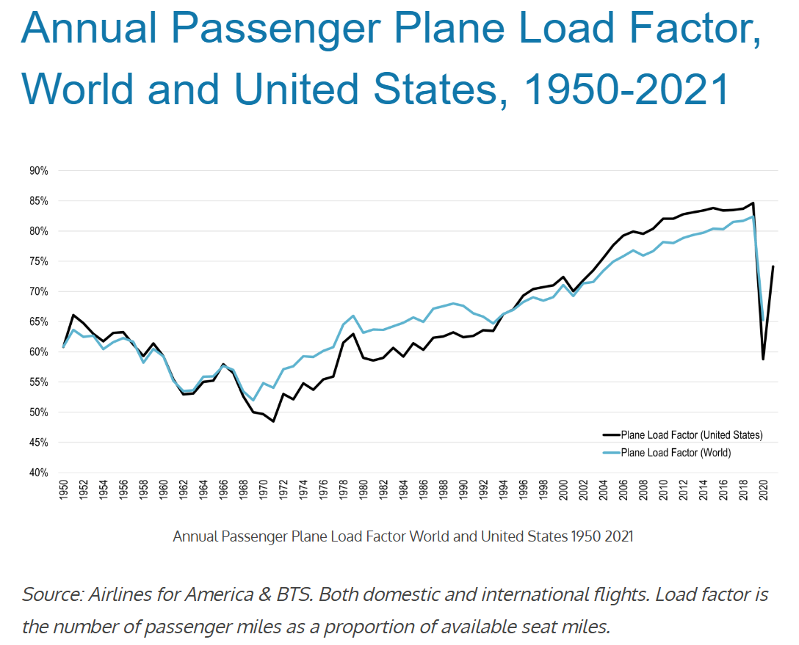
Streamlined Supply
Unclassified; Distribution is Unlimited
Notes:
Revenue & Pricing Strategies
Yield Management & Dynamic Pricing: Algorithms adjust prices in real-time based on demand, time to departure, and historical data, filling seats at optimal prices, often higher for last-minute bookings.
Overbooking: Selling more tickets than seats (e.g., 105% capacity) to compensate for expected no-shows, ensuring full flights and revenue.
Customer Segmentation: Offering different products (premium, budget) to various traveler types (business, leisure) to capture broader revenue.
Upselling: Charging extra for seat selection (legroom, window/aisle) or other amenities to increase revenue per passenger.
Aircraft & Cabin Design
Cabin Reconfiguration: Redesigning layouts, using slimmer seats, and adjusting seat pitch to fit more seats in the same space.
Higher Density Aircraft: Using specialized models, like the Boeing 737 MAX 200, designed for up to 200 seats with extra exits for high-density configurations.
Upgrading Aircraft: Replacing smaller planes with larger ones on busy routes to increase total capacity.
Data & Operations
Predictive Analytics: Using historical data, social media, weather, and booking patterns to forecast demand and adjust pricing/inventory.
Flight Limiting: Strategically limiting the number of flights on a route to drive demand for existing ones.

