Slide 1
Warfighting Readiness Industry as a Weapon System CAPT Kevin Behm Commanding Officer NUWC Division Newport 27 Jan 2026
UNCLASSIFIED
UNCLASSIFIED

Slide 2
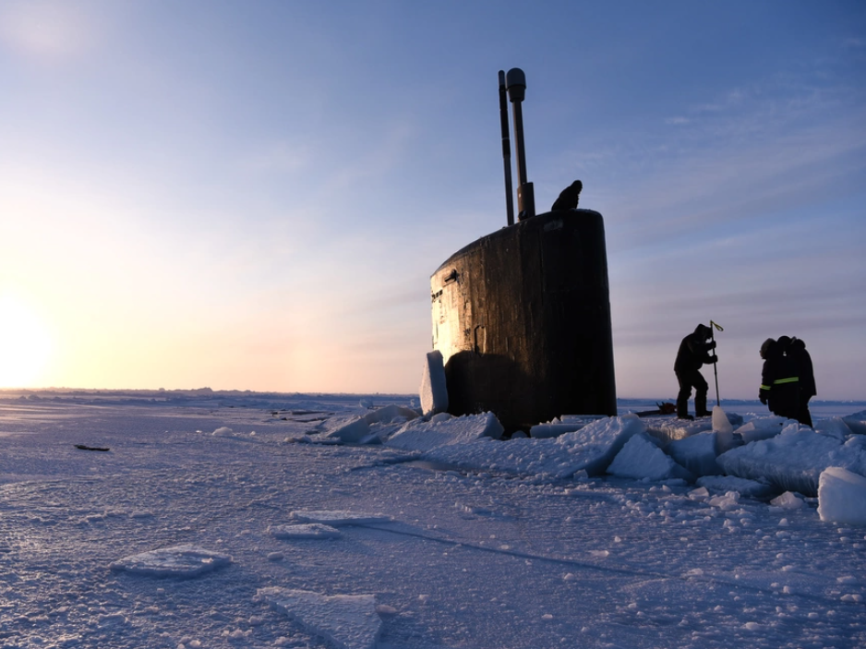
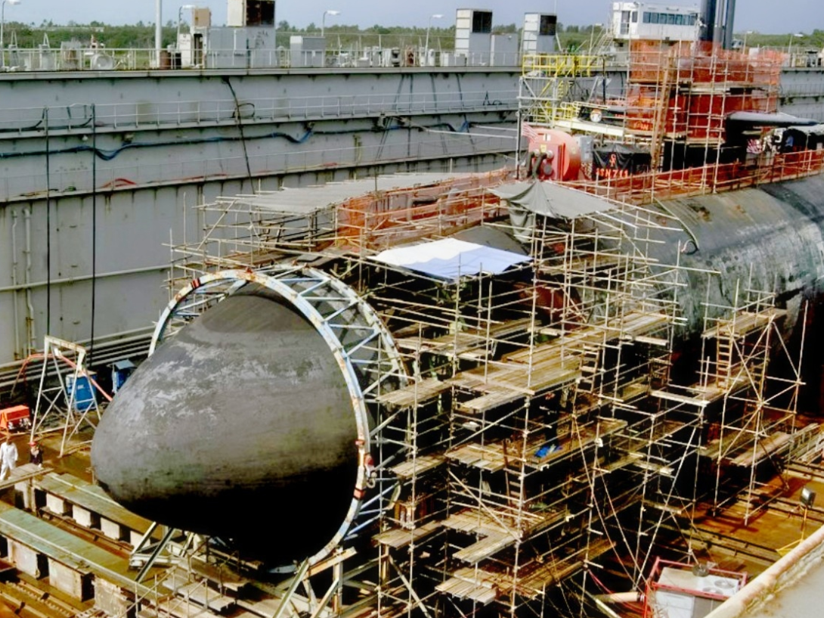
The canary in the coal mine
UNCLASSIFIED
Unclassified; Distribution is Unlimited
UNCLASSIFIED

Slide 3
When Shipyards Struggle, Sailors Feel It First
UNCLASSIFIED
USNI News: “Junior Sailors on USS George Washington Endured Some of the Toughest Living Conditions”
Military.com: “USS George Washington Heads to Japan, Ending Troubled Shipyard Stay That Included String of Suicides”
LA Times & AP: “Navy probe prompted by suicides condemns conditions at shipyard: ‘We let our people down’”
Unclassified; Distribution is Unlimited
UNCLASSIFIED

Slide 4
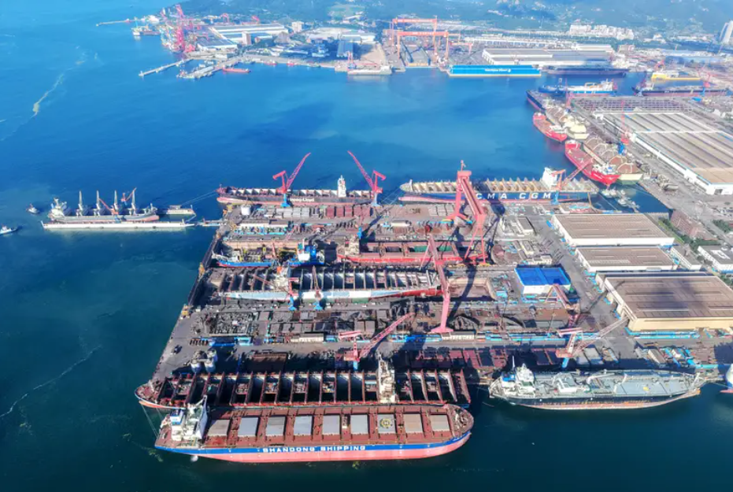
QUANTITY HAS ITS OWN QUALITY
UNCLASSIFIED
Unclassified; Distribution is Unlimited
UNCLASSIFIED

Slide 5


History Doesn’t Repeat — It Rhymes
UNCLASSIFIED
Unclassified; Distribution is Unlimited
UNCLASSIFIED

Slide 6
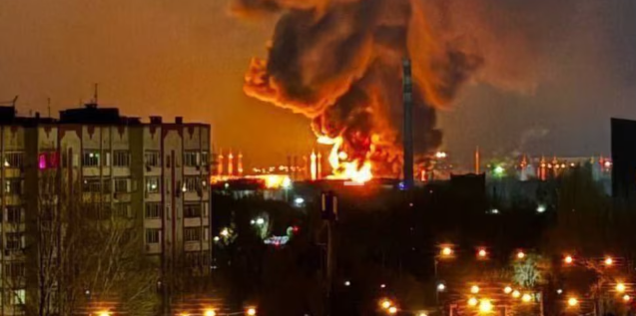
THE CHANGING CHARACTER OF WAR
UNCLASSIFIED
National Security Journal: “Kilo-Class: The Russian ‘Black Hole’ Submarine Ukraine Crippled With Sub Sea Baby Underwater Drones”
Associated Press: “Built in the shadows and launched at night, Ukraine’s long-range drones are rattling Russia”
Unclassified; Distribution is Unlimited
UNCLASSIFIED

Slide 7

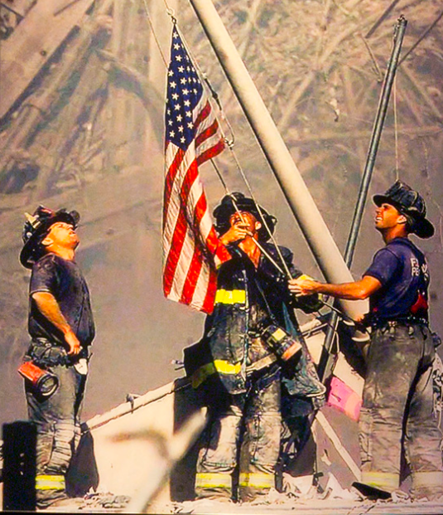
WILL URGENCY COME SOON ENOUGH?
UNCLASSIFIED
Geography sets the clock
Response sets the outcome
Unclassified; Distribution is Unlimited
UNCLASSIFIED

Slide 8
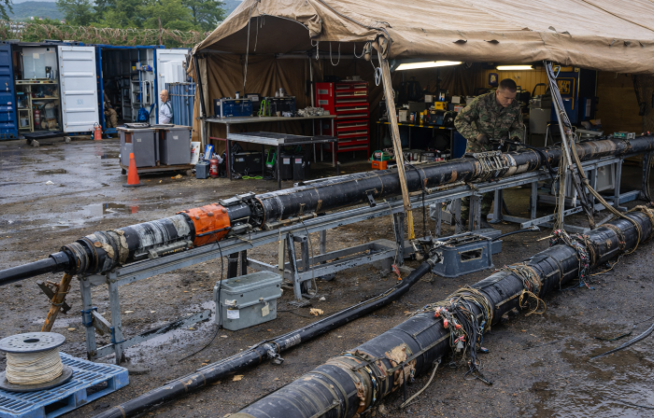
ARE WE READY?
UNCLASSIFIED
Day 0 ───────── Day 40 ───────── 4 Months ──────── 12 Months
50% Capability 100% Capability Historical Reality
Unclassified; Distribution is Unlimited
UNCLASSIFIED

Slide 9
WARTIME QUESTIONS
UNCLASSIFIED
Are we ready to think differently?
What level of risk is acceptable
Who owns the risk?
How will incentive structure change?
What must contracts enable immediately?
Can you operate forward deployed inside the WEZ?
Unclassified; Distribution is Unlimited
UNCLASSIFIED

Slide 10
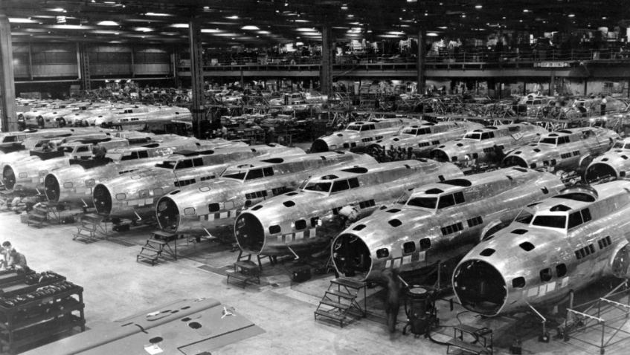
INDUSTRY IS A WEAPON SYSTEM
UNCLASSIFIED
Speed, not capability, will be the decisive factor
Unclassified; Distribution is Unlimited
UNCLASSIFIED

