Slide 1


Office of Small Business Programs
Maria Gregory Director, Office of Small Business
NUWC Division Newport
Approved for Public Release Distribution is Unlimited

Slide 2
Agenda
Office of Small Business Programs
Mastery of the Seas
NUWCDIVNPT Small Business Statistics
Small Business and WARP
Maritime Industrial Base (MIB)
Small Business Acquisition Strategies
Engage with NUWCDIVNPT

Slide 3





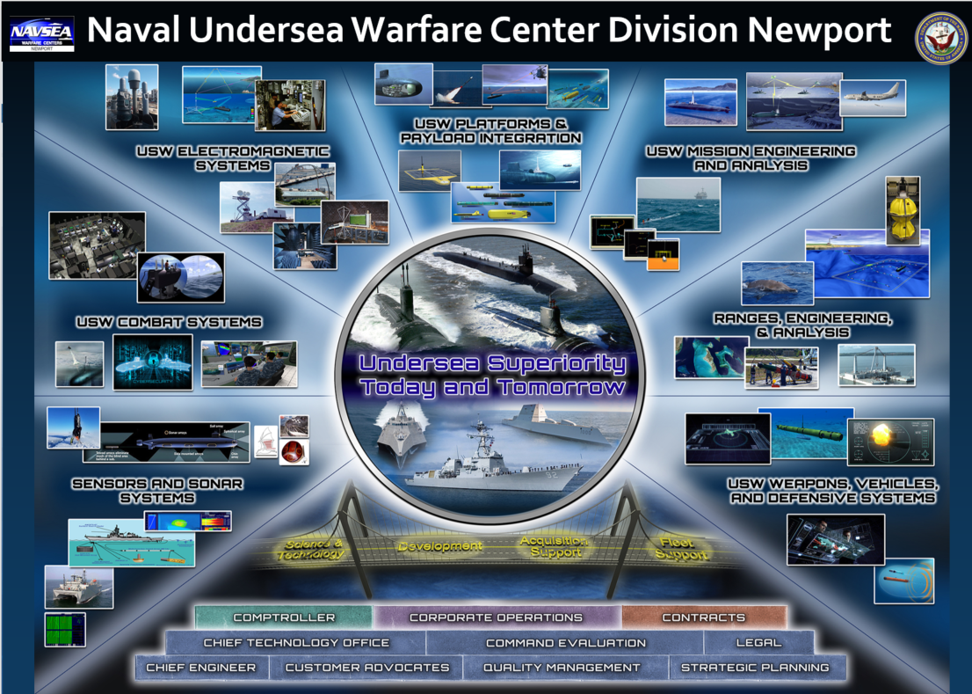





Small Business Director Role
NAVSEA, NAVY and DoD OSBP, SBA
Acquisition Professionals
SB and LB
PIA Partners, Non-Profit and State/Economic Promoters
S&T Office
Technical Requirement Generators

Slide 4
Office of Small Business- 00K
Mission: Maximize competition in acquisitions and create greater opportunities for small businesses to compete at the prime and subcontracting level
Vision: Create a sustainable culture of small businesses that expands our industrial base for today and tomorrow.

Slide 5
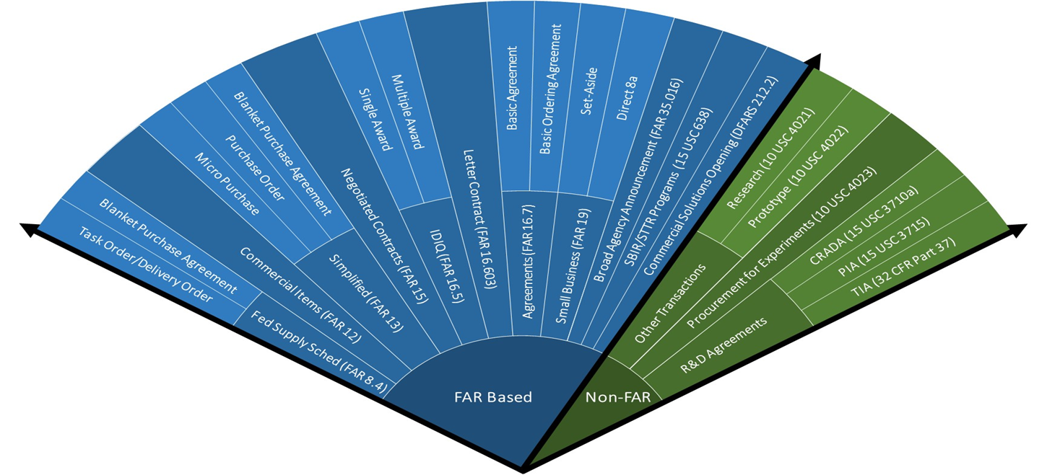
DAU Contracting Cone

Slide 6
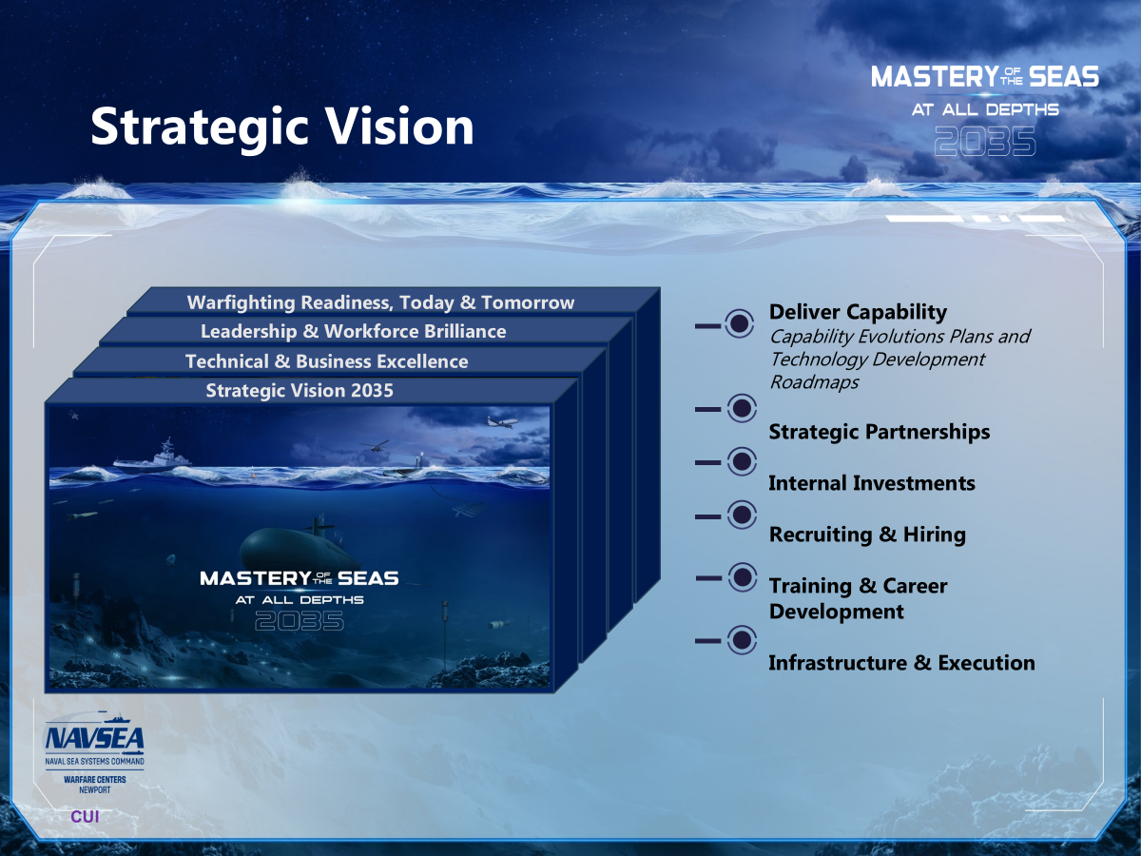




Slide 7
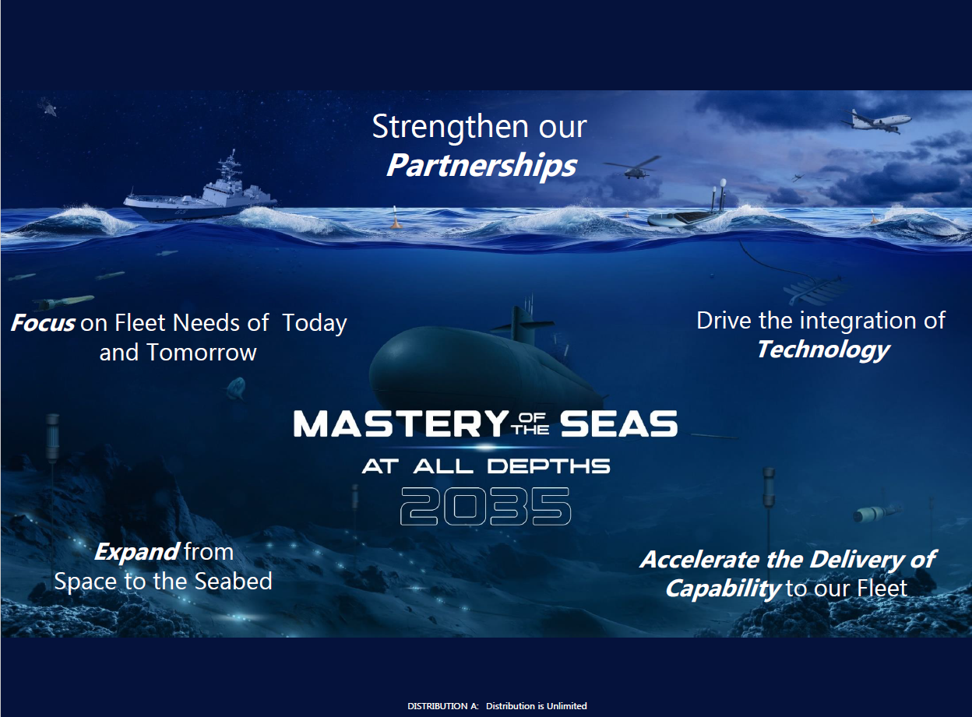
MoS- Strategic Partnerships

Slide 8
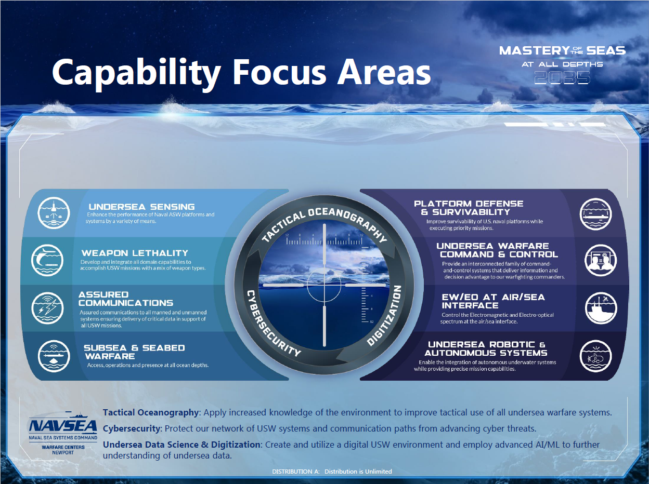
MoS- Strategic Partnerships

Slide 9
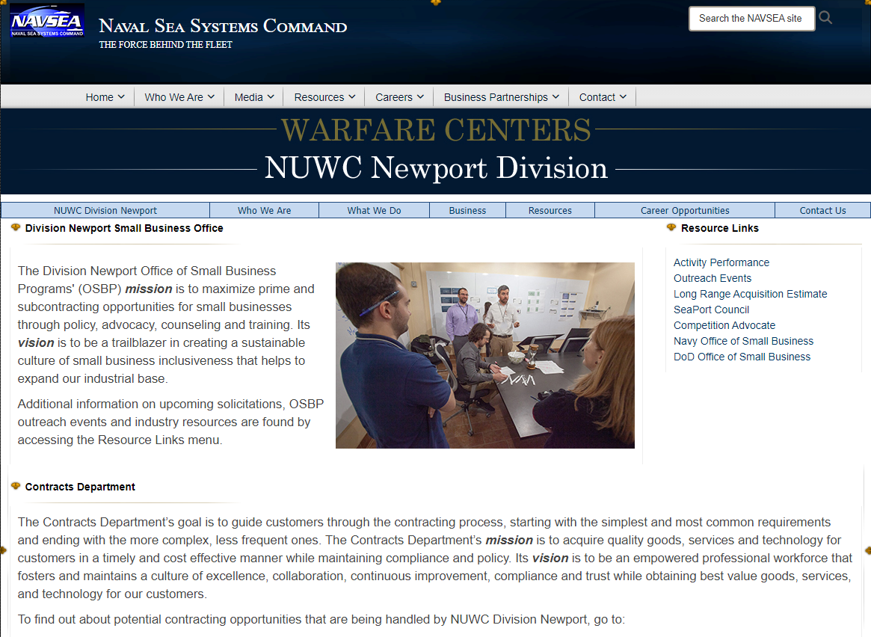
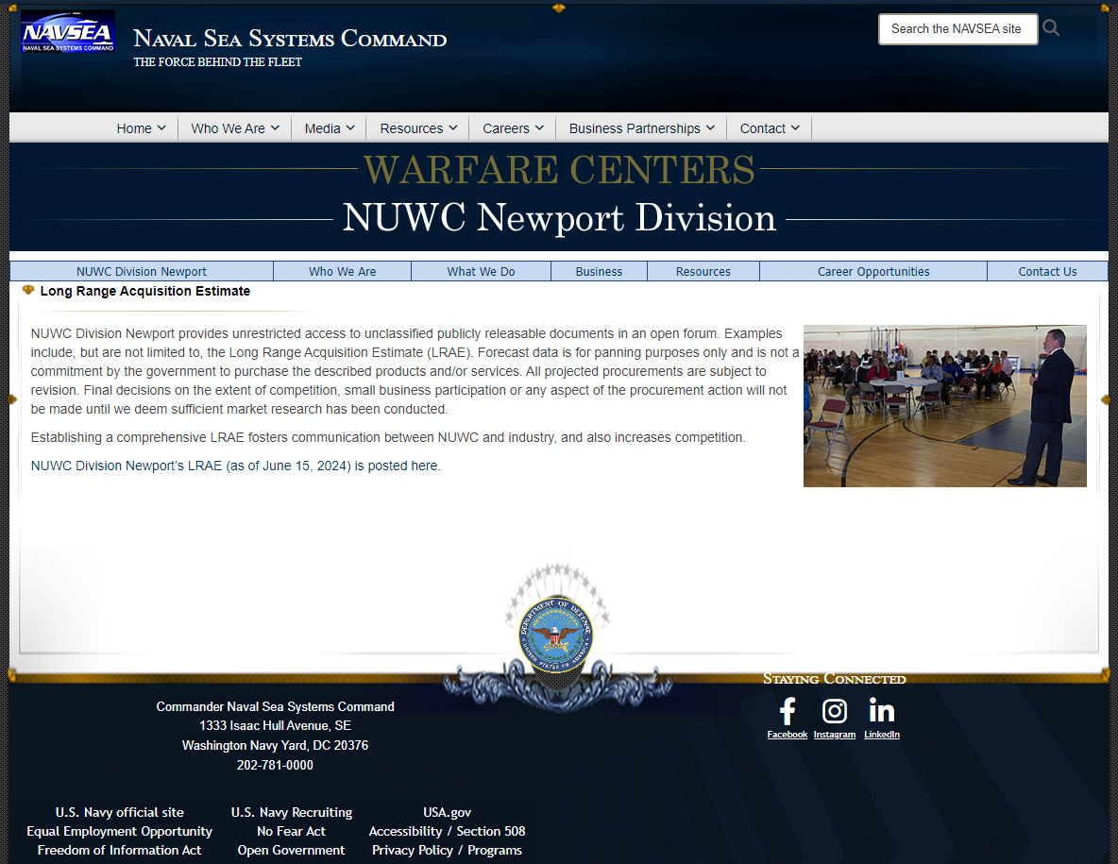
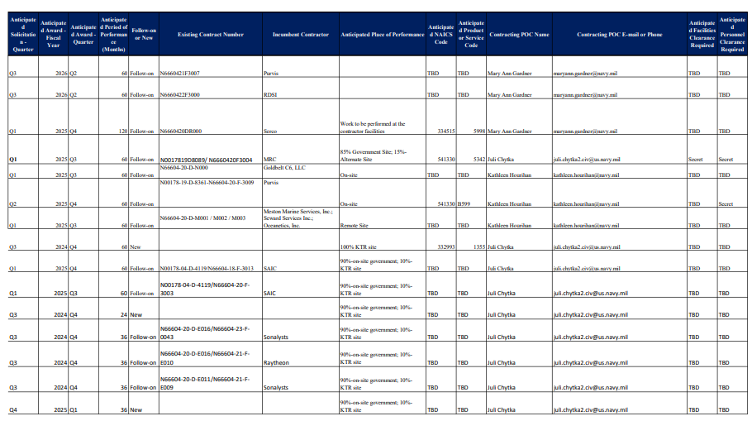
Long Range Acquisition Estimate
NUWC Division Newport’s LRAE (as of December 4, 2025) is posted here

Slide 10
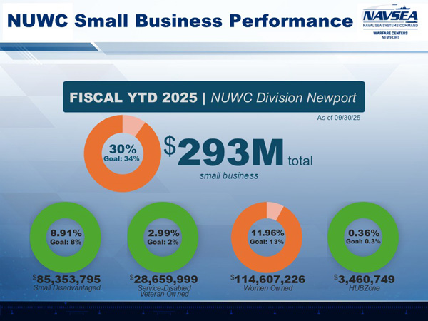

Slide 11
Socio-Economic Goals- NAVSEA

Slide 12
Small Business and War Time Readiness Planning (WARP)
Small Businesses have the agility, flexibility and innovation to accommodate fast and efficient resources when needed
Personnel Readiness: Ensuring the right amount of resources are required for the tasking. Includes accounting for deployed service members. (Are travel plans in place, ids/passports?)
Equipment and Material Readiness: Maintenance and Availability- Spare parts, inventory management, other consumables
Training and Mobilization: Having personnel fully understand and capable prior to action.

Slide 13
Small Business and War Time Readiness Planning (WARP)
Material Focus:
Diversify Suppliers
Advanced Tracking
Strategic Stockpiling
Innovative Practices

Slide 14
Small Business and War Time Readiness Planning (WARP)
Additional Questions and Thoughts to Consider:
What are your logistical gaps or weaknesses. Do you need to increase inventory?
Risk Management- how critical is this part/material to the overall product or service
Understand your contract- are there holes in it when it comes to War Time Readiness? Talk to your Contracting Officer
What are your internal lines of communication?

Slide 15
Maritime Industrial Base (MIB)
Established in September 2024
Spearhead efforts to revitalize the comprehensive network of industries, infrastructure and workforce dedicated to building, maintaining, repairing and modernizing maritime vessels and supporting maritime operations.
Focus Areas for the MIB
Supplier Development
Workforce Development
Advanced Manufacturing

Slide 16
Resources
MIB
https://www.secnav.navy.mil/rda/mib/Pages/default.aspx
Blue Forge Alliance (BFA)
Non-profit, mission driven partner accelerating the revitalization of the defense industrial base
https://www.blueforgealliance.us/
Team Submarines
Focuses on research, development, acquisition and maintenance of submarines and undersea systems
https://www.navsea.navy.mil/home/team-subs/

Slide 17
Innovative Technology Projects Pilot Program
Special Authority
$7.5 m or less
Small Business or Non-traditional defense contractor
Certified cost and pricing data not required
Exempt from audit requirements
Technical, merit based, such as a BOA
SBIR
STTR

Slide 18
SBIRs and STTRs
Phase I: Concept Development
Solicit Topics and TPOCs throughout the year based on the cycle
Phase II: Prototype Development
Assist companies to get through the Valley of Death
Reach Backs
SBIR/STTR Transition Program (STP)
NavySTP.com
DON SBIR/STTR Experimentation Cells (DON-SEC)
NavySBIR.com/SEC
Phase III: Commercialization
Working with NUWC Stakeholders in Acquisition Strategy

Slide 19
100% Employee-Owned Stock Ownership Plan (ESOP)
Congress recognized the innovative potential in encouraging DoD to work with business wholly owned through an ESOP (100% ESOPs)
Earn higher CPARS scores for customer
Less susceptible to consolidation
FY22 NDAA Sec. 874 authorized DoD to establish a pilot program to encourage contracting with 100% ESOPs by giving contracting officers the ability to award a one-time sole source follow-on contract
FY24 NDAA Sec. 872 made improvements
Allows for contracts awarded by DoD as well as awarded by GSA for DoD
Allows for one follow on per each contract held by the 100% ESOP
Expands the pilot program from 5 to 8 years

Slide 20
100% Employee-Owned Stock Ownership Plan (ESOP)
Rulemaking Update: DFARS Part 270 effective November 2024
DFARS now includes Part 270
DFARS Subpart 270.1 implements the Pilot Program to Incentivize Contracting with Employee-Owned Businesses:
https://www.acquisition.gov/dfars/part-270-defense-contracting-programs
DFARS Subpart 270.1 is accompanied by Procedures, Guidance, and Information (PGI) 270.104 which includes procedures for using DFARS Subpart 270: https://www.acquisition.gov/dfarspgi/pgi-part-270-defense-contracting-programs
Policy Memo on DFARS Subpart 270.1:
https://www.acq.osd.mil/dpap/policy/policyvault/USA000409-25_DPCAP.pdf

Slide 21
Options to Engage with NUWC
Broad Agency Announcement-posted on SAM https://sam.gov/opp/dac027606fff4a6e8cd5982512ae09be/view
Cooperative Research and Development Agreement (CRADA)
Work for Private Party (WPP)
Participate in Prize Challenges

Slide 22
MoS- Strategic Partnerships

Slide 23
Summary
Small Businesses are crucial to WARP
Critical Thinking of Risks
Engage with the MIB and Resources
Special Authorities
Looking beyond typical acquisition strategies
Engage with NUWCDIVNPT
Mastery of the Seas and Capability Focus Areas
WARP suggestions and comments
Reach out for continued conversation
Expand the Industrial Base
Through Small Business Initiatives

Slide 24
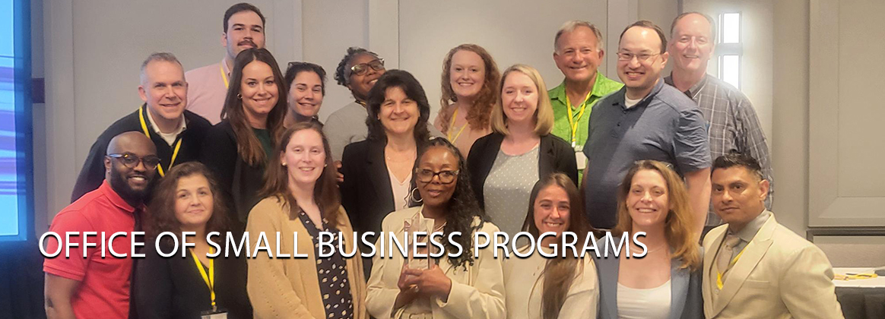
Small Business Professionals at NAVSEA

Slide 25

Contact
Maria Gregory
NUWCDIVNPT, Office of Small Business
Email: maria.f.gregory.civ@us.navy.mil
Tel: (401)832-8078/
(401) 578-3023

