Slide 1
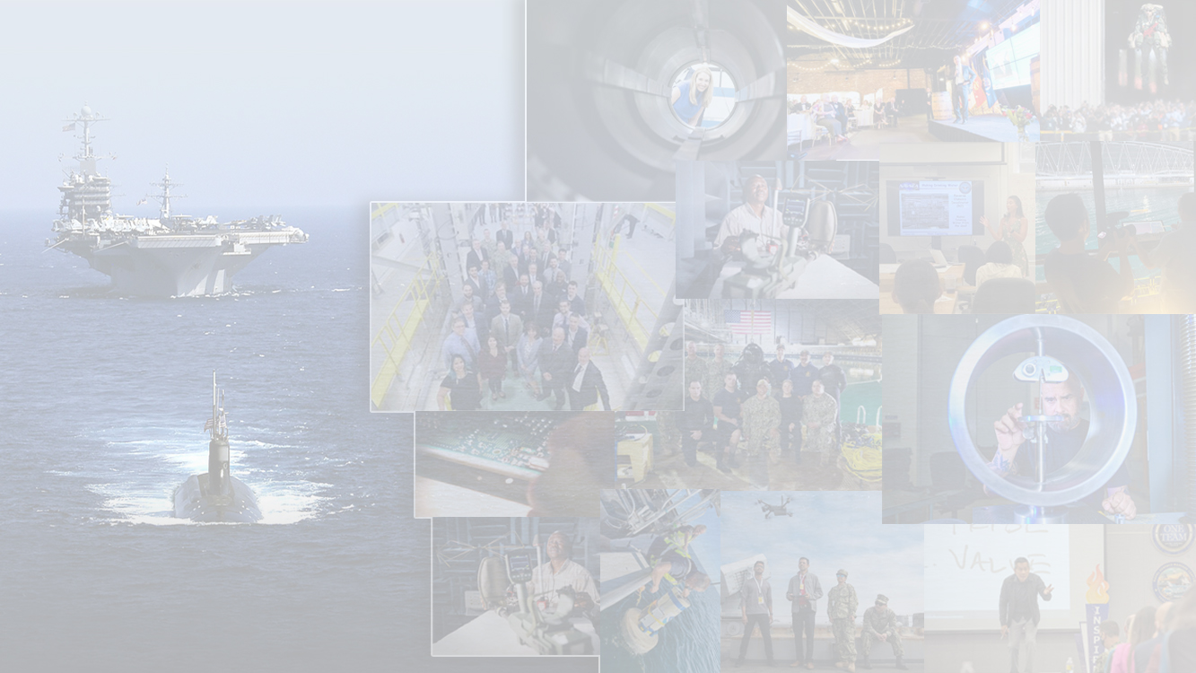

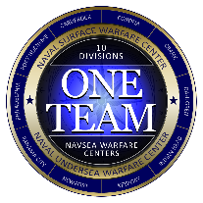
NAVSEA WARFARE CENTERS
NAVSEA WARFARE CENTERS
The USW Role in Strategic Competition
Presented by:
Mike Cockey
Deputy Director for Undersea Warfare
NAVSEA Warfare Centers HQ
Approved for Public Release-Distribution A
- 16 October 2024 -
NAVSEA WARFARE CENTERS
NAVSEA WARFARE CENTERS
Notes:
Personal Introduction

Slide 2
Agenda
Strategic Completion – Activities short of war & expectations if a broader war breaks out
  The USW forces are extremely engaged in Strategic Competition and are very busy
Navy Leadership and Guidance to the Forces
  USW forces play a huge role in deterrence and combat with Strategic Competitors
USW Leadership Guidance
  Submarine Force Commander instructed the force to be ready for combat by 2027 – Aligned to the CNO guidance.
Fleet Demand Signals
We all must understand the warfighting challenges and work with the operators.
Approved for Public Release-Distribution A

Slide 3
Evolving National Defense Strategy (NDS)
2012 National Defense Strategy
2022 National Defense Strategy
Countering terrorism and irregular warfare
Deter and defeat aggression
Project power despite anti access/area denial challenges
Counter weapons of mass destruction
Operate effectively in space and cyberspace
Maintain a safe, secure, effective nuclear deterrent
Defend the homeland and provide support
to civil authorities
Provide a stabilizing presence
Counter stability and counterinsurgency
operations
Conduct humanitarian, disaster relief
and other operations
Defending the Homeland, paced by the growing, all-domain threat posed by the PRC
Deterring strategic attacks against the United States, allies, and partners.
Deterring aggression, while being prepared
to prevail in conflict when necessary –
prioritizing the PRC challenge in the
Indo-Pacific region, then the Russia
challenge in Europe
Building a resilient Joint Force and
defense ecosystem
USW is
the key to success in
all NDS Priorities
USW played key roles in 4-5 priorities
Approved for Public Release-Distribution A

Slide 4
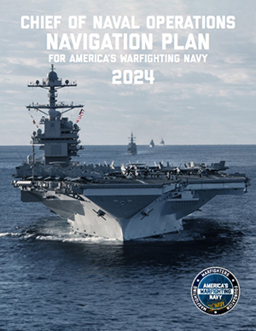
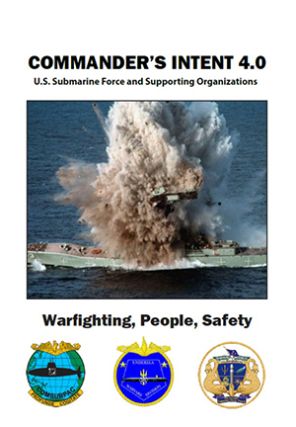
Leadership Guidance
CNO’s Navigation Plan – Project 33 Targets
Ready the force by eliminating ship, submarine, and aircraft maintenance delays
Scale robotic and autonomous systems to integrate more platforms at speed
Create the command centers our fleets need to win on a distributed battlefield
Recruit and retain the force we need to get more players on the field
Deliver a quality of service commensurate with the sacrifices of our Sailors
Train for combat as we plan to fight, in the real world and virtually
Restore the critical infrastructure that sustains and projects the fight from shore
SUBFOR Commander’s Intent Lines of Effort
Modernize Our Strategic Deterrent
Prepare for the Fight in the “Decade of Maximum Danger”
Maintain Our Overmatch in the Undersea Domain
Evolve Our People Strategy to Sharpen Our Competitive Edge
Enhance U.S. Alliances and Partnerships
“Our Undersea Force must be ready to go to war at all times. This perspective should govern all we do from our submarines operating forward to those in long term maintenance availabilities fighting their way back to sea.”
“You are important – in preparing our team for combat – arm them for the fight with every ounce of your effort”
Approved for Public Release-Distribution A

Slide 5
Other Key Insights from the CNO Navigation Plan
The Chairman of the People’s Republic of China (PRC) has told his forces to be ready for war by 2027—we will be more ready.
The PRC’s defense industrial base is on a wartime footing, including the world’s largest shipbuilding capacity now at the hands of the PLA navy
A wounded and isolated Russia remains dangerous. Russia’s illegal and unprovoked invasion of Ukraine drew global condemnation and prompted Finland and Sweden to join NATO. On the battlefield, however, Russia has demonstrated operational learning, adapting technologically and tactically to Ukrainian innovations.
Moscow, Beijing, Tehran, and Pyongyang have strengthened their linkages and are actively targeting the U.S., our Allies, and our partners in the information domain. Damage to undersea pipelines and cables underscored how seabed infrastructure has become targetable.
Despite Black Sea losses, Russia’s fleets retain combat power in the High North and Atlantic, Mediterranean, Baltic, and North Pacific. The Kremlin also holds the world’s largest nuclear stockpile. We must continue to support credible deterrence alongside Allies and partners in the Euro-Atlantic area.
Highly interconnected threats make peace brittle. Hamas’s 2023 assault on Israel required a Navy presence across the Middle East to deter attacks by other Iranian proxies and reduce the risk of a wider conflict. Emboldened by Hamas and armed by Iran, Houthi forces target merchant shipping along the Bab al-Mandeb, a key chokepoint in the Red Sea, exposing our Sailors to the most persistent hostile fire we have faced since World War II.
Iran, which is also supplying arms to Russia, further launched hundreds of drones and missiles at Israel, bringing the entire region to the verge of war.
These events prove how quickly the security environment can shift through seen and unseen linkages, and how essential our Navy is to providing flexible response options to our Nation’s decision-makers.
The Navy must address fundamental challenges to our force—ship, submarine, and aircraft construction, recruiting, munitions production, software acquisition, infrastructure, and platform maintenance—at the same time as we continue to outpace learning, adaptive adversaries. Approved for Public Release- Distribution A
Approved for Public Release-Distribution A

Slide 6
What do we read about Strategic Competition?
Chinese SSBN to be fitted with JL-3 missiles capable to Strike the US Coast
Russia Moves Nuclear Weapons to NATO Borders – threatens escalation on war in Ukraine
Treaties – Russia Violates the Intermediate Range Nuclear Forces (INF) Treaty
US and Russia leave the INF Treaty
Russia leaves the START treaty
USS Georgia sails through the Straits of Hormuz to send a signal to Iran
US Launches most advanced stealth submarine amid undersea rivalry
Report to Congress (2022) – “The PRC has the largest Navy in the world with an overall Battle Force of 350 ships and submarines, including over 150 major combatants”.
US Navy Sails 2 Vessels through the Taiwan Straits
Russia could have its most powerful and quiet submarines on persistent patrols off either US Coasts in the next 2 years
China Dispatches Nuclear Armed Submarine on First Combat Patrol
US Shrugs as WW lll Looms
Shifting the U.S.-Japan Alliance from Coordination to Integration
Russia deploying hypersonic missiles on new nuclear submarines
US Ballistic missile submarine & doomsday-plane-take-part-in-rare-show-of-force-off-Norway
China Indo-Pac military power trumps US, but US remains more influential
Lowy Institute
The US might lose a war with China, congressional commission says
Insufficient industry, readiness, innovation, and funding hamper military’s ability to prevail in conflict, key experts find.
The military should be able to “Credibly threaten to sink all Chinese military vessels, submarines, and merchant ships in the South China Sea within 72 hours”
Michele Flouronoy (Previous OSD Policy)
Chinese scientists work on powerful new ‘submarine killer’ with eye on the US far into South China Sea
Monster sub participates in Yemen Strike
US SSBN makes port call in South Korea to assure key US Ally
Russia Submarine Captain Gave Order to
'Arm' Torpedoes in Brush With US Sub
US and China wage war beneath the waves – over internet cables
INDOPACOM boss testifies that only about half of his demand signal for SSNs is being met
China engaged in “breathtaking” nuclear expansion warns STRATCOM Commander
Russia has completed “Key stages of Trials” of nuclear capable Poseidon underwater drone
In the dark depths of the Pacific, US submarines patrol with an eye fixed firmly on China
China Surrounds Taiwan during Taiwan Inauguration – Operation Joint Sword 24
CNO urges China to avoid confrontations, refuses to back down on Taiwan Straits
Russia has modernized all aspects of its nuclear weapons arsenal and seeks asymmetric options
Approved for Public Release-Distribution A

Slide 7

1938 to 2024 Comparisons
Germany Invades Austria
Germany Annexes Sudetenland (Czechoslovakia)
Britain, Italy, France agree with German partition of Czechoslovakia (Munich pact)
Japan goes to war with China
Internal purges in various countries – more than 25M deaths
1938
Russia takes the Crimean Peninsula from Ukraine (2014)
Russia invades Georgia (2014)
Russian invades Ukraine – 2022
Russia abrogates from various Treaties with the US
China South China Sea (SCS) territorial expansions
China exerts control over Hong Kong
North Korea nuclear testing and missile testing, supplying Russia with weapons
Iran supporting various states/non state actors in the Middle East (Hamas, Hezbollah, Houthis, Syria, Iraq)
2024
Approved for Public Release-Distribution A

Slide 8
USW Roles
Approved for Public Release-Distribution A

Slide 9
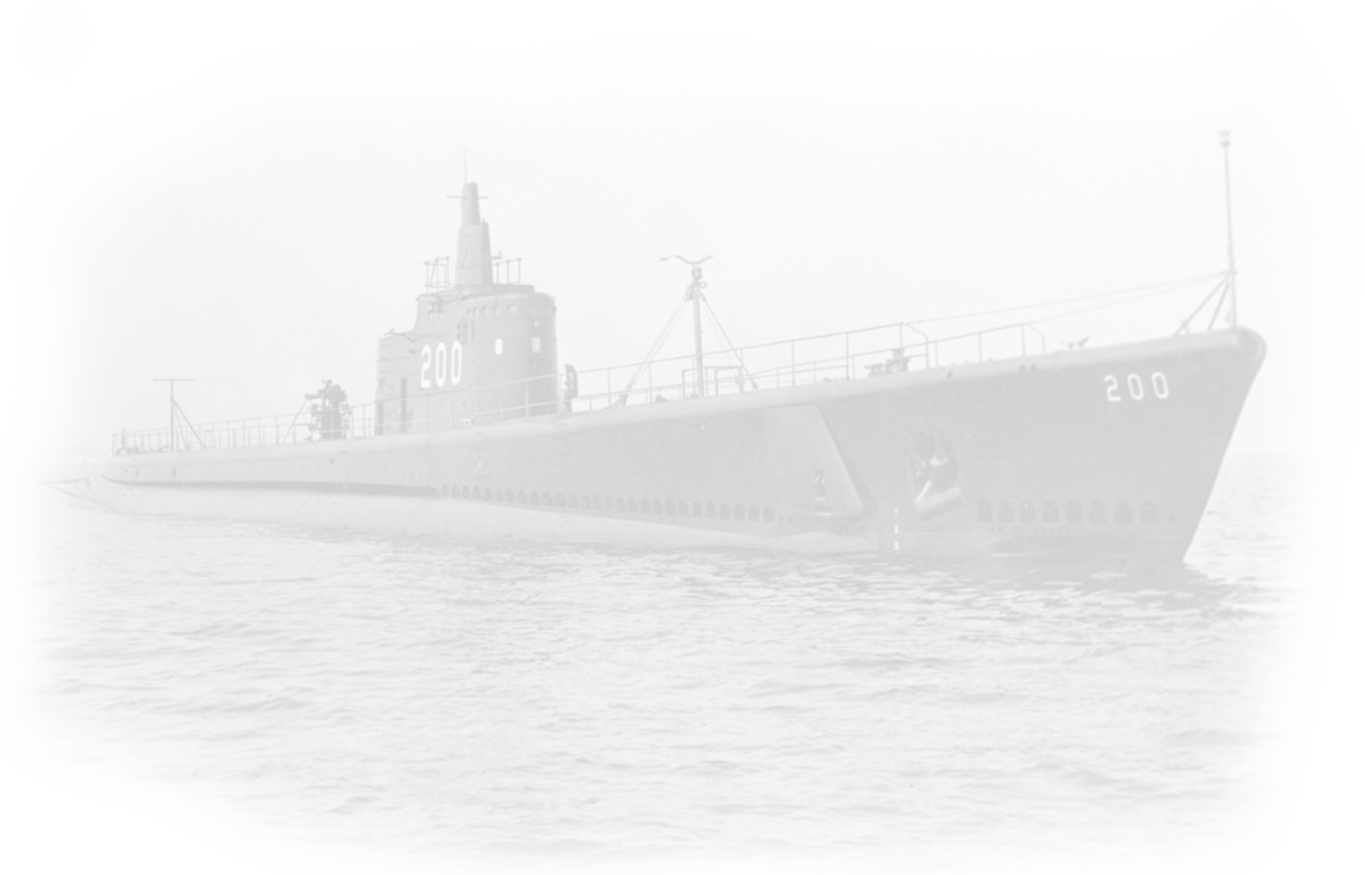
WWII Submarine Roles
  The attack on the U.S. Pacific fleet at Pearl Harbor on December 7, 1941 significantly disabled our force of battleships in addition to killing and wounding thousands of Americans.
  Consequently, U.S. strategic plans and tactics to engage the Japanese military in battle were made obsolete nearly overnight.
  Recognizing how handicapped U.S. forces were in fighting the Japanese Navy, and how dependent the Japanese Islands were on maritime supply, the Navy Department ordered our fleet to conduct “Unrestricted air and submarine warfare" against the Japanese Empire. This meant that both Japanese warships and Japanese merchant ships were now considered fair targets.
“ In carrying out the tasks in Operational Plan 29-42, you will be governed by the principles of calculated risk, which you shall interpret to mean avoidance of exposure of your forces to attack by superior enemy forces without a good prospect of inflicting, as a result of that exposure, greater damage to the enemy”
C.W. Nimitz
Approved for Public Release-Distribution A

Slide 10
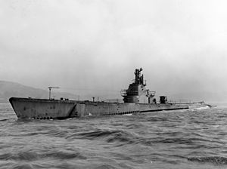
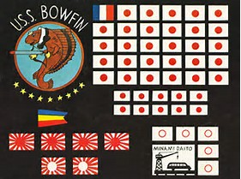
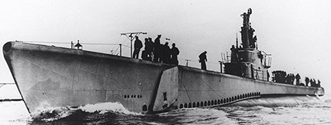
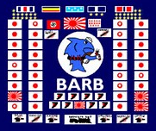
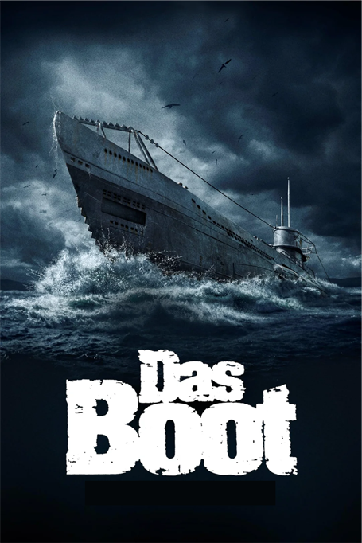
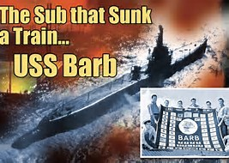
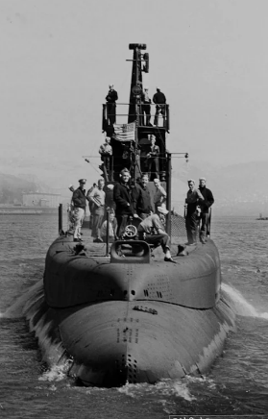
WWII Submarine Actions Drawing From the Commander’s Intent
WWII Submarine History
“Reconnoiter”
Wahoo left Brisbane, Australia, in
mid-January 1943, with orders to reconnoiter Wewak, a Japanese base on the northern side of New Guinea,
By the time he was done, "Mush the Magnificent" had sunk a heavy destroyer and laid the groundwork for 2 kills the next day.
After creeping nearly blind for some nine hours through the unknown and uncharted Wewak Harbor looking for ships and with
land now on
three sides of
them, this prize
target finally
presented itself.
52 US Submarines and 3500 submarine sailors lost in WWII
Us manufactured 17,000 torpedoes in WW2 – employed 14,000
US built 280 submarines in WW2
Germany built 700 Submarines in WW2
The classic movie Das Boot, released in 1981, chronicles the ultimate demise of a force that was outnumbered and overmatched in technology.
German submarine losses were staggering — of the 40,000 submariners who went to sea during the war, almost 30,000 perished.
ADM Jamie Foggo - 4th Battle of the Atlantic
“Fluckey’s crew was on its 12th war patrol – now they were excited about bagging a train”
Approved for Public Release-Distribution A

Slide 11
Cold War Submarine Roles and Facts
  Following the defeat of Nazi German and Imperial Japan, it was not long before the United States and her allies entered a bipolar contest with the Soviet Union resulting in the Cold War.
  This Cold War resulted in a nuclear and naval armaments race between the United States and the Soviet Union. Ours was a cost-imposing strategy, which neither the industrial base nor the Communist Party could keep up with, ultimately contributing to the fall of the Berlin Wall in 1989 and the collapse of the Soviet Union in 1991. ADM Jamie Foggo - 4th Battle of the Atlantic
  The U. S. and Soviet Union faced off against each other with more than 25,000 strategic nuclear Warheads on each side. The U.S. had an inventory of 42 SSBNs at its peak.
  During peak years, the U. S. fielded more than 100 Fast Attack Submarines and the Soviet Union Fielded more than 300. During peak years, the U.S. industrial base produced 7 Nuclear submarines per year.
Approved for Public Release-Distribution A

Slide 12
Strategic Competition – USW Forces are Completely
Aligned to the National Defense Strategy
“The PRC is the only country with the intent to reshape the international order, and increasingly, the economic, diplomatic, military, and technological power to do so”
2022 National Defense Strategy
“Russia could have its most powerful and quiet nuclear attack submarines on persistent patrols off of either U.S. Coasts in the next 2 years. The risk is absolutely increasing. Within the last year, Russia has also placed their Yasens in the Pacific. Not only in the Atlantic, but we have also seen them in the Pacific and its just a matter of time – probably a year or two – before that’s a persistent threat, 24 hours a day…’
General Glen VanHerck (Commander NORTHCOM) testimony to the Senate Armed Services Committee, March 2023)
“We face a world of rising nationalism.. (a) growing rivalry with China, Russia, and other authoritarian state. We are in a heated completion with adversaries who do not share our values, do not respect national sovereignty, and are actively working to undermine the international rule of law that we have safeguarded since 1949”
VADM Houston, Commander Submarine Force – Commander’s Intent 4.0
Approved for Public Release-Distribution A

Slide 13
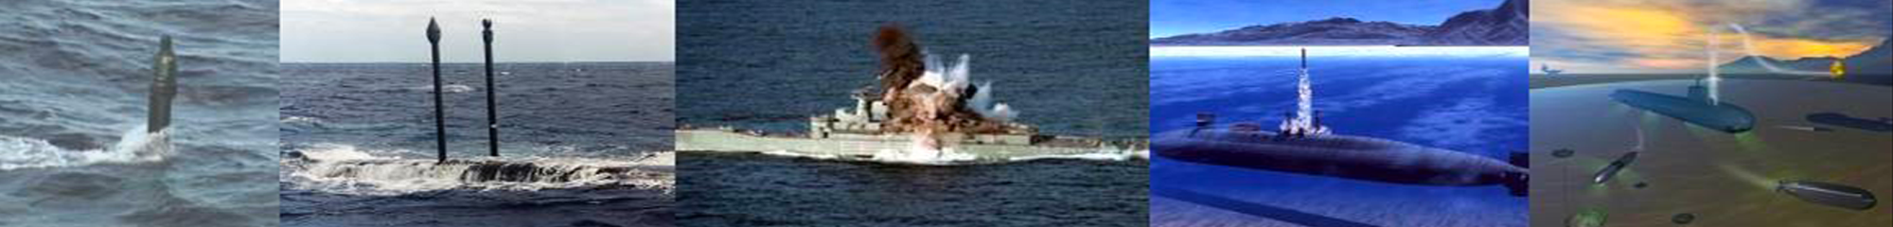

Spectrum of Submarine Warfare
Stealth… Agility… Endurance… Firepower
PEACE
Intelligence:
Battlespace Preparation
Pre-Hostilities
Conflict Escalation
WAR
Precision Strike
Anti-Submarine Warfare (ASW)
Subsea & Seabed Warfare
Anti-Ship Warfare (ASUW)
Offensive Mining
Special Operations Forces Support (SOF)
Mine Reconnaissance
Information Operations (IO)
Intelligence Preparation of Battlespace (IPB)
Indication and Warning (I&W)
Intelligence/Surveillance/Reconnaissance (ISR)
Strategic Deterrence (conducted by SSBNs)
Approved for Public Release-Distribution A
13
NAVSEA WARFARE CENTERS

Slide 14

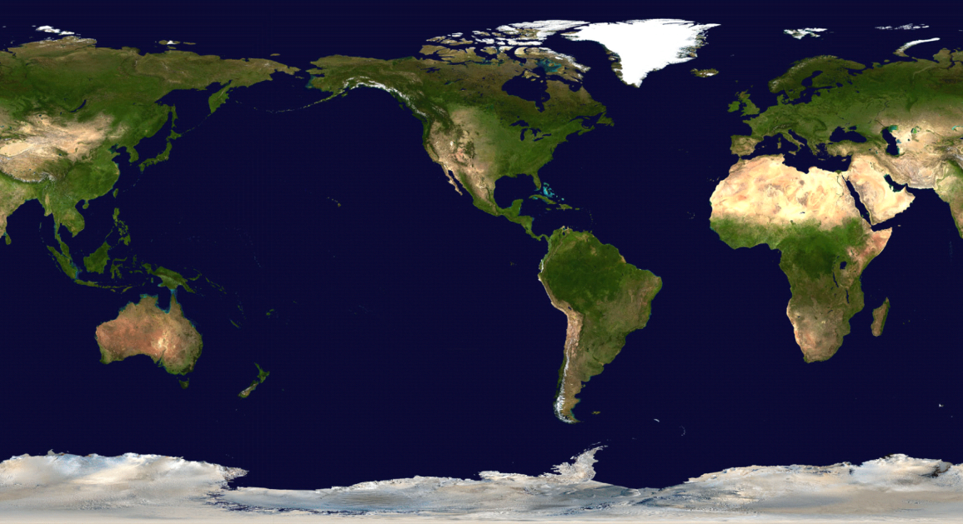
Delivering Survivable
Strategic Deterrence
SSBN Visits
“Every operational plan in the Department of Defense and every other capability we have rests on an assumption that strategic deterrence is holding, and
in particular that nuclear deterrence is holding. If …deterrence fails, no other plan and no other
capability in the Department of Defense is going to
work as designed.”
ADM Chas Richard - USSTRATEGIC COMMAND
Two-ocean operations necessary for global target coverage and survivability
(From 2021 – 2023) The SSBN Force has Demonstrated:
“A unique set of SSBN operations, coordinating with US allies and partners to showcase the ability to maneuver unimpeded and undetected around the globe, then pop up at places of our choosing, placing our competition and adversaries on notice that today, or any other day, is the absolute wrong day to challenge the United States or her allies”
ADM Daryl Caudle – Fleet Forces Commander
SSBNs - Sea-Based Strategic Deterrence
Providing the nation’s Survivable Strategic Nuclear Deterrence
Survivability is enabled by stealth, force size and CONOPs.
Force structure is at optimum minimum size – each SSBN must be survivable
Approved for Public Release-Distribution A

Slide 15
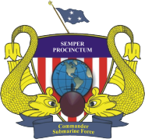
World Wide Submarine Operations
EUCOM
ASW
ISR
I&W
IPB
SSW
EASTPAC
ASW
WESTLANT
ASW
INDOPACOM
ASW
ASUW
ISR/I&W/IPB/SSW
SOF
Strike
EUCOM/AFRICOM
ASW/SOF
ISR/I&W/IPB
CENTCOM
ASW
Strike
ISR/I&W/IPB
“Speaking of our Sailors and families, right now, there are 15 submarines deployed around the world, showing firsthand why the President, the Secretary of Defense, the Combatant Commanders, and Navy leadership rely on the Submarine Force as the “first to the fight and last to leave as the steely-eyed killers of the deep.”
ADM Daryl Caudle in a speech to the Virginia Talent Pipe Line Graduation - 3 June 2023
Gulf of Guinea/ West Coast Africa
I&W/IPB/ISR
SOUTHCOM
Counter Narco-Terrorism (CNT)
Approved for Public Release-Distribution A
Notes:
TASW: Theater Anti-Submarine Warfare

Slide 16
SUBFOR Priorities
Warfighting
  Improve shipyard performance to increase combat ready submarines
  Deploy on plan in support of STRATCOM and Geographic CCDRs
  Develop tactics to defend Taiwan and maintain a free and open Pacific
  Develop tactics to defend the Homeland and counter RFN aggression
  Leverage our allies and partners to deter adversaries from conflict
Warfighter
  Apply fundamental watchstanding principles in all we do
  Provide our Sailors the tools needed to operate and maintain our forces
  Improve Quality of Service for our Sailors by removing barriers
  Build on our strong Submarine culture and history
Foundation
  SubSYD (SUBFOR Role in delivering submarines from maintenance)
  AUKUS
  Posture for the Future
    Unmanned/Hybrid
    Artificial Intelligence
    Additive manufacturing
    Cross Domain Command and Control (C2)
    Provide a safe industrial environment for our units in maintenance
  Operate safely at sea
  Protect our Sailors and their families in-port
Report Card:
(Proceedings Magazine, Oct 2024)
The submarine force is honing its edge with new technologies, intensive training scenarios, better maintenance practices, and expanded partnerships with allies and partners. Specifically:
Exceeding STRATCOM readiness requirements.
Deployed USS Florida for 730 days
Demonstrated pier side STARLINK,
Delivered “Day one ready sailors”
Deployed better in port fire fighting,
Executing SSBN crew Swaps
Executed Ice Camp 2024
Improving material readiness for availabilities
Integrating Royal Australian Navy Sailors on US Subs
Preparing for a deployment with Torpedo tube launch and recovery of a UUV
Instituted AM on submarines/Industrial Base
Developed common AI development environment
Improved cross domain C2 options to maintain submarine stealth
Approved for Public Release-Distribution A

Slide 17
China – Our Pacing Strategic Competitor

Slide 18
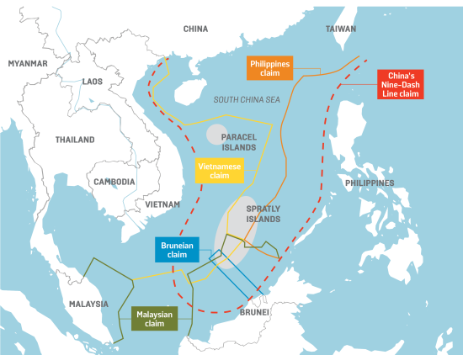
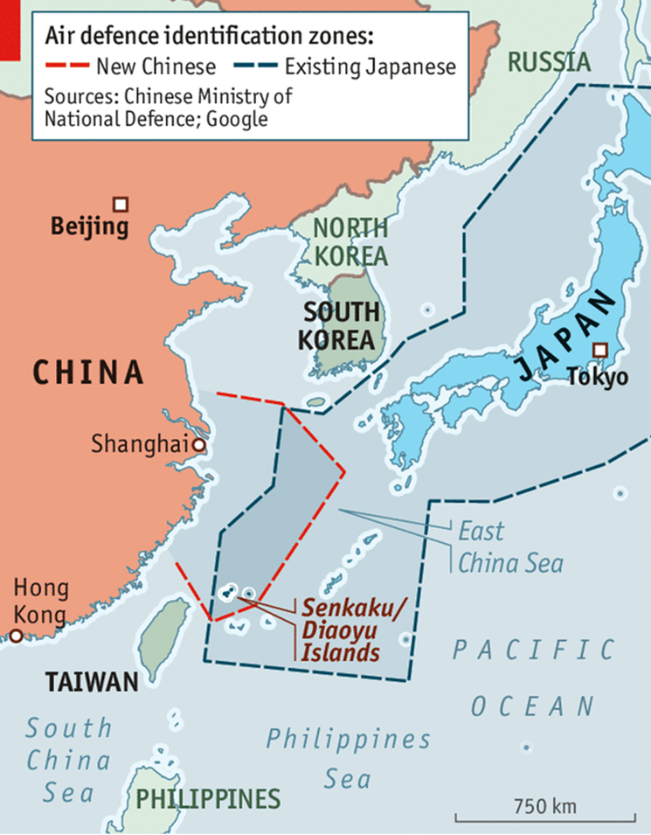
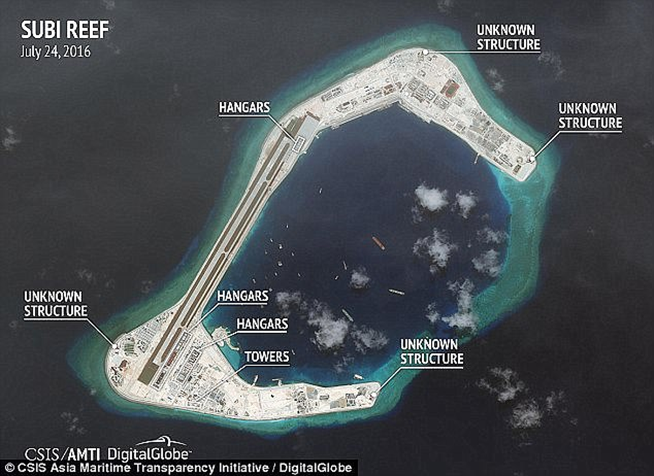
Western Pacific Flash Points
BLUF
The nine-dash line is a resource rich territorial claim of China which lays in direct conflict to the territorial claims of six other nations; two (Philippines and Taiwan) of which hold mutual defense ties with the United States (U.S.). An escalation between these nations and China could warrant direct involvement of the U.S. government.
China Bullying Regional Competitors as the world hunkers down during COVID - The US Navy Sends the Submarine Force to the South China Sea in a Show of Strength to China
“Our operations are a demonstration of our willingness to defend our freedoms under international law”
RADM Blake Converse, COMSUBPAC
Notes:
Economy
SCS is roughly 3 million kilometers and lies on lucrative hydrocarbon deposits
12% of global catch of fish
55% of global fishing vessels operate here
The nine-dash line is a resource rich territorial claim of China which lays in direct conflict to the territorial claims of six other nations; two of which hold mutual defense ties with the United States (U.S.).
While Chinese power projection into the South China Sea secures its access to vast hydrocarbon resources and abundant fisheries. However, their domestic consumption is beyond the scale provided by this region alone.
China’s economy and growing middle class increasingly depend on access to global markets for the importation of raw materials and the export of manufactured goods. Therefore, China views power projection along naval lines of communication (NLOCs) as critical element of its sovereignty.
Why is the land disputed? UNCLOS
United Nations Convention for the Law of the Sea
Came into operation and became effective 16 November 1982
Why? Countries began exploiting natural resources on their oceans’ continental shelfs
EEZ
These extend 200 nm (370 km; 230 mi) from the baseline. Within this area, the coastal nation has sole exploitation rights over all natural resources.
The EEZs were introduced to halt the increasingly heated clashes over fishing rights, although oil was also becoming important.
EEZ also applies to areas around islands
Territorial Waters
Out to 12 nautical miles (22 kilometres; 14 miles) from the baseline, the coastal state is free to set laws, regulate use, and use any resource

Slide 19
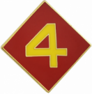
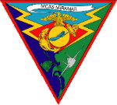





China / Taiwan – Timeline Wargame
This could be closer than we think.
2022
2023
2024
2025
TAIWAN STRAIT CROSSING SEASTATE
(Green possible, blue rough)
APR
OCT
APR
OCT
APR
OCT
APR
March 2022
Beijing Olympics
I
Nov 2022
U.S. Senate Election
Jan 2024
Taiwan Election
Nov 2024
U.S. POTUS Election
October 2021
Maintain narrative of peaceful reunification.
D
D
D
I
Why might XI fight before he is ready?
Taiwan Independence
US Congressional action
Regime Legitimacy
Demographics
Economic Challenges
Expedite national rejuvenation (2049)
Today is not the Day!
Won reelection in 2022 for an additional 5 years. Age will be 69-74yo.
Notes:
This is a hypothetical timeline for Chinese action within the Taiwan region. This assessment makes several broad assessments but the intent is to provide several key collection points and to inform decision makers on potential risk areas.
On the top portion of this timeline is the Taiwan Strait sea state. During April (+-1 month) and October (+-1) the region is most likely to provide consistent sea state conditions that can support movement for the largest period of time.
Assessment: China will not do any further escalation prior to the Olympics due to a desire to portray a strong China on the global stage. Early 2022 China is expected to announce Xi Jinping for another term as the leader of the CCP.
Senate Election: Chinese hackers and political influence of the Nov 2022 Senate Election is likely since any ability to sow disunity will lead to a less decisive USA, further increasing the likelihood of US focus on internal issues rather than foreign issues.
Jan 24 Taiwan Election: With all of the narrative of peaceful unification China will likely give it one further shot to sway the vote to a Chinese friendly leader. This would be ideal for China since it would remove the bloodshed of Han Chinese, prevent US intervention, and accomplish the Chinese mission. Even failure to overthrow could sow enough discord to cause internal issues that provide a good excuse for Chinese intervention. If the Chinese friendly candidate does not win there is another opportunity to build a homegrown Chinese/Taiwan rebel group that can interdict directly on the island and control part of the media narrative.
Nov 24 US Election: Chinese disruption here could also cause internal issues that would remove focus from outside actions. Building racialized groups that contest the US election results in early 2025 would effectively isolate the US actions especially if the division extends into the US Military.

Slide 20
Challenges and Opportunities

Slide 21
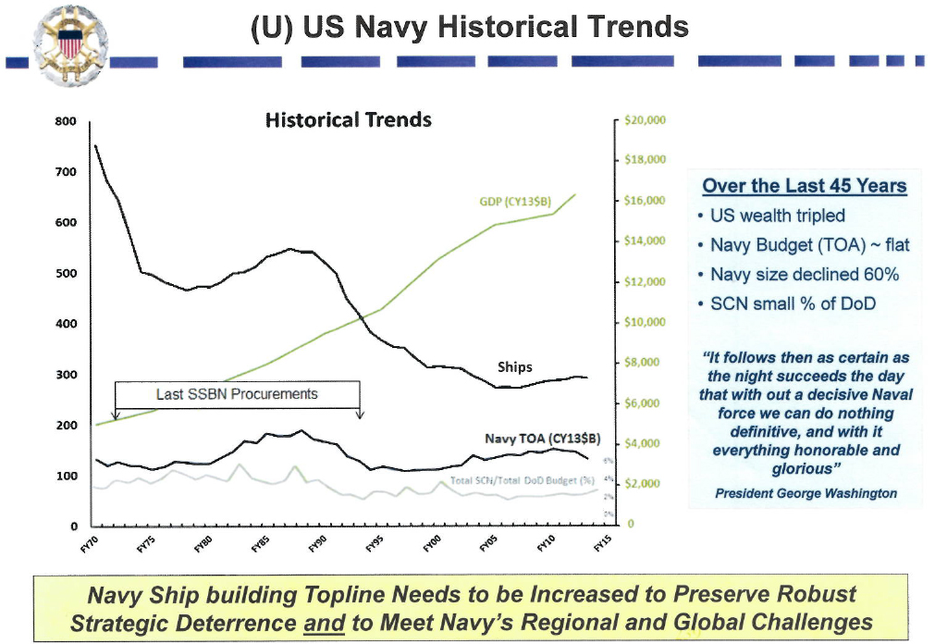
Navy Ship Inventory
National Security Spending is
down from 63% (Late 1950s) of total government outlays to <15% in 2020

Slide 22
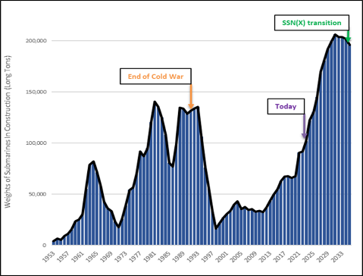
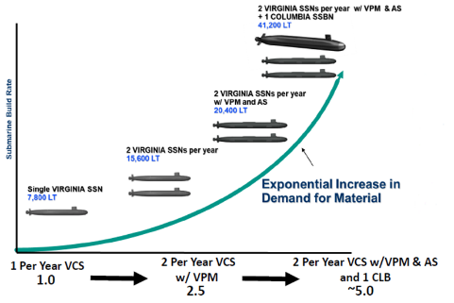
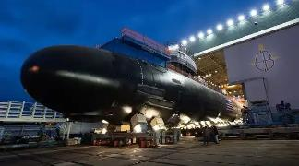
Rising to the Challenge
Submarine Industrial Base Resurgence
SIB Investment to Achieve 1 + 2 build rate
+$2.3B PB23 FYDP
DoN–Industry partnering critical to success
Shipbuilding Infrastructure
Supply Chains Capacity
Advanced Manufacturing
Workforce Trade-Skills
Strategic Outsourcing
Government Oversight
Submarine construction, L-tons/yr
UNCLASSIFIED

Slide 23
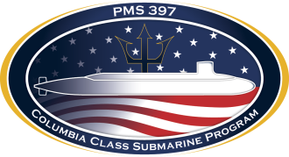
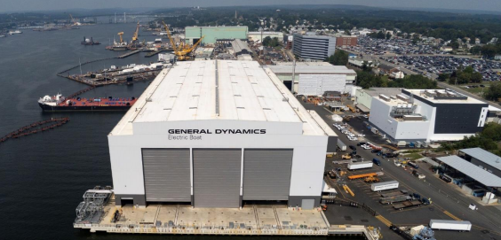
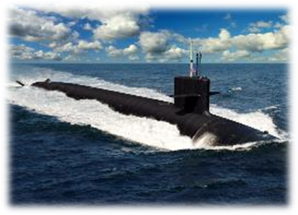
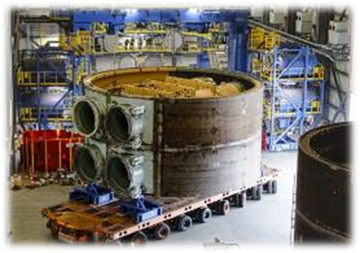
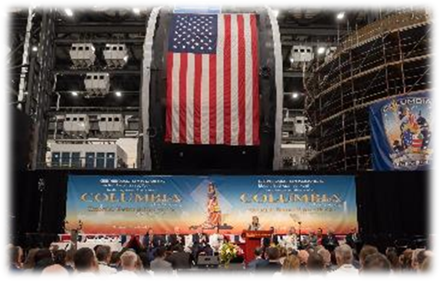
USS District of Columbia
“The Strength of a Nation”
#1 DOD acquisition priority
No margin for delay
Fully funded
SSBN 826 On patrol Oct ‘30
Construction start Oct ’20
Keel Laying Jun ’22
Delivery FY28
Sustaining OHIO SSBNs:
  Pre-Inactivation Restricted Availabilities on up to 5 hulls.
“We Build
Giants!”
Approved for Public Release-Distribution A
23

Slide 24
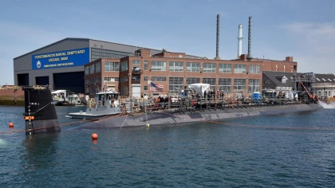
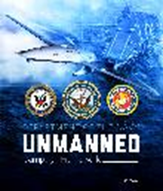
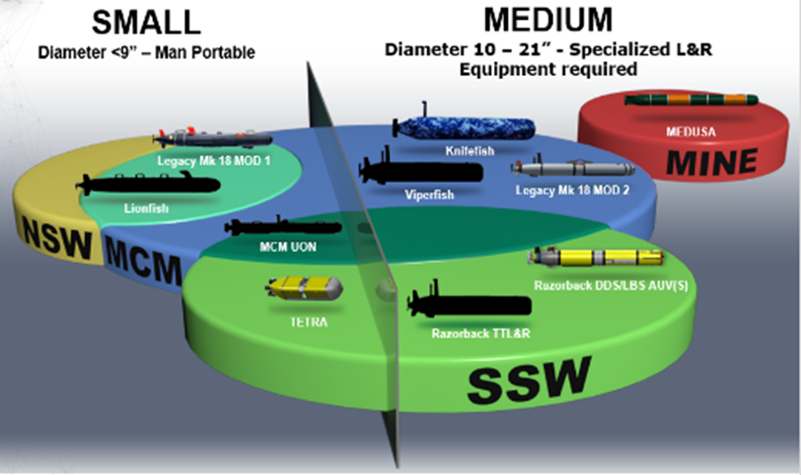
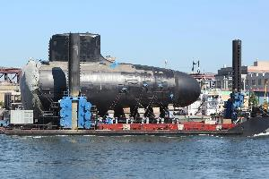
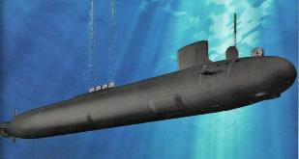
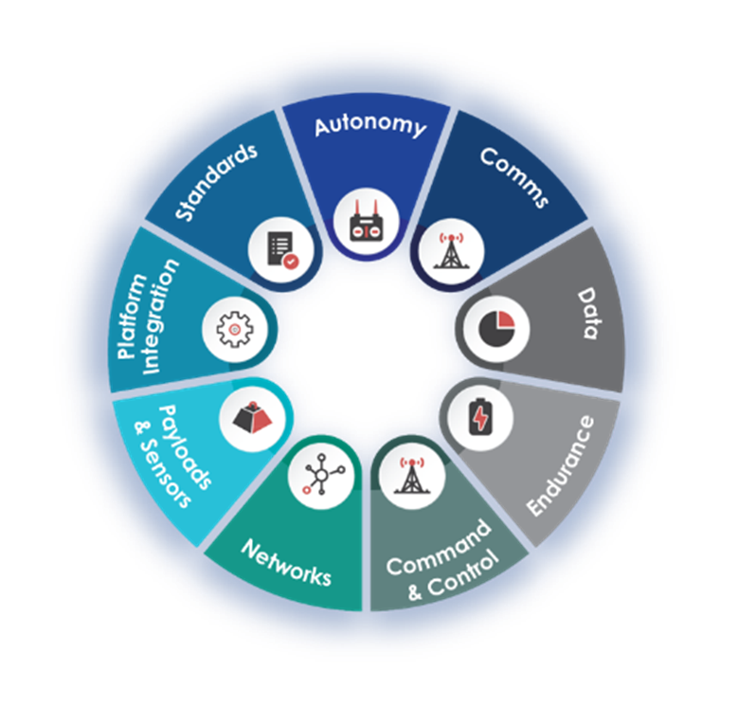
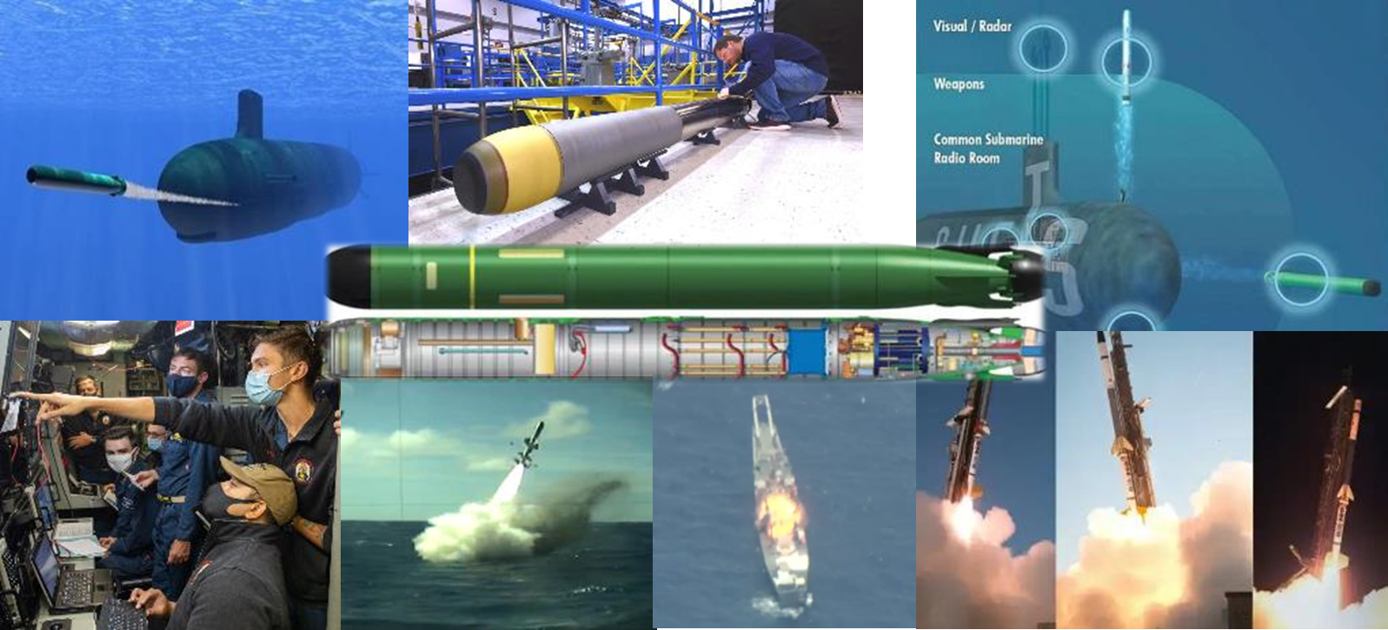
Attack Submarines
Restoring Readiness
Extending SSN capabilty
Evolving VCS Lethality
Enhancing the Industrial base
Defining Future Capabilty - SSN(X)
UNCLASSIFIED
USW Enterprise Priorities
Enabling the Undersea Forces:
Improving Future Capability
Extending Organic Sensor Range and Enabling Distributed Undersea Warfare
Undersea Weapons
Development
Capacity and Capability
Undersea Advantage is key to Integrated Deterrence and Decisive Victory
UNCLASSIFIED
24

Slide 25
PACFLT Intent to the Fleet
Mission Command – “Our success in out thinking our adversary will be enabled by our willingness to embrace institutional Mission Command concepts at all levels.”
Mission Command is the decentralized execution of military operations through mission orders
“We need empowered Commanding Officers that understand my operational level of intent, methods, and approach to achieve decisive victory in the event of armed conflict.”
“This will require a cultural shift that demands we grow comfortable taking measured risks bolstered by mutual trust so that we can continue the fight when the lights go out and there is silence on the net.”
“Success involves making bold decisions and taking action under uncertain conditions.”
“This conflicts with a peacetime view that seeks to drive out uncertainty and remove all risk from operations.”
ADM Swift – PACFLT Commander

Slide 26
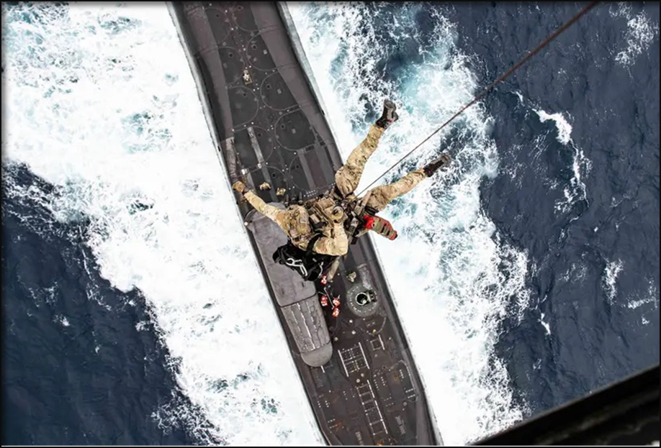
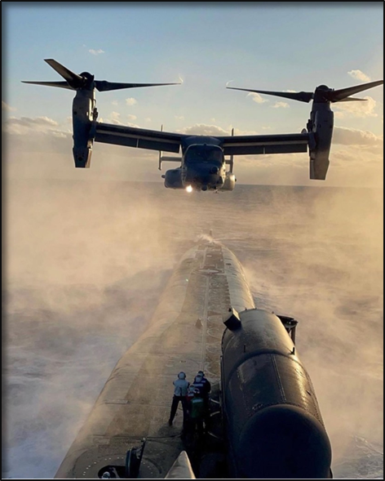

What Can We Do?
Yes…if..
Get in the conversation at the classified levels – understand that red gets a vote
Work through the challenges within and outside of government
Develop our workforce to solve problems
Figure out how we might do business in wartime

Slide 27
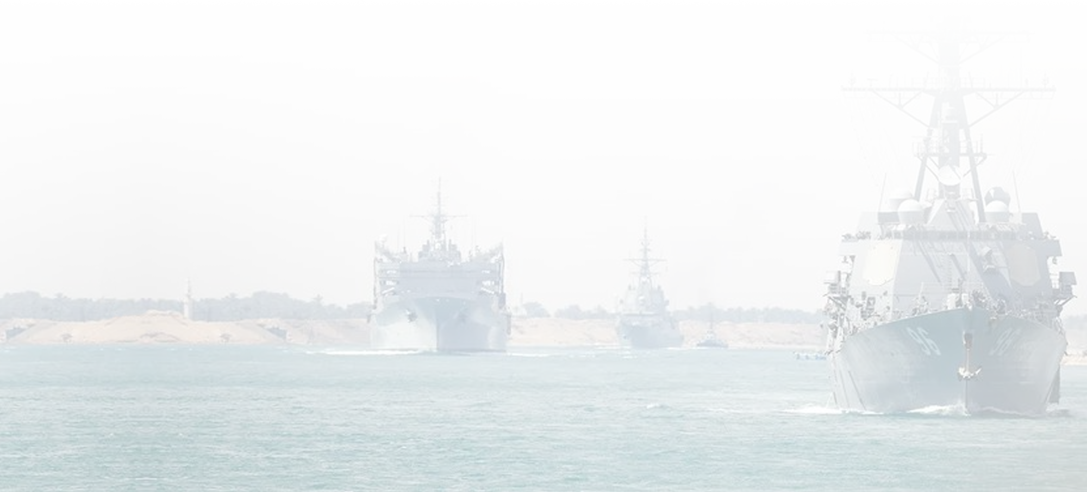
Our Warfighting Navy
Recent CBS reporting on our Navy operations in the Middle East
left the audience with the following words
“To see the work of Navy sailors … is nothing short of awe inspiring. …this is the new, finest generation. These men and women are the very best of America, serving their country selflessly. And with honor, they put themselves in harm's way and they leave their loved ones for months at a time in the defense of freedom.”
Approved for Public Release-Distribution A

Slide 28
Backup

