Slide 1


Naval Undersea Warfare Center
Division Newport
Office of Small Business Programs
Maria Gregory
Director, Office of Small Business
NUWC Division Newport
Approved for Public Release Distribution is Unlimited

Slide 2



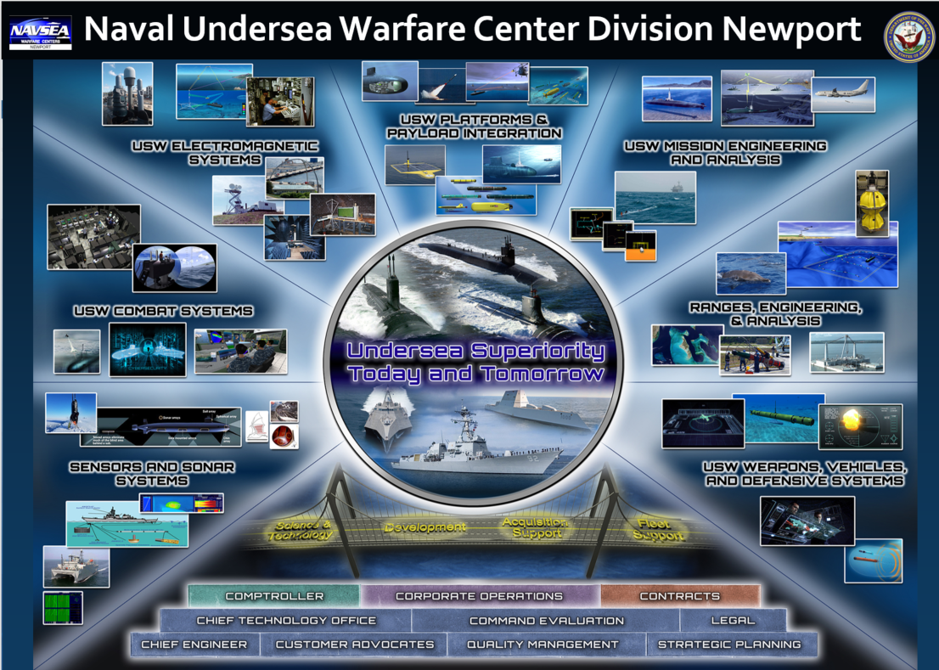
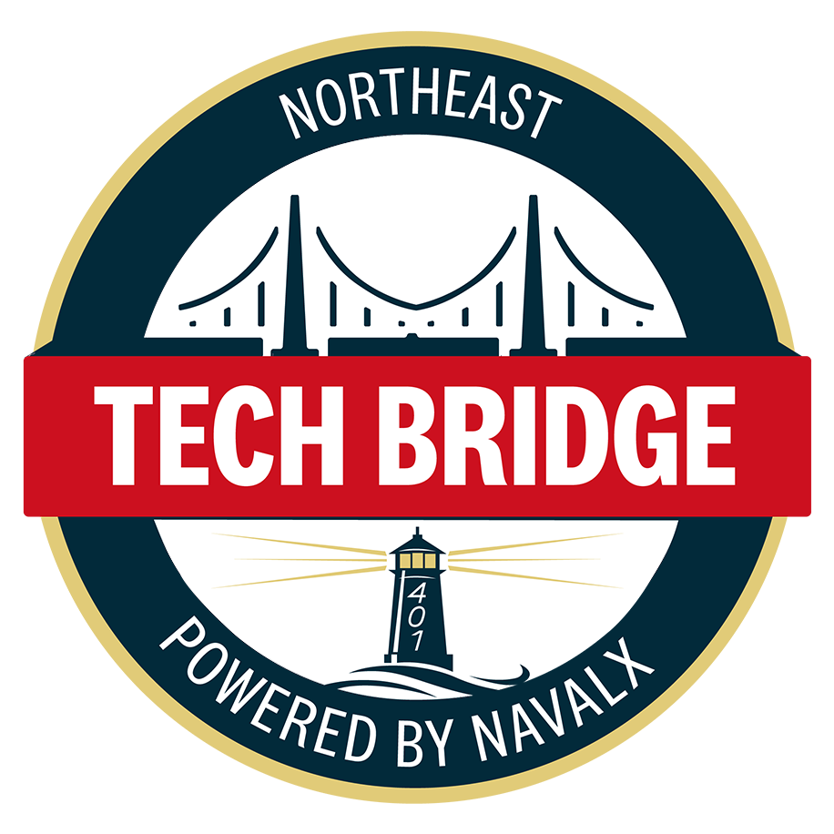
Small Business Director Role
NAVSEA, NAVY and DoD OSBP
Acquisition Professionals
Industry
PIA Partners, Non-Profit and State/Economic Promoters
Technical Requirement Generators

Slide 3
Competition Initiatives
Advocate for Set-Asides during Acquisition Strategy
Host and Attend Industry Outreach Events
Release of Advanced Notices (i.e. fair warning)
Utilization of Sources Sought
NUWCDIVNPT Consistently Educates,
and Engages with Industry

Slide 4

Top NAICs for NUWCDIVNPT

Slide 5
Non-Traditional Buying Methods
Cooperative Research and Development Agreement (CRADA)
Agreement to a non-Federal entity to perform collaborative research and development in any area that is consistent with a Federal laboratory's mission.
Other Transactional Authority (OTA)
Authority of the Department of Defense (DoD) to carry out certain prototypes, research, and production projects
Small Business Innovation Research (SBIR)
  Uses federally funded research dollars to stimulate innovative small businesses
  Facilitates the transition of the research to the commercial sector
Small Business Technology Transfer (STTR)
  University, a Federally Funded Research and Development Center (FFRDC), or a qualified non-profit research institution

Slide 6
Traditional Buying Methods
Items Under $10,000
Purchase Card
Supplies over $10,000
Contracts over $25,000 are posted on sam.gov
IT Hardware/Software NASA SEWP Contract
GSA
Services
Indefinite Delivery Indefinite Quantity (IDIQ) large dollar value contracts
SeaPort- NAVSEA’s Multiple Award Contracting Vehicle
(Must be a SeaPort contract holder in order to bid as a prime on task orders)

Slide 7

The SeaPort NxG Program Management Office (PMO) conducted the next competitive SeaPort NxG Rolling Admissions in April 2024 to award Multiple Award Indefinite-Delivery/Indefinite Quantity (IDIQ) contracts. Rolling Admissions Solicitation Number N00178-24-R-7000 was released on SAM.gov on 9 April 2024. Interested offerors should monitor SAM.gov for any applicable amendments.
SeaPort NxG (navy.mil)
Contact the SeaPort NxG Program Management Office team at SEAPORT_EPCO@navy.mil

Slide 8
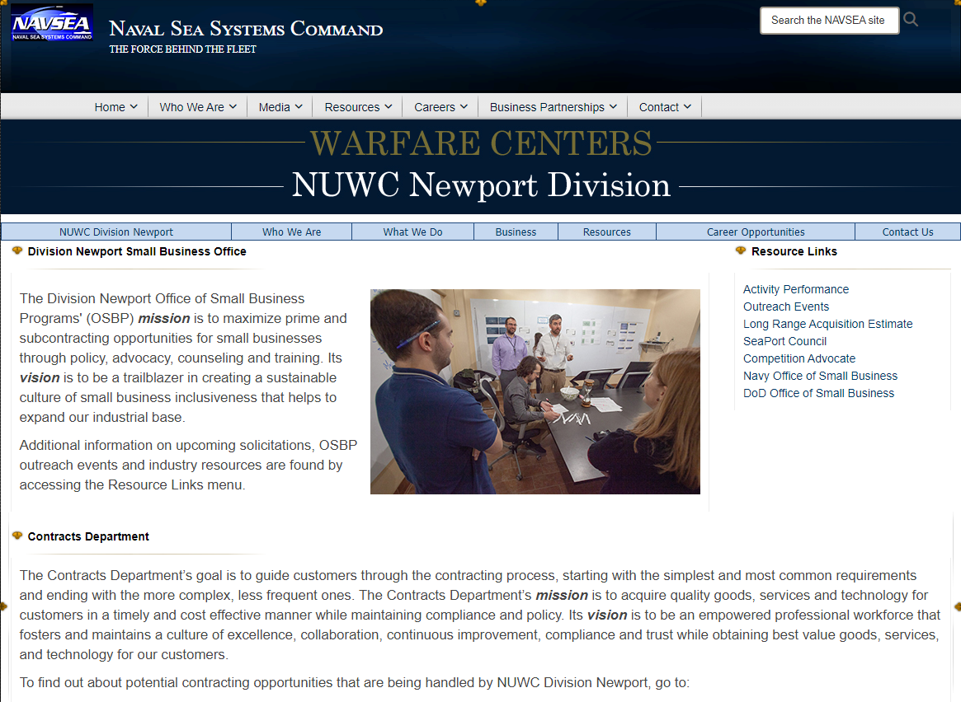
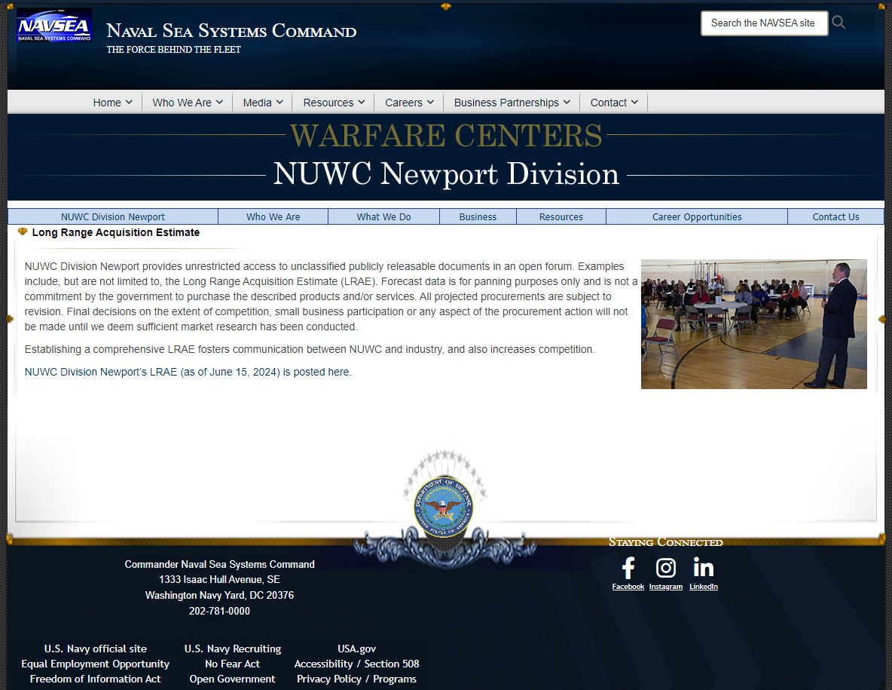
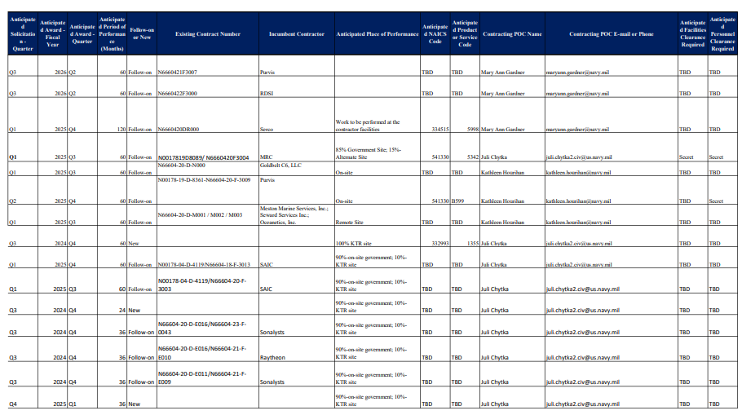
Long Range Acquisition Estimate

Slide 9
Tips for Success
Review the Federal Acquisition Regulations, FAR Part 19 for Small Business socio-economic status
Ensure System for Award Management (SAM) is accurate.
  If you are self-certifying in SAM, ensure it reflects your business and socio-economic categories
Clear Capability Statement
Profile in SBA Dynamic Small Business Search

Slide 10
Tips for Success
Reach out to your Apex Accelerator
  Rhode Island Apex |
  Business Assistance & Support (riapex.org)
  Massachusetts APEX Accelerator | UMass Amherst (massapex.org)
  CT PTAC | Marketing & Procurement Assistance for CT Businesses

Slide 11
Tips for Success
Know your customer
Follow the instruction in the proposal completely
JCP certification is needed to access drawings in the solicitation
Participate in Sources Sought and Requests for Information
If you see something in a solicitation that looks overly restrictive, say something
Don’t underbid just to win (could have resulting cost overruns and negative CPARs)
Ask for a debrief
If you have questions, don’t hesitate to ask

Slide 12
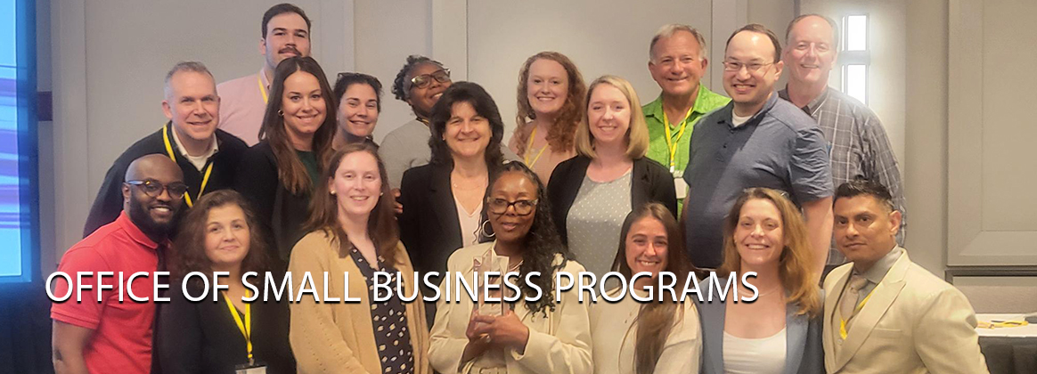
Small Business Professionals at NAVSEA

Slide 13
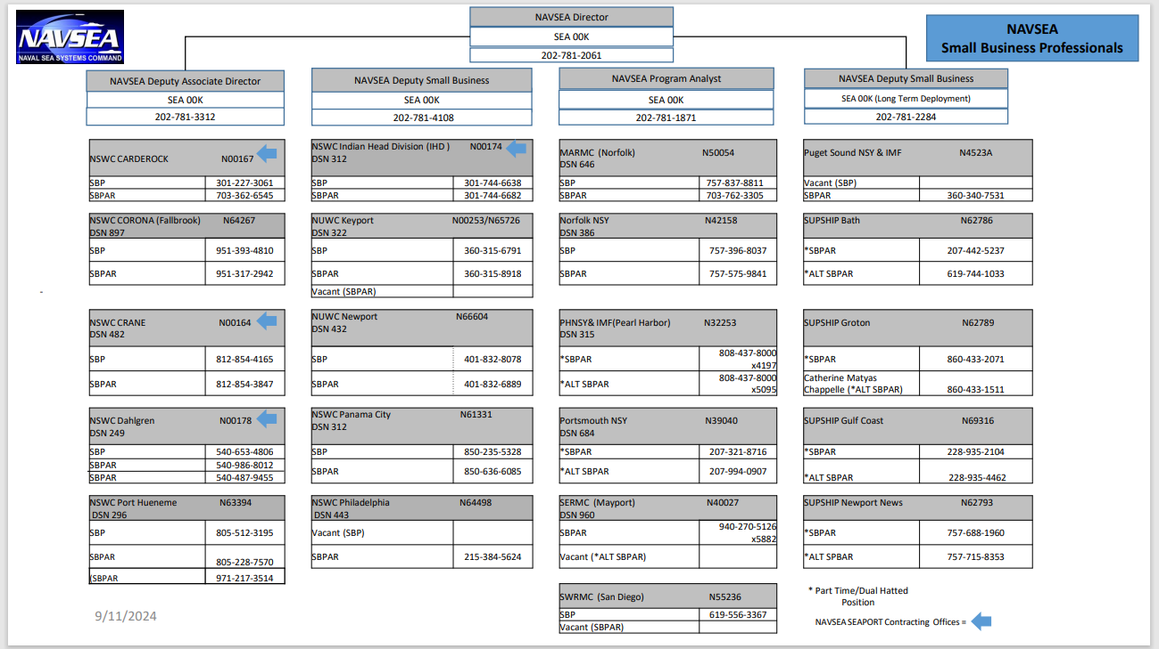
Small Business Professionals at NAVSEA

Slide 14
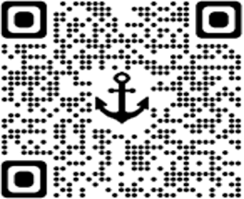
NAVSEA Office of Small Business
NAVSEA_SMALL_BIZ.fct@navy.mil or 202-781-2061
NAVSEA_SMALL_BUSINESS_FIELD_OFFICES@us.navy.mil
For more information about doing business with NAVSEA

Slide 15

Major Navy Buying Commands
Office of Naval Research (ONR)
https://www.nre.navy.mil/work-with-us/small-business
Naval Supply Systems Command (NAVSUP)
https://www.navsup.navy.mil/Business-Opportunities/Home/
Naval Air Systems Command (NAVAIR)
https://www.navair.navy.mil/osbp/
Naval Information Warfare Systems Command (NAVWAR)
https://www.navwar.navy.mil/About/Small-Business-Programs/
Notes:
Looking for other navy buying commands

Slide 16
Resources
Department of the Navy Resources
https://www.secnav.navy.mil/smallbusiness/Pages/DBWD.aspx
Procurement Technical Assistance Centers
https://www.aptac-us.org/
Project Spectrum
https://projectspectrum.io/
Manufacturing Extension Program (Polaris in RI)
https://polarismep.org/
Rhode Island Small Business Development Center
https://web.uri.edu/risbdc/
Notes:
Project Spectrum: CMMC certified videos, tools, help

Slide 17
Questions?
Maria Gregory
NUWCDIVNPT, Office of Small Business
Email: maria.f.gregory.civ@us.navy.mil
Tel: (401)832-8078/
(401) 578-3023

