Slide 1
NUWC Division Newport
Code 02
October 16, 2024
Industry Day

Slide 2
Contracts Department – Code 02
Contracts Department Head
02
P-Card Compliance Reporting
Technical Acquisition Office/02T
Contracts Deputy Dept Head
02B
COR
Oversight 0214
Business Office 02B1
Acquisition Policy & Oversight Division
021
Procurement Division 1
022
Procurement Division 2
023
Policy & Self Assessment
0212
Procurement
Branch 1
0221
(45 & 85)
Procurement
Branch 2
0222
(15, OTA, SUBMEPP)
Procurement
Branch 3
0223
(SAP, 01, 60, Construction)
Procurement
Branch 4
0231
(10, 34, TEAMSUB)
Procurement
Branch 5
0232
(25 & 70)
P-Card Program Management
0211
Notes:
SLIDE COMPLETE

Slide 3
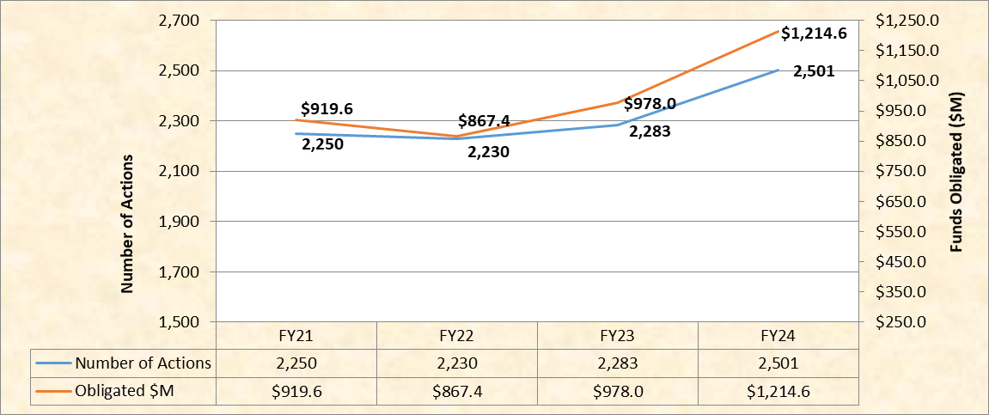
Production by Fiscal Year
FY24 Obligations including OTAs and TEAM SUB: $1,214.6
NUWC - $814.1M Team SUB Direct - $177.8M OTA - $222.7M

Slide 4
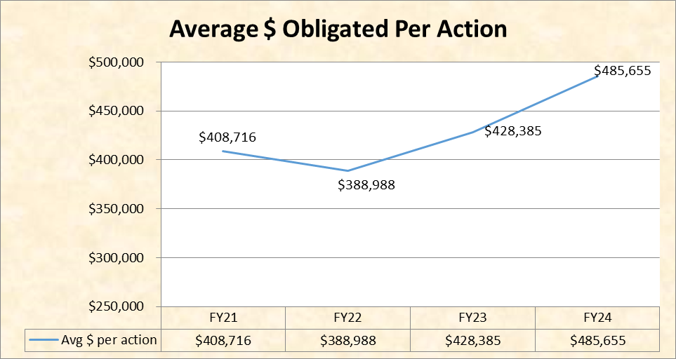
Obligation Funding per Action Trend
-- Continuously striving to obligate more dollars with fewer actions --

Slide 5
Obligations by Action Type – FY22, FY23 and FY24
 | FY22 |  | FY23 |  | FY24
Type of Action | #of Actions | $ (M) | #of Actions | $ (M) | #of Actions | $ (M)
Major Contract | 11* | $7.50 | 16* | $2.90 | 39* | $2.70
Seaport TO | 20 | $16.28 | 10 | $15.20 | 16 | $31.90
Mult. Award TO/DO | 20 | $10.34 | 9 | $4.80 | 56 | $15.60
Sin. Award TO/DO | 162 | $115.30 | 150 | $164.30 | 132 | $189.90
Modifications | 1,508 | $559.58 | 1,497 | $585.40 | 1,651 | $694.90
New SAPs | 425 | $40.54 | 501 | $49.90 | 479 | $56.90
OTA Actions | 84 | $117.90 | 100 | $155.50 | 128 | $222.70
TOTAL | 2,230 | $867.44 | 2,283 | $978.00 | 2,501 | $1,214.60
Notes*:
In FY23, there were 5 multiple awards under one unique contract requirement, the total unique requirements awarded is 12
In FY24, there were 30 multiple awards under 3 unique contract requirements, the total unique requirements awarded is 12

Slide 6
Supplies v. Services & Competition
FY23 and FY24

Slide 7
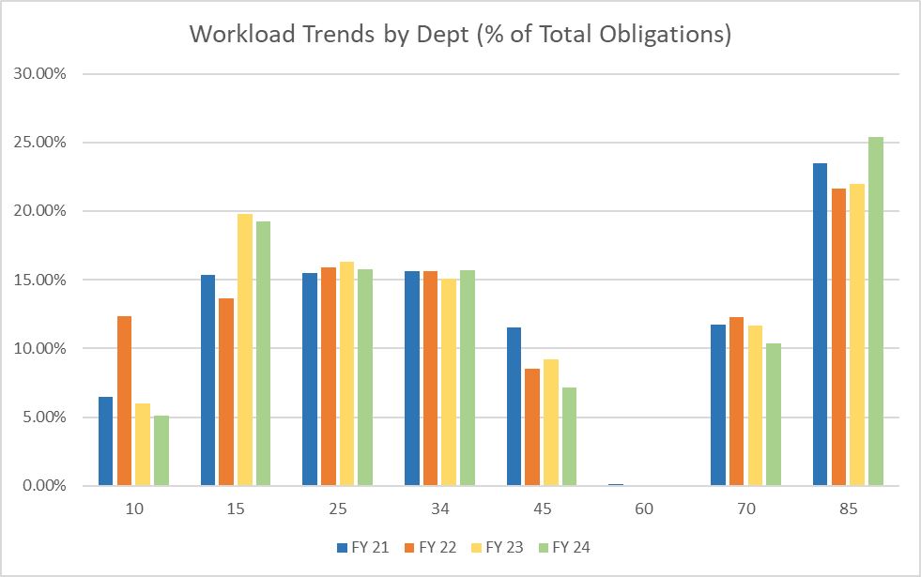
Workload by NUWCDIVNPT Department
Notes:
Using FY21 – FY24 (to date 9/1/24) using tableau recap #s, by Obligations.
Denominator is only the value of NUWC Departments, does not include external awards (TeamSub, SUBMEPP, NSWC, etc)

Slide 8
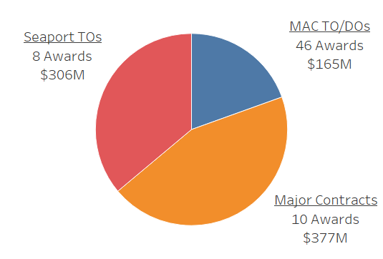
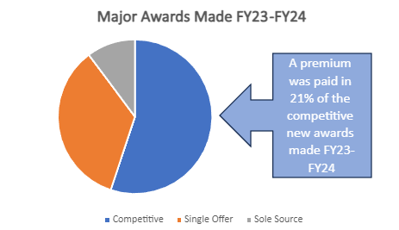
Single Offer and Best Value Premiums
Awarded Ceiling FY23 - FY24
Major Awards Made FY23 - FY24
Notes:
Bottom pie chart – single offer awarded ceiling by action type
Upper pie chart – best value premium taken from CRB logbook

Slide 9
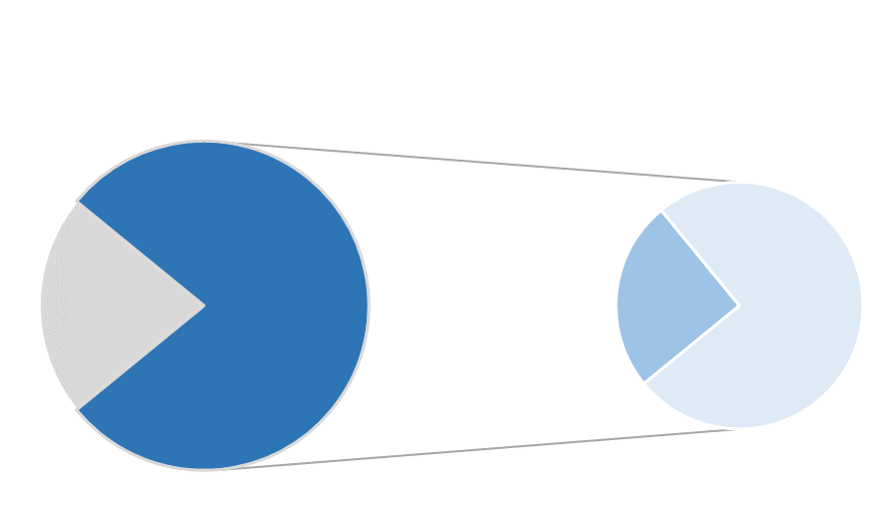
SB Award Data: New Awards
Set-aside Solicitations
21%
Unrestricted
Solicitations
79%
SB
23%
OTSB
77%
Approximately 21% of new awards in FY23 and FY24 were set-aside for SBs; Small businesses were awarded 23% or $70M of the work solicited as F&O
Data as of 9/30/24

Slide 10
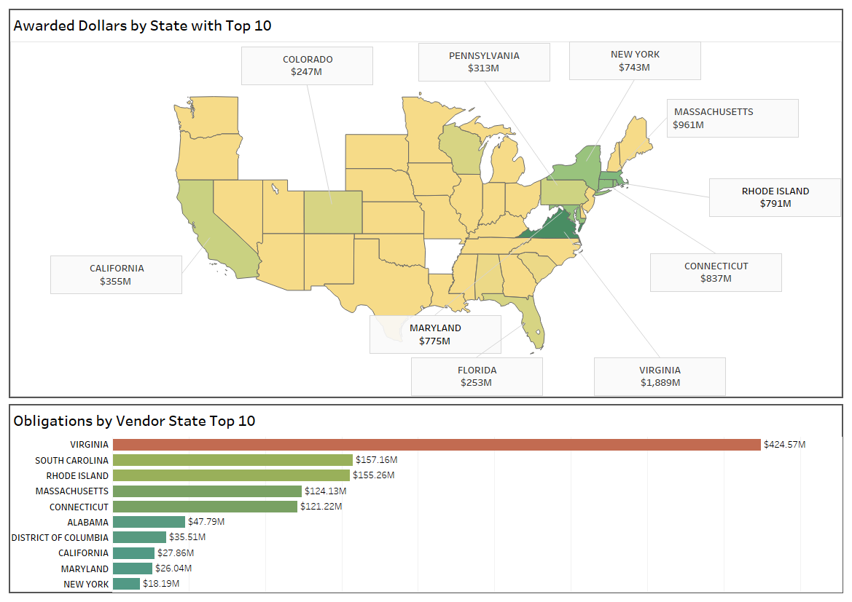
Defense Industrial Base By Dollars Awarded and Obligated (10/1/23-9/1/24)
Awards made in 44 States!
Notes:
THIS SLIDE DATA IS FY24 ONLY
Map is showing total Ceiling awarded, include MAC awards. The MAC Awards had a large impact in total awarded ceiling for FY24, notably:
24 MAC Base awards with potential ceiling of $246M
2 MAC Base awards with potential ceiling of $50M
4 MAC Base awards with potential ceiling of $30M

Slide 11
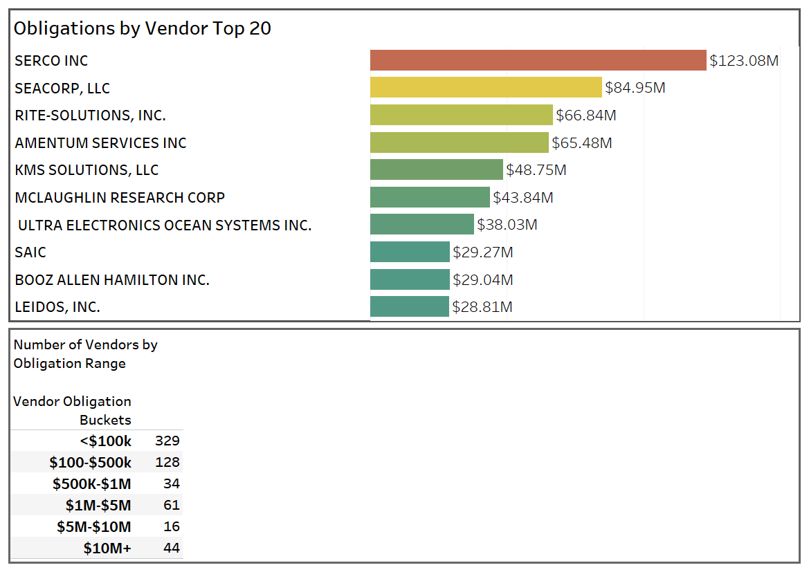
Defense Industrial Base (Continued) By Dollars Obligated (10/1/23-9/1/24)
Awards made to 598 Unique vendors in FY24
Notes:
This is FY24 data only. OTA awards not included.

Slide 12
Defense Industrial Base (Continued) By Dollars Obligated in FY23 and FY24
Top 20 Businesses |  | Top 20 Small Businesses
SERCO INC |  | RITE-SOLUTIONS, INC.
SEACORP, LLC |  | KMS SOLUTIONS, LLC
ADVANCED TECHNOLOGY INTERNATIONAL |  | MCLAUGHLIN RESEARCH CORP
AMENTUM SERVICES INC |  | MIKEL INC
RITE-SOLUTIONS, INC. |  | PURVIS SYSTEMS INCORPORATED
MCLAUGHLIN RESEARCH CORP |  | SYNCHRON, LLC
SCIENCE APPLICATIONS INTERNATIONAL CORP |  | PATRONA CORPORATION
LEIDOS, INC. |  | MASSA PRODUCTS CORPORATION
KMS SOLUTIONS, LLC |  | RESEARCH & DEVELOPMENT SOLUTIONS INC
ULTRA ELECTRONICS OCEAN SYSTEMS INC |  | SEACORP, LLC
BOOZ ALLEN HAMILTON INC |  | SYQWEST INC
MIKEL INC |  | PROGENY SYSTEMS CORP
PURVIS SYSTEMS INCORPORATED |  | SONALYSTS INC
SYNCHRON, LLC |  | TELECONSULTANTS INC
L3 TECHNOLOGIES INC |  | SYSTEMS RESOURCE MANAGEMENT INC.
NORTHROP GRUMMAN SYSTEMS CORP |  | INDUS TECHNOLOGY INC.
LOCKHEED MARTIN CORPORATION |  | ATAP INC
SAAB INC. |  | CAMEO, PROFESSIONAL SUPPORT SERVICES, LLC
PATRONA CORPORATION |  | C-K COMPOSITES CO., LLC
MASSA PRODUCTS CORPORATION |  | SECHAN ELECTRONICS, INC.
$100K or More – 279 companies, $500K or more 126 Companies
$1M or more – 92 Companies
Notes:
This is 2 FYs, FY23 – FY24

Slide 13
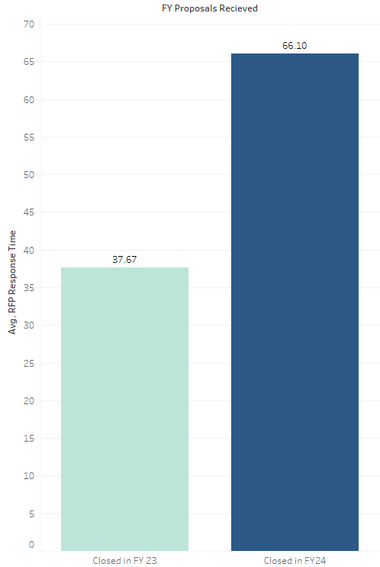
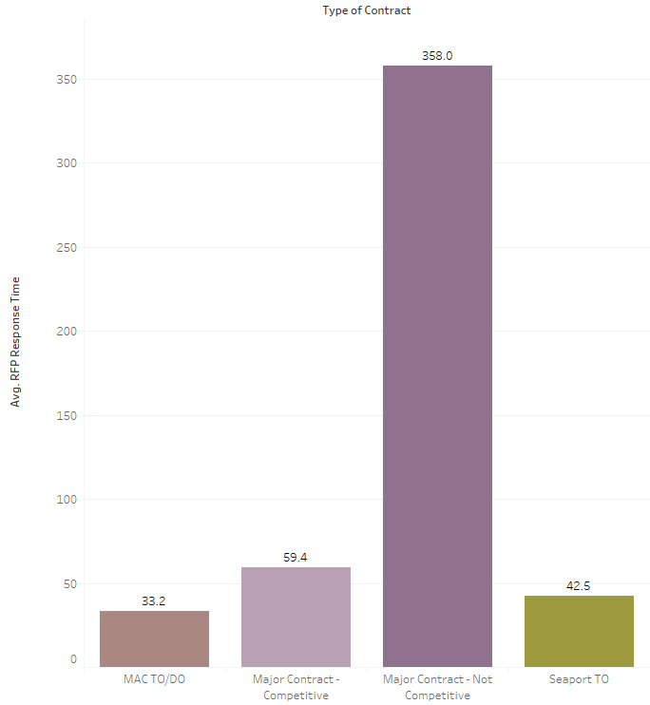
RFP Response Times (RFPs Closed in FY23-24)
Notes:
This is 2 Fys, FY23 – FY24

Slide 14
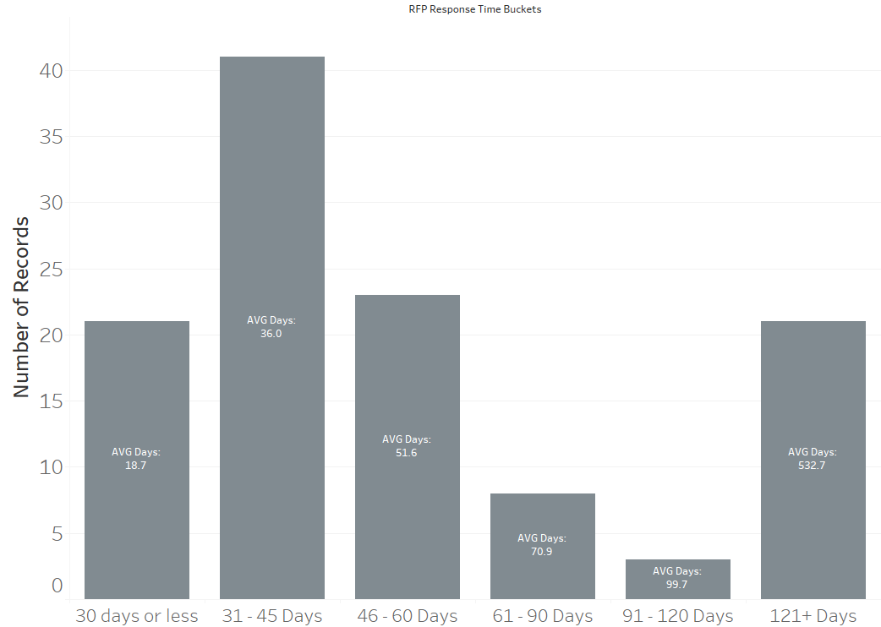
RFP Response Times (RFPs Closed in FY23-24)
Notes:
This is 2 Fys, FY23 – FY24

Slide 15
QUESTIONS?

