Slide 1
Sensors and SONAR Systems Department
NUWC Division Newport, Code 15
NCMA RI Chapter Industry Day
16 October 2024
Julie Henry, Sensors and SONAR Systems
Deputy Department Head (acting)
1

Slide 2
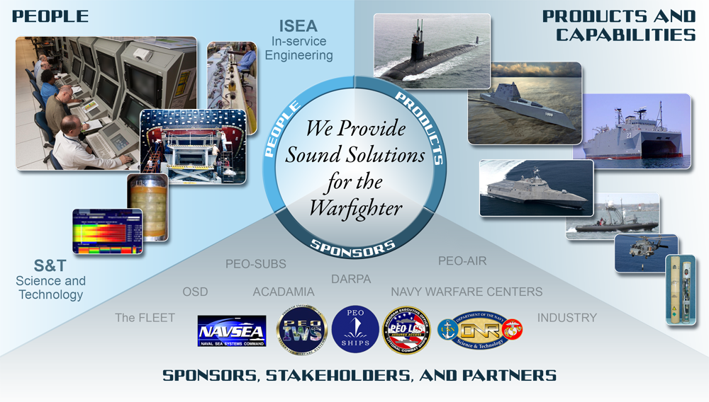
Sensors and SONAR Systems Department
We Advance Timely, Innovative, Integrated, Next Generation
Solutions to Maintain FLEET UNDERSEA SUPERIORITY
NAVSEA PEO USC NAVSEA PEO UWS NAVSEA PEO SHIPS
THE FLEET NAVSEA PEO IWS ONR ONI

Slide 3
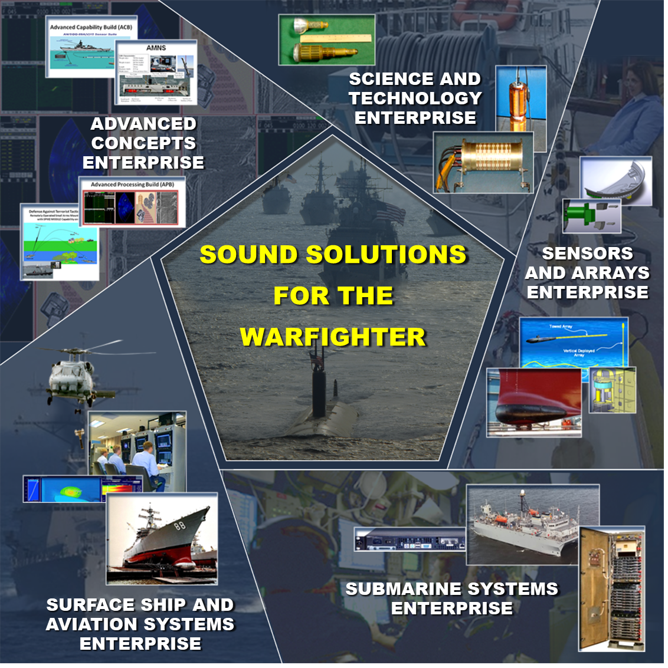
Sensors & SONAR Systems Department
Core Competencies
Undersea Warfare (USW) Sensors & Arrays
Submarine & Surface Ship SONAR Systems
Maritime Surveillance
Science & Technology
Advanced Development
DISTRIBUTION STATEMENT A: Approved For Public Release; Distribution Is Unlimited
3

Slide 4
Sensors & SONAR Systems Department
15 Department Head
15B Deputy Department Head
15T Director of Undersea Sensing Technologies
1501 Director, Business Operations
159 Director, Programs & Contracts
Department Contract Manager (DCM)
15B Customer Advocacy
Surface Ship USW
Towed Systems, Sensors and Acoustics
Maritime Surveillance
1502 Director, Information Technology
15E Director, Engineering
Chief Systems Analyst
151 Science and Technology Division
152 Advanced Concepts Division
153 Sensors and Arrays Division
154 Submarine Systems Division
155 Surface Ship and Aviation Systems Division
1511 Automation Algorithm Development
1512 Devices, Sensors and Materials R&D
1513 Signal Processing
Algorithm Development
1521 Developmental Systems Engineering
1522 Prototype Development
1523 Technology Integration
1524 Concepts and Experimentation
1531 Underwater Sound Reference
1532 Towed and Deployed Arrays Engineering
1533 Hull Arrays and Distributed Sensors Engineering
1534 Handling Systems Engineering
1535 Fleet Sensors and Cables Engineering
1541 Submarine and Surveillance Systems Engineering
1542 Systems Analysis and Passive Systems Engineering
1543 Submarine and Surveillance Systems Integration
1544 Submarine and Surveillance Test, Evaluation and Analysis
1545 Submarine and Surveillance Training, Logistics and Fleet Support
1551 Surface and Aviation Systems Engineering
1552 Active Systems Engineering
1553 Surface and Aviation Systems Integration
1554 Surface and Aviation Test, Evaluation and Analysis
1555 Surface and Aviation Training, Logistics and Fleet Support
Over 600 Highly-Qualified Engineers, Scientists, Technicians, and Staff Professionals

Slide 5
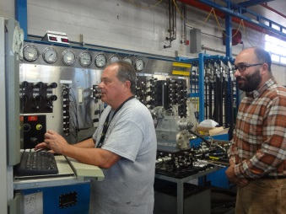
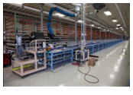
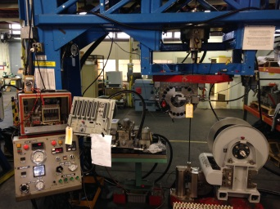
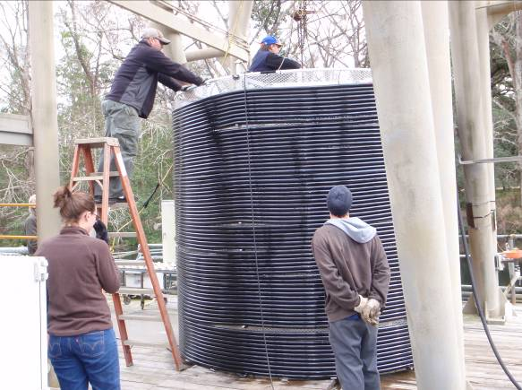
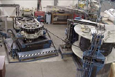
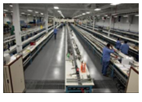
Service Cost Centers
Towed Array Handler Equipment Facility (TAHEF)
Naval Array Technical Support Center (NATSC)
Underwater Sound Reference DIVNPT (USRD)
Center of Excellence for overhaul of Towed Array Handler Equipment
Registered to ISO 9001-2000 and
aligned with the Towed Systems ISEA Organization
Land-based test facilities for 276 and
542 systems
Established as a result of a NAVSEA initiative to integrate all Towed Array
and Tow Cable Repair Level Activity into
a consolidated facility
Responsible for the repair and refurbishment of Surveillance Towed Arrays (SURTASS) A180R and TL-29A; Surface Ship Towed Array TB-37; and Submarine Towed Arrays TB-16, TB-29A and TB-34
Responsible for the manufacturing of
TB-16, AN/SQR-19, TB-34 and SURTASS Tow Cables
Rapid array and sensor Calibration/Certification Response Center to accommodate urgent fleet requirements
Navy’s principal Activity for N.I.S.T. traceable calibration of Tactical Towed Arrays including developmental Towed Arrays and Submarine and Surface Ship coatings and hull sensors
Towed Array calibrations include platforms: TB-16 (E,F,G), TB-29, 29A, TB-34, TB-37 and new Fiber Optic Arrays; and Receive Sensitivity Calibration
5

Slide 6
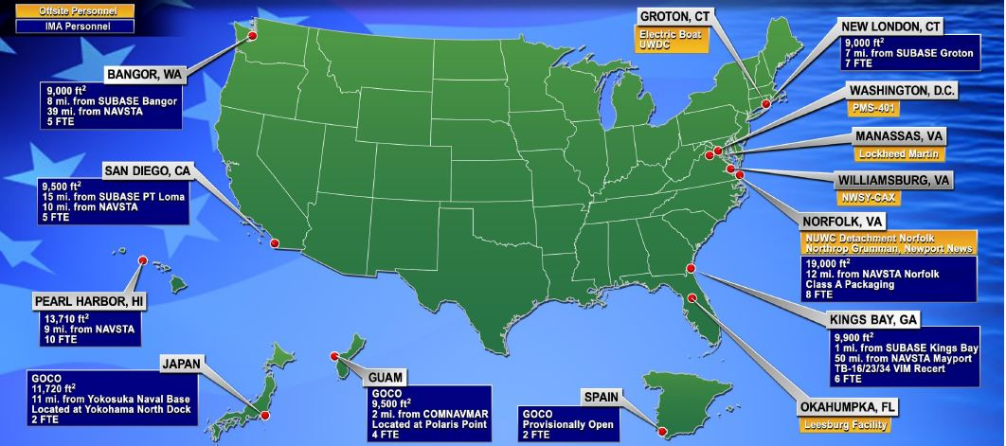
Strategically Located Offsite and Intermediate Maintenance Activities (IMA) Personnel
Our Resources and Expertise Support National and Foreign Military Efforts
6

Slide 7

C15 Strategy Map
NUWCDIVNPT OPERATING PRINCIPLES
Teamwork Fleet/Customer Focus
Technical & Business Excellence
A l i g n w i t h N U W C D I V N P T S t r a t e g i c G u i d a n c e
NUWCDIVNPT STRATEGIC FOCUS AREAS
Our People
Technical & Business Readiness
Next Generation Undersea Warfare
CODE 15 VISION: Sound Solutions for the Warfighter
CODE 15 MISSION: Conduct full spectrum research & development, prototyping, engineering, integration, training, test & evaluation, logistics, and acquisition support for sensors and SONAR systems in undersea warfare (submarine, surveillance, surface ship, aviation and associated areas of irregular warfare) for undersea superiority today and tomorrow.
1.0 Maintaining Acoustic Superiority For The Fleet Of Today And Tomorrow​
2.0 Create The Acoustic Superiority Workforce Of The Future
3.0 Develop The Acoustic Superiority Facilities/ Infrastructure
4.0 Acoustic Superiority Wartime Readiness​
CODE 15 GOALS
CODE 15 NEAR-TERM TECHNICAL FOCUS
Distributed Sensing and SONAR Systems
Cloud Computing/Infrastructure Management
Non-Traditional Sensing Technologies
Foreign Military Sales
Warfighter Performance
System Commonality
System Life-Cycle
Science and Technology
7

Slide 8
Leadership Thoughts and Outlook
Concerns- Thoughts from the Helm
    Demand for our products and services has never been higher
    We are experiencing large numbers of retirements and we are hiring mostly new engineers to replace
    Senior engineers and scientists are at a premium
Outlook Challenges or Changes regarding Product Line, Acquisition, etc
    Growing demand for our Depot products (technician support)
    Growing demand for Sonar Systems analysis
    Heavy workload in our ISEA areas- particularly wet end and ARCI
    Heavy workload in Sonar T&E- particularly surface ship and submarine
8

Slide 9
Contracting Status
9

Slide 10
Contract Management Structure
C159, Director
of Programs
& Contracts
Department Contract Manager (DCM)
TDAA
Business Operations
1501
S&T & Invest.
151
Adv Concepts
152
Towed Sys & Sensors IPT
153
Submarine Systems
154
Surface Ship Systems
155
Hull Sensor Systems
Service Cost Centers
Towed
Systems
To manage our procurement workload within Code 15, we have established the Contracts Management IPT
The Contacts Management IPT consists of supervisors, project leaders, and acquisition professionals from across the entire Sensors and SONAR Systems project portfolio to promote teamwork, knowledge sharing, and cross-department communications
10

Slide 11
Projected Contracting ($M)

Slide 12
Services Outsourced By Skill (FY 24)
Driven by SCCs
357 FTEs

Slide 13
Major Code 15 Contractors
GVI |  | Towed Array Handler Equipment Facility (TAHEF) Maintenance, Repair & Overhaul
Leidos |  | Naval Array Technical Support Center (NATSC)
Hydroacoustics Inc. |  | HLF-1 Services & Refurb
Leidos |  | Towed Array Intermediate Maintenance Activity (IMA)
SyQwest / Ultra / Massa / USS |  | Sensors, Hydrophones & Transducers
MRC |  | Wet End Engineering, Test & Evaluation
MIKEL |  | Dry End System Eng., Test & Evaluation
INDUS |  | Business Operations Support
SEACORP |  | Trainers, Training & Human Factor Eng.
L-3 Chesapeake Sciences Corp |  | Towed Array Integrated Product Team Telemetry (TAIPT)
Canadian Rolls Royce |  | OK-410

Slide 14
Code 15 Projected Contracts
 | Summary of Contract Scope | Contracting Method: (SeaPort, IDIQ, etc.) | Expected RFP release | Follow On?
TR-302/TR-355 Transducer Production | Establish a 5-year FFP IDIQ contract for TR-302/TR-355 transducer production. | FFP IDIQ | TBD | N66604-18-D-D800: Massa Products Corporation
NATSC Follow On | Naval Array Technical Support Center Follow On | Cost-Reimbursement | FY24 Q3 | N6660421DA000: Leidos
15 - HFSA Fiber Optic Receive Cables | Establish a five year IDIQ contract for HFSA Fiber Optic Cables | FFP IDIQ | FY25 Q1 | N6660419DB900: TE CONNECTIVITY SEACON
15 - DT-511/DT-592 Hydrophones Production Contract | Establish IDIQ for DT-511/DT-592 Hydrophones | FFP IDIQ | FY25 Q2 | N6660419DE900: UNDERSEA SENSOR SYSTEMS, INC.
15 - DT-574 Series Hydrophones Production Contract | Establish a 5 year IDIQ for DT-574 series hydrophones production | FFP IDIQ | FY25 Q2 | N6660419DF900: MASSA PRODUCTS CORPORATION
15 - DT-100 Staves Production | Build-to-Print requirement for production DT-100 Staves. | FFP IDIQ | FY25 Q1 | N6660418DF800: SyQuest
15 - TR-317 Transducers, TR-353 Transducers & TR-353 Installation Kits Production | Establish 5 year IDIQ contract for the production of TR-317 transducers, TR-353 transducers, and installation kits for TR-353 transducers. | FFP IDIQ | TBD | N6660421DC100: Ultra Electronics

Slide 15
Code 15 Projected Contracts
 | Summary of Contract Scope | Contracting Method: (SeaPort, IDIQ, etc.) | Expected RFP release | Follow On?
15 - Telemetry Follow On Contract | This contract action is to allow the Naval Array Technical Support Center and associated programs to continue to purchase telemetry parts to repair and modify towed arrays for continued Fleet use on submarine, surface and surveillance ships. | FFP IDIQ | FY25 Q1 | N6660421DL000: L3 Technologies, Inc.
15 - Dry End Sonar System Engineering | Follow on Contract for N0017819D8122/N6660421F3002 | Cost-Reimbursement SeaPort | FY25 Q1 | N0017819D8122/N6660421F3002: Mikel Inc.
IMA Follow On | Towed Array Intermediate Maintenance Activity (IMA) contract follow on | Cost-Reimbursement | FY25 Q1 | N0017819D8006/N6660420F3010: Leidos
15-Wet End Service Contract | Wet End service contract follow on to N6660422F3009 | Cost-Reimbursement SeaPort | TBD | N6660422F3009: MRC

Slide 16
Opportunities
ASW Performance Analysis
Distributed Sensors
Cyber Security
Hull Mounted Arrays
Human Systems Integration
Next Gen Arrays - Highly Skilled Technicians
In Service Engineering
Advanced Sensor Development
Signal Processing
Simulation/Stimulation
Towed System Reliability
Transducer / Hydrophone Technology
Test & Evaluation
Keys to Contracting Success:
Competition
Advanced Planning
Sources Sought
Trusted Partner

Slide 17
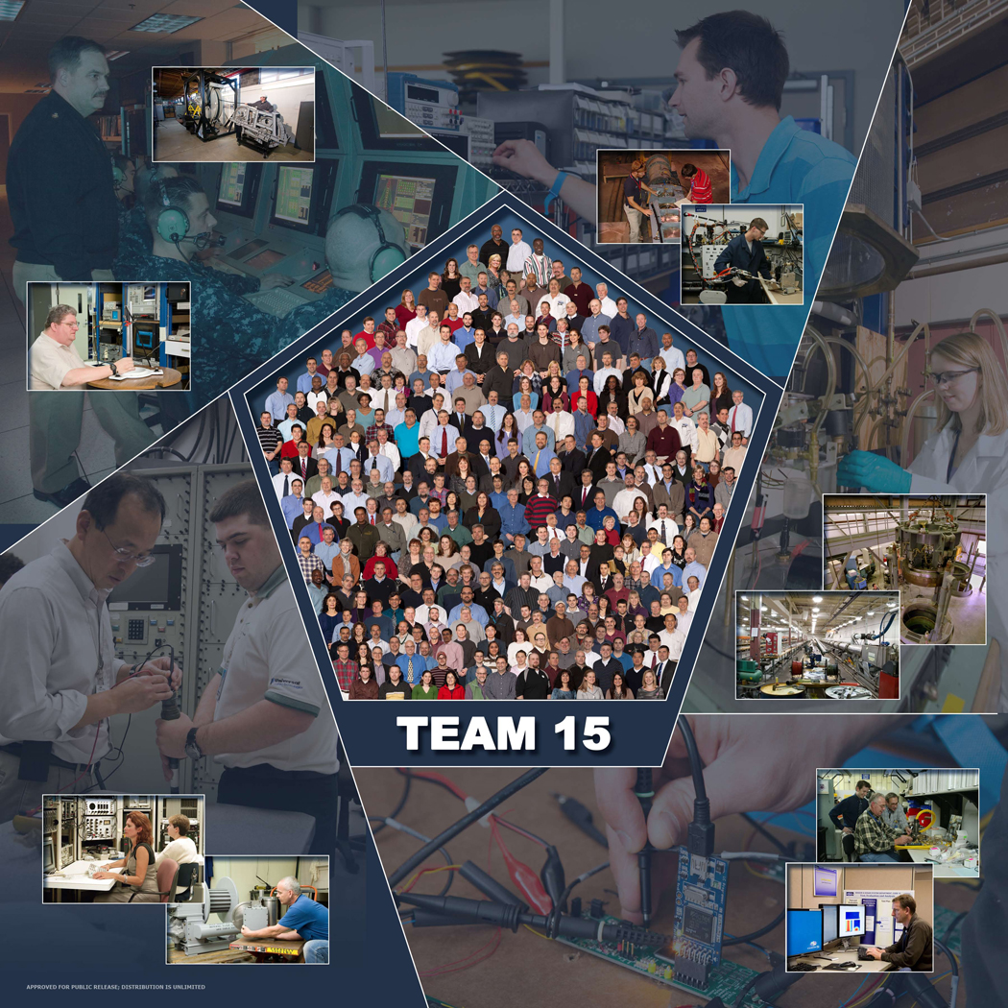
QUESTIONS ?
C15 TDAA
donald.p.young7.civ@us.navy.mil
(401) 832-7947
Working with Industry, Academia and Navy Labs to Deliver Solutions to the Warfighter Where and When They are Needed

