Slide 1

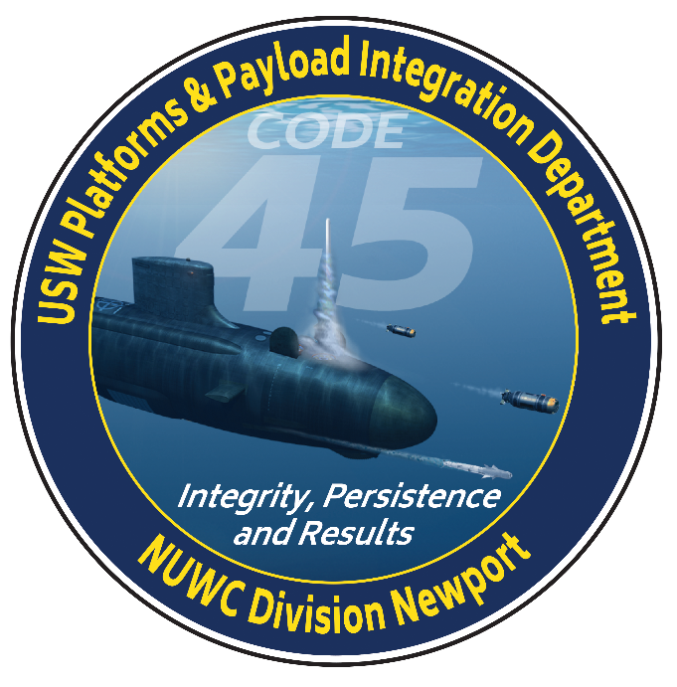
Code 45 – USW Platforms and Payload Integration Department: Industry Day 2024
16 October 2024
USW Platforms & Payload Integration Department
Naval Undersea Warfare Center Division Newport, RI
DISTRIBUTION STATEMENT A. Approved for public release. Distribution is unlimited

Slide 2
USW Platforms & Payload Integration Department - Code 45 Overview
Our Mission:
Exercise full-spectrum programmatic and technical excellence in tactical missile, payload integration and unmanned undersea system solutions to deliver and sustain USW superiority
Our Vision:
Exploit the Ocean Interface for USW Platform & Payload Superiority.
DISTRIBUTION STATEMENT A. Approved for public release. Distribution is unlimited

Slide 3
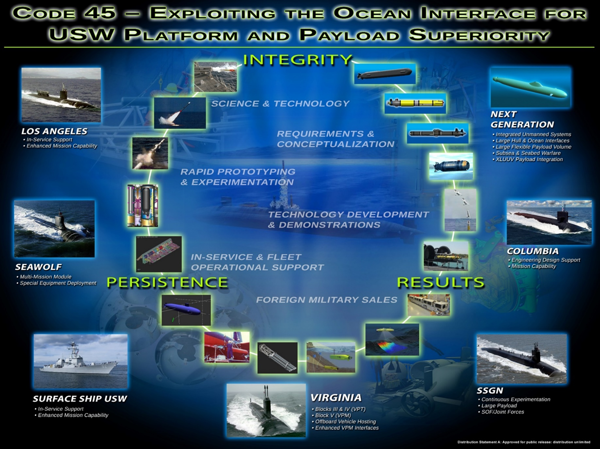
USW Platforms & Payload Integration Department - Code 45 Overview (cont’d)
CUI - Pending Public Release Approval
DISTRIBUTION STATEMENT A. Approved for public release. Distribution is unlimited

Slide 4
USW Platforms & Payload Integration Department - Code 45 Overview (cont’d)
USW PLATFORMS & PAYLOAD
INTEGRATION DEPT 45
DEPUTY DEPARTMENT HEAD 45B
DIRECTOR, USW UNMANNED SYSTEMS
AND AUTONOMOUS BEHAVIOR
BUSINESS OPERATIONS OFFICE 4501
PROGRAM MANAGEMENT OFFICE 459
DEPARTMENT CONTRACTS
MANAGER (DCM)
TECHNICAL DEPARTMENT
ACQUISITION ADVOCATE (TDAA)
ENGINEERING, SCIENCE AND
TECHNOLOGY OFFICE 45T
MISSILES AND PAYLOAD
INTEGRATION DIVISION
451
OCEAN INTERFACES
DIVISION
452
UNMANNED UNDERSEA
SYSTEMS DIVISION
453
DIGITAL ENGINEERING
DIVISION
454
SYSTEMS ENGINEERING
BRANCH 4511
VIRGINIA PAYLOAD TUBE AND
MODULE BRANCH 4521
UUS OPERATIONS
BRANCH 4531
APPLIED SCIENCES &
STRUCTURAL MECH BRANCH 4541
CAPSULES, SHAPES AND
SIMULATORS BRANCH 4512
PLATFORM CONCEPT
FORMULATION BRANCH 4522
UUS DEVELOPMENT AND
ACQUISITION BRANCH 4532
INFORMATION SYSTEMS & DATA
ANALYTICS BRANCH 4542
EMBEDDED SYSTEMS
BRANCH 4513
HORIZONTAL PLATFORM SYSTEMS
BRANCH 4523
UUS EXPERIMENTAL
PAYLOADS BRANCH 4533
SUBSEA WARFARE INTEGRATED
SYSTEMS BRANCH 4543
LOGISTICS AND FLEET
SUPPORT BRANCH 4514
EXTERNAL LAUNCHERS &
DEFENSIVE SYSTEMS BRANCH 4524
USW PLATFORM
INTEGRATION BRANCH 4534
ADVANCED CONCEPTS
BRANCH 4544
DISTRIBUTION STATEMENT A. Approved for public release. Distribution is unlimited

Slide 5
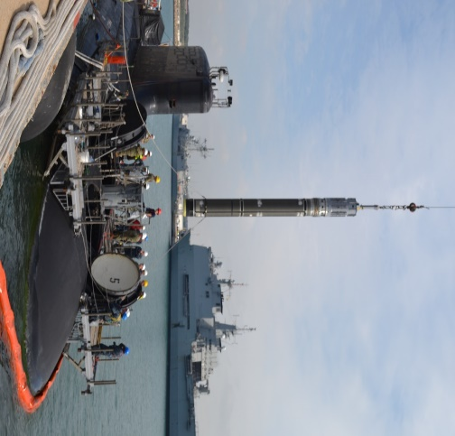
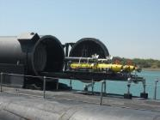
USW Platforms & Payload Integration Department - Code 45 Overview (cont’d)
Warfare Center Technical Capabilities
NP09 – USW Launcher Systems and Payload Integration
NP10 – Submarine Tactical Missile Integration
NP11 – USW Autonomous Vehicles
NP20 – Subsea and Seabed Systems
Customers: COMSUBFOR, PEO SSN, PEO UWS, PEO USC, PEO U&W, PEO IWS, SSP, NAVSEA 05, USSOCOM, DARPA, ONR, others…
DISTRIBUTION STATEMENT A. Approved for public release. Distribution is unlimited

Slide 6
C45 Demand Increase Summary
NP09 - USW Launcher Systems and Payload Integration
Growth across the customer base in support of multiple new TEMPALT efforts and increases in SSN(X) tasking, Virginia Payload Module analytical requirements, continued integration efforts of Undersea Dominance Payloads and Dry Deck Shelter (DDS)
NP10 – Submarine Tactical Missile Integration
Strategic System Programs All Up Round simulator efforts leveraging Tomahawk MK112
Foreign Military Sales efforts remain stable and Allied support growth anticipated due to AUKUS
NP11 - USW Autonomous Vehicles
Growth across the customer base for payload and sensor development and integration, Large Vehicle Integration, Full Spectrum Undersea Warfare Innovative Naval Prototype and Joint Undersea Surveillance and Targeting support, Autonomy integration and Digital Engineering Efforts, along with increasing requirements associated with C45's UUV Software Support Agent Role
NP20 - Subsea and Seabed Systems
Growth across the customer base for payload, sensor and platform development and integration
DISTRIBUTION STATEMENT A. Approved for public release. Distribution is unlimited

Slide 7
Contracts Overview
DISTRIBUTION STATEMENT A. Approved for public release. Distribution is unlimited

Slide 8
Contracts Overview (cont’d)
SEAPORT
  Lab Complex – Based upon current tasking C45 is currently extending by one year. LRAE will be updated accordingly.
NON-SEAPORT MULTI-AWARD
  DDS Payload Integration – Current ordering period has been extended thru Nov 2029. Rolling Admissions/On-Ramp is being considered for this MAC with a sources sought planned in FY25.
  SUBSAFE Hardware and Services – Epsilon Systems Solutions, Inc. and Delphinus Engineering, Inc. have been awarded contracts via on-ramp in Dec 2023. Current ordering period for this MAC is currently being extended thru Nov 2029.
  Rapid Prototype – No Planned follow-on at this time.
  UUV Family of Systems (FoS) – Follow-on is planned for award in Jul 2027. Assessment/rework of functional areas, open beyond UUV (Ie. Platform and Payload FoS MAC), and provisions for limited quantity prototypes for system validation/verification is currently underway.
DISTRIBUTION STATEMENT A. Approved for public release. Distribution is unlimited

Slide 9
C45 Laboratory Complex Engineering and
Technical Services
Summary of Contract Scope: 5 year Seaport order for engineering, technical, design, field services, and integrated logistics support services in for the C45 Laboratory Complex and related programs which require the use of the C45 Laboratory Complex. Support provided under this contract includes:
Operational, documentation, logistics and maintenance support for C45 Launcher Lab equipment, including upgrade and repair of components, as well as relocation, installation, and removal of laboratory support equipment.
Engineering and technical services for development of test plans and procedures, development and production of prototype, shipboard, and laboratory hardware, simulators and related equipment.
Configuration management of C45 missile, launcher and payload system documentation.
Remote field services for installation, removal, loading/unloading, repair and test and evaluation of those systems.
DISTRIBUTION STATEMENT A. Approved for public release. Distribution is unlimited

Slide 10
C45 Laboratory Complex Engineering and
Technical Services (cont’d)
Contracting Method: SeaPort
Anticipated Period of Performance: 5 year PoP
Acquisition Strategy: TBD; Sources Sought / Pre-Sol Conf planned
Level of Effort: 404,000 hrs / ~$30M with approximately ~36% ODCs
Anticipated work location: 75% on-site / 25% contractor site
Contract Type: Cost Plus Fixed Fee (CPFF) and Cost Reimbursement (Cost Only) provisions for ODC’s along with FFP for yearly HAZMAT tasking.
DISTRIBUTION STATEMENT A. Approved for public release. Distribution is unlimited

Slide 11
C45 Laboratory Complex Engineering and
Technical Services (cont’d)
Unique Characteristics
  Key Personnel requirements:
    Mechanical technicians may be required to maintain, repair, or otherwise handle equipment designated as SUBSAFE, SUBSAFE/MIC LEVEL I and LEVEL I material during the performance of tasking
    Personnel that are trained and qualified to the requirements of Craftsmen or Controlled Material Handlers (CMH) per the SUBSAFE/ Level I (SS/L1) requirements of NUWCDIVNPT SOP 8.
    Category II and III Crane Operator certification
    OSHA/HAZMAT certification
  Facility requirements: Secret.
Follow on ? Yes. SeaPort N0017819D8089/N6660420F3004 with McLaughlin Research Corporation
Does OCOI clause apply? Yes
Expected RFP release: FY25Q4
DISTRIBUTION STATEMENT A. Approved for public release. Distribution is unlimited

Slide 12
C45 SUBSAFE Hardware
and Services
Summary of Contract Scope: 5 year IDIQ MAC to support high criticality submarine safety (SUBSAFE) / LEVEL 1 (L1) engineering and technical services for systems engineering, technical analyses, mechanical and electrical design, manufacturing, installation, test and evaluation, and repair services of tasks which may include SUBSAFE/L1 components or assemblies.
This scope encompasses efforts for both SUBSAFE and non-SUBSAFE hardware and systems.
  SUBSAFE efforts will require NAVSEA Note 5000 certification.
  Non-SUBSAFE efforts will require skills and expertise integral to development and integration of submarine launcher and payload systems
DISTRIBUTION STATEMENT A. Approved for public release. Distribution is unlimited

Slide 13
C45 SUBSAFE Hardware
and Services (cont’d)
Contracting Method: IDIQ MAC
Anticipated Period of Performance: 5 year PoP
Acquisition Strategy: Unrestricted; Sources Sought / Pre-Sol Conf planned
Level of Effort: ~260,000 hrs / ~$60M total ceiling
Anticipated work location: 40% on-site / 60% contractor site
Contract Type: Cost Plus Fixed Fee (CPFF) and Firmed Fixed Price (FFP) provisions for hardware/supplies/material. CPFF services and Cost Reimbursement (Cost Only) provisions for ODC’s (Travel only).
DISTRIBUTION STATEMENT A. Approved for public release. Distribution is unlimited

Slide 14
C45 SUBSAFE Hardware
and Services (cont’d)
Unique Characteristics
  Qualifications:
    NAVSEA Note 5000 (SUBSAFE/L1 Only)
  Key Personnel requirements:
    Personnel that are trained and qualified to the requirements of Craftsmen or Controlled Material Handlers (CMH) per the SUBSAFE/ Level I (SS/L1) requirements of NUWCDIVNPT SOP 8.
    Additional key personnel may be requested covering designated areas of expertise; if requested, a resume will be necessary for each key person
  Facility requirements: Secret
Follow on ? Yes.
    N6660420DD001, 2, 3 with Electric Boat Corporation, Huntington Ingalls, Inc., and Oceaneering International, Inc.
    N6660424DD004 and 5 with Epsilon Systems Solutions, Inc. and Delphinus Engineering, Inc. via on-ramp
Does OCOI clause apply? Yes
Expected RFP release: FY29Q1
DISTRIBUTION STATEMENT A. Approved for public release. Distribution is unlimited

Slide 15
C45 DDS Payload Integration
Hardware and Services
Summary of Contract Scope: 5 year IDIQ MAC contract providing engineering and technical services supporting the development of Deep Submergence Systems Scope of Certification (DSS-SOC) UUV systems, as well as the Dry Deck Shelter (DDS) platform.
This will include DSS-SOC tasking such as equipment integration and/or fabrication, controlled material handling, equipment test/inspection/troubleshooting/grooming, installation/removal activities, and DSS-SOC storage.
This will also include Non-DSS-SOC tasking such as concept/design development, engineering and technical services for the performance of ship checks, Temporary Modifications, Field Changes, Carry on Hardware, and Major Altercations (TEMPMOD / FC / COH / TEMPALT / SHIPALT) development, receipt inspection, and development of life cycle support plans.
DISTRIBUTION STATEMENT A. Approved for public release. Distribution is unlimited

Slide 16
C45 DDS Payload Integration
Hardware and Services (cont’d)
Contracting Method: IDIQ MAC
Anticipated Period of Performance: 5 year PoP
Acquisition Strategy: Unrestricted; Sources Sought /Pre-Sol Conf planned
Level of Effort: 98,500 hrs / ~$49.5M total ceiling (labor and material) with approximately 12% ODC for travel
Anticipated work location: 30% on-site / 70% contractor site
Contract Type: Cost Plus Fixed Fee (CPFF) provisions for hardware/supplies/material. CPFF services and Cost Reimbursement (Cost Only) provisions for ODC’s (Travel only).
DISTRIBUTION STATEMENT A. Approved for public release. Distribution is unlimited

Slide 17
C45 DDS Payload Integration
Hardware and Services (cont’d)
Unique Characteristics
  Qualifications:
    NAVSEA Note 5000 (required for DSS-SOC tasking)
    CMMI Level 3 or equivalent
  Key Personnel requirements:
    A group of key personnel may be requested covering designated areas of expertise; if requested, a resume will be necessary for each key person.
  Facility requirements: Secret
  Software Development Plan: Yes
Follow on ? Yes.
    N6660419DL901, 2, 3 with American Systems Corporation, Oceaneering International, Inc., and Serco, Inc.
    N6660420DL904 with Systems Engineering Associates Corporation.
Does OCOI clause apply? Yes
Expected RFP release: FY28Q4
DISTRIBUTION STATEMENT A. Approved for public release. Distribution is unlimited

Slide 18
C45 UUV FoS – Current Contract
N66604-18-D-C8XX
Summary of Contract Scope: The scope of this contract covers systems and subsystems required to support the advancement of the UUV Family of Systems (FoS), including current UUV systems and subsystems as well as any future UUVs systems and subsystems.
Contracting Method: IDIQ MAC
Period of Performance: 5-year base with 4-year option (PoP End Date: 29 July 2027)
Current Awarded Values:
  Level of Effort: 1,518,273 Hours
  Number of awardees: 22 (awarded with 23 but due to merger now at 22)
  Dollar Value: $794,530,000
Current Execution Summary:
  Level of Effort Executed to date: 819,815 Hours
  Number of Orders to Date: 46*
  *Includes kick-off meeting and minimum guarantee
DISTRIBUTION STATEMENT A. Approved for public release. Distribution is unlimited

Slide 19
C45 UUV FoS – Current Contract
N66604-18-D-C8XX (cont’d)
VENDOR | CONTRACT | # of Orders*
Aerojet Rocketdyne | C801 | 0
SERCO | C802 | 2
AMERICAN Systems | C803 | 0
BAE Systems | C804 | 1
DRAPER | C806 | 2
DRS Naval Power Systems | C807 | 0
General Atomics | C808 | 1
General Dynamics | C809 | 1
Hamilton Sundstrand UTC Aerospace | C810 | 0
HII Fleet Support Group LLC | C811 | 2
HII Unmanned Systems | C812 | 0
L-3 Technologies | C814 | 0
Lockheed Martin | C815 | 3
MOOG | C816 | 0
Northrop Grumman | C817 | 2
Oceaneering | C818 | 1
Raytheon | C819 | 0
Rite Solutions | C820 | 2
SAIC | C822 | 0
SEA CORP | C823 | 1
Southwest Research Institute | C825 | 0
Teledyne Brown | C826 | 0
Woods Hole Oceanographic Institute | C828 | 5
Twelve (12) Functional Areas:
  1. Payloads
  2. Hull & Structure
  3. Propulsion
  4. Energy Storage/Conversion
  5. Electrical Power
  6. Vehicle Controller
  7. Software
  8. Non-Payload Sensors
  9. Vehicle Controller Systems
  10. Host Platform Elements
  11. Ashore Elements
  12. Internal Architecture
*Does not includes kick-off meeting / minimum guarantee
DISTRIBUTION STATEMENT A. Approved for public release. Distribution is unlimited

Slide 20
C45 Platform & Payload Family of Systems
Multi-Award Contact
Summary of Contract Scope: The scope of this contract covers systems and subsystems required to support the advancement of Platform and Payload Family of Systems (FoS), including current systems and subsystems as well as any future systems and subsystems. Functional areas are under review and provisions for limited quantity prototypes for system validation and verification are being included.
Contracting Method: IDIQ MAC
Anticipated Period of Performance: 5-year base with 4-year option
Acquisition Strategy: Unrestricted; Sources Sought / Pre-Sol Conf planned
Level of Effort: TBD
Anticipated work location: TBD
Contract Type: Cost Plus Fixed Fee (CPFF) Services & Supplies, Firmed Fixed Price (FFP) Supplies, Cost Reimbursement (CR) ODCs
Anticipated Sources Sought Release Date: FY25Q2
Anticipated RFP Release Date: FY26Q1
DISTRIBUTION STATEMENT A. Approved for public release. Distribution is unlimited

Slide 21
C45 Platform & Payload Family of Systems
Multi-Award Contact (cont’d)
Unique Characteristics
  TBD, Under review
Key Personnel Requirements: TBD
Security Requirements: Secret
Facility Requirements: TBD
Does OCOI clause apply? Yes
DISTRIBUTION STATEMENT A. Approved for public release. Distribution is unlimited

