Slide 1

Code 60: Industry Day 2024
October 2024
USW Mission Engineering & Analysis Department
Naval Undersea Warfare Center Division Newport, RI
DISTRIBUTION STATEMENT A. Approved for public release. Distribution is unlimited

Slide 2
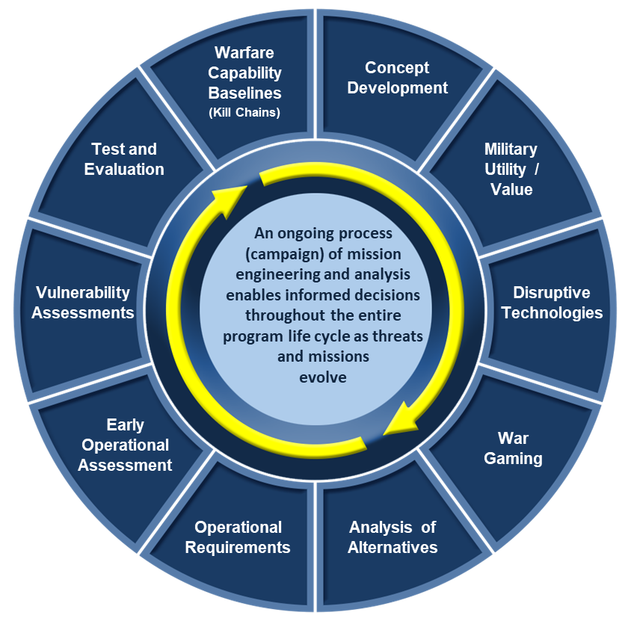
USW Mission Engineering & Analysis Department Code 60
Applying analytical principals to define and frame problem sets and offer solutions to stakeholders in the undersea warfare community
  Fleet support
  Acquisition support
  Technology assessments
Provide insight via comparative assessments, operations research, intelligence, wargaming and workshops, mission engineering, CONOPS development, and modeling and simulation.

Slide 3

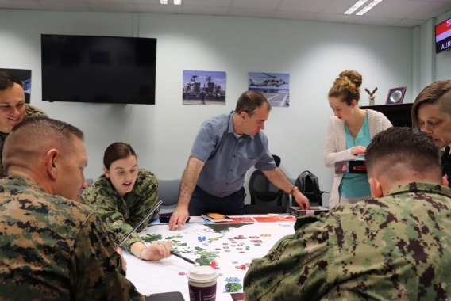
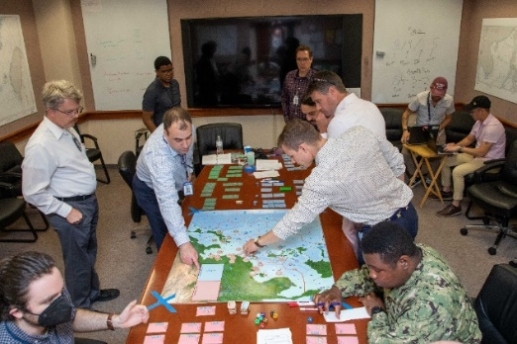
USW Mission Engineering & Analysis Department - Code 60
Our Mission: Our mission is to sustain and execute the requisite mission analysis, engineering, and intelligence functions that enable NUWCDIVNPT to be the nation’s government warfare center for Undersea Warfare.
Our Vision: Be the Navy’s fully trusted and first sought partner for Full Spectrum USW analysis products to achieve USW Maritime Dominance.
Warfare Center Technical Capabilities
NP14 – Undersea Warfare (USW) Analysis
Customers: PEO COLUMBIA, PEO VIRGINIA,
NAVSEA 05, ONR, SSP, NAO, NAVWAR, PMS351, PMS404, PMS515, and others.
54 Civilian Employees
92% Engineers and Scientists
40% Female, 60% Male
Average Age – 42 yrs.
DISTRIBUTION STATEMENT A. Approved for public release. Distribution is unlimited

Slide 4
USW Mission Engineering & Analysis Department - Code 60 Engineering and Technical Services
Summary of Contract Scope: C60 department wide contract for wargaming workshop support and warfare analysis for a variety of sponsors on submarine platforms, weapon systems, and undersea vehicles. These analyses examine the performance of current versions of these systems as well as potential future improvements to the systems, within the context of contemporary undersea warfare challenges.
Contracting Method: SAP and Contract Support from Technical Departments
Anticipated Period of Performance: =<1 year PoP
Acquisition Strategy: TBD
Level of Effort: ~250 hrs / ~$400K with approximately 5% ODCs
Anticipated work location: 100% on-site
DISTRIBUTION STATEMENT A. Approved for public release. Distribution is unlimited

