Slide 1
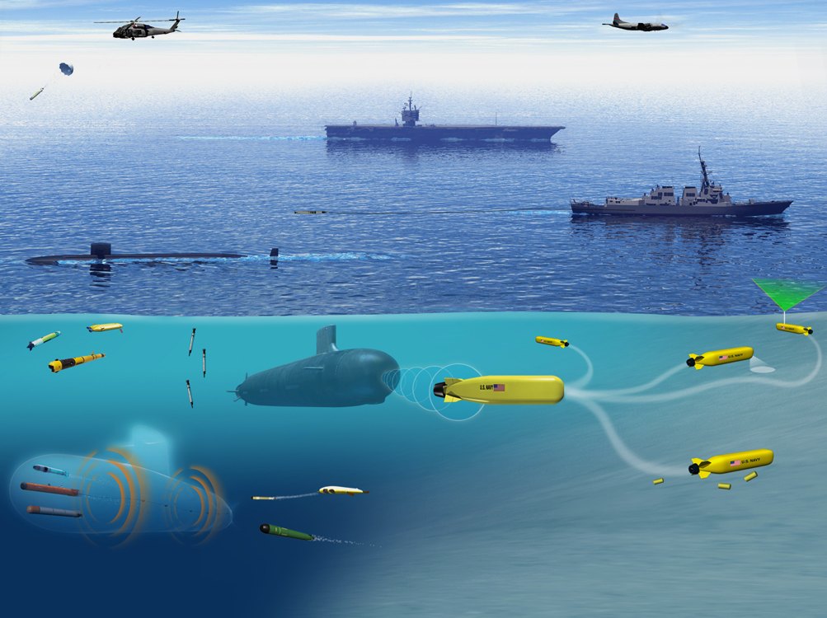
Undersea Warfare Weapons,
Vehicles, and Defensive Systems Department
Code 85 Department Head
&
Technical Dept. Acquisition Advocate
Presenting to:
NCMA RI Chapter Industry Day 2024
DISTRIBUTION STATEMENT A: Approved for Public Release; distribution is Unlimited

Slide 2
Presentation Outline
Department Leadership Overview
Mission & Vision
Products
Organization / Department Resources
Customers & Funding Projections
Leadership Thoughts & Outlook
Code 85 Projected Contract Details
Contracts Details
Questions
Department Leadership Overview
Mission & Vision
Products
Organization / Department Resources
Customers & Funding Projections
Leadership Thoughts & Outlook
Code 85 Projected Contract Details
Contracts Details
Questions
DISTRIBUTION STATEMENT A: Approved for Public Release; distribution is Unlimited

Slide 3
Department Mission & Vision
Mission
“Provide integrated full spectrum undersea Weapon, Autonomous, and Defensive System solutions to the warfighter through technical expertise, cooperative innovation, engineering, and life cycle stewardship.”
Vision
“Undersea Dominance through superior Autonomous and Defensive Systems”
Philosophy
“Operate with Excellence; Commit to Success”
Mission
“Provide integrated full spectrum undersea Weapon, Autonomous, and Defensive System solutions to the warfighter through technical expertise, cooperative innovation, engineering, and life cycle stewardship.”
Vision
“Undersea Dominance through superior Autonomous and Defensive Systems”
Philosophy
“Operate with Excellence; Commit to Success”
DISTRIBUTION STATEMENT A: Approved for Public Release; distribution is Unlimited

Slide 4
Products
Science and Technology for:
Torpedoes / Targets
Autonomous Undersea Vehicles (AUVs)
Countermeasures/Counterweapons
System Development, Integration & Test
AUVs
Mobile ASW Targets and Torpedoes
Undersea Defensive Systems
T&E, Assessments, and M&S
Acquisition, Fleet Support, & In-Service Engineering
HW and LW Torpedoes
Mobile ASW Targets
Undersea Defensive Systems
Science and Technology for:
Torpedoes / Targets
Autonomous Undersea Vehicles (AUVs)
Countermeasures/Counterweapons
System Development, Integration & Test
AUVs
Mobile ASW Targets and Torpedoes
Undersea Defensive Systems
T&E, Assessments, and M&S
Acquisition, Fleet Support, & In-Service Engineering
HW and LW Torpedoes
Mobile ASW Targets
Undersea Defensive Systems
DISTRIBUTION STATEMENT A: Approved for Public Release; distribution is Unlimited

Slide 5
Organization
DISTRIBUTION STATEMENT A: Approved for Public Release; distribution is Unlimited

Slide 6
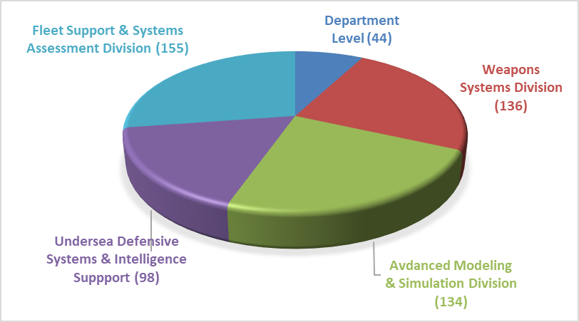
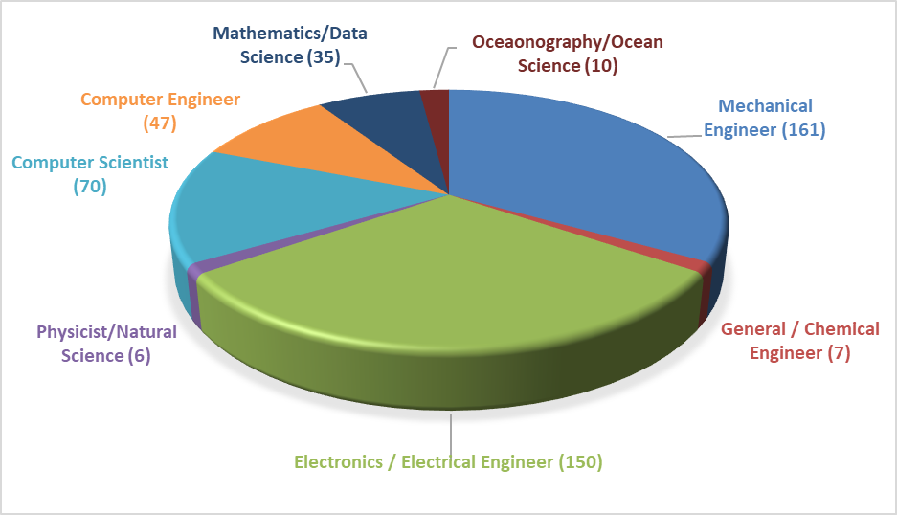
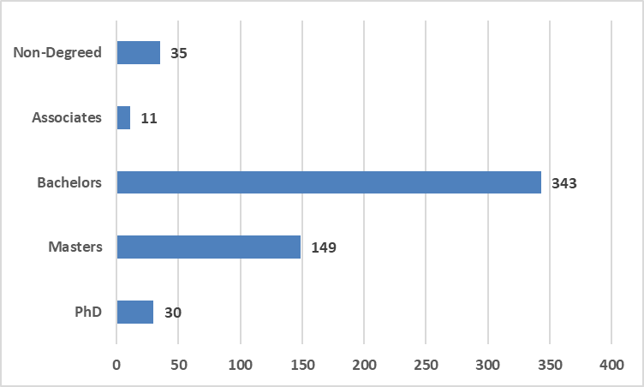
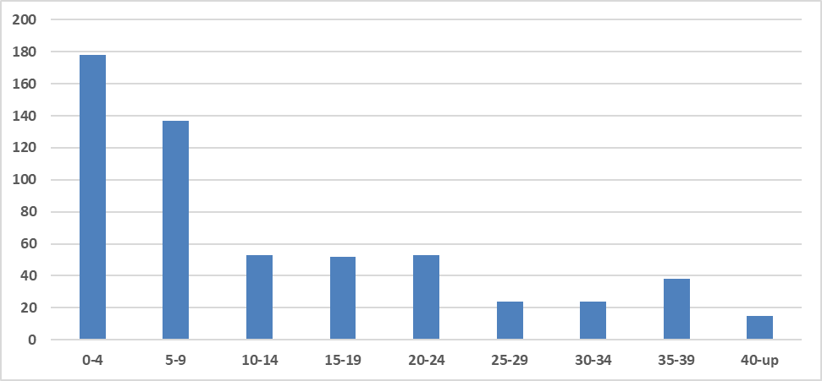
Resources
Code 85 On Board Count - 567
Code 85 Overview
Engineers & Scientists (485)
Code 85 Education
Code 85 Experience
Number of Employees
Years of Experience
Continuously Managing The Balance of People, Training, Knowledge, and Right Work
DISTRIBUTION STATEMENT A: Approved for Public Release; distribution is Unlimited

Slide 7
Customers
PMS 404, 406, 415, NELO
International Sales
PMS 404, 415, NELO,
International Sales, Fleet
DARPA, SCO, ONR, Internal Investment, ILIR/IAR,
NELO, & Private Partnerships
PMS 404, 406, 415, 495,
NELO, ONI, RDSA,
International Sales
Biometrics
Advanced Propulsion
Non-Acoustic Technologies
Supercavitation Technologies
Advanced Sensor Technologies
Next Generation CM/CCM
G&C Technology
Vehicle Array technologies
Propulsion, Silencing & Hydrodynamics
Broad band
Fiber Optics
Stealth
Tactical oceanography
Next Gen M&S/Live Virtual Constructive
New targets and decoys
AN-SLQ-25E
Torpedo Modular Upgrade Program (TI/APB).
Next Generation CM (ADC MK5)
Vehicle Array Technologies
Advanced Navigation
Advanced Autonomy
System Requirements/Specs
Non-Acoustic Technology
Tactical Software Development
System Integration / T&E
Performance M&S
Test Equipment
Technical Direction Agent (HWT/LWT and CMs)
AN-SLQ-25
MK30 Mod 1/2
Technology Refresh Engineering
Signal Analysis System
HWT/LWT Sonar Tech Insertion
ADC CMs
MK 39 EMATT
Systems integration
Production Engineering Support
System Evaluation and Acceptance Testing Support
Fleet Introduction Planning
Test Equipment
AN/SLQ-25
Countermeasures ADC 2/3/4
Signal Analysis System
MK30 Mod 1/2
MK 39 EMATT
Weapon performance assessment
Fleet T&E support
Fleet Failure Analysis / CA
Reliability Management
SCC training
SW Downloads
Fleet Procedures
IMA Certifications
ORDALT Development
Test Equipment
In Service Engineering Agent for HWT and CMs)
TOTAL: 27%
TOTAL: 29%
TOTAL: 28%
TOTAL: 16%
DISTRIBUTION STATEMENT A: Approved for Public Release; distribution is Unlimited

Slide 8
FY25 Funding Projections
PEO-UWS (PMS404, PMS415)
PEO-USC (PMS495, PMS515)
Total LRE for FY25 estimated at $300-305M
DISTRIBUTION STATEMENT A: Approved for Public Release; distribution is Unlimited

Slide 9
Code 85 Perspective
Priorities
Capabilities that impact the Davidson Window with appropriate scale
Capability within a near term horizon (next 5-7)
Next Generation Systems and Scalable effects
Challenge
Deliver capability quickly within a resource constraint environment
What we need from Industry
Reliably build/manufacture what you are contracted to deliver
Manage/challenge the supply chain/suppliers
Government willing to share risk
Put together the RIGHT team
Self reliance within the contractor team
Flexibility -- Surge
DISTRIBUTION STATEMENT A: Approved for Public Release; distribution is Unlimited

Slide 10
Code 85 Projected Contract Details

Slide 11
Competitive Acquisition Forecast
Presented by
C/85 Technical Department Acquisition Advocate
Major Contracts
Contract | Type | Scope | PoP w/ options | Projected RFP
PTF Services | SeaPort | $200-250M | Five years | FY25 Q1
Surface Ship Torpedo Defense Services | SeaPort | $45-50M | Five years | FY25 Q1
UW/UD Family of Systems MAC | MAC IDIQ | ≥$250M | ≥Five years | FY25 Q4
DISTRIBUTION STATEMENT A: Approved for Public Release; distribution is Unlimited

Slide 12
Propulsion Test Facility (PTF) Services
Summary of Contract Scope: Operate and maintain the PTF Complex and provide engineering and technical services for $200–250M
Contracting Method: SeaPort Task Order
Anticipated Period of Performance: 5 years (1 base year and 4 option years)
Acquisition Strategy: Full and open competition
Level of Effort: 959,400 hours
Anticipated work location: 90% on-site/10% contractor site requirement
Contract Type: CPFF
Follow on? Yes, N66604-20-F-3003, awarded to SAIC
Does OCOI clause apply? No
Expected RFP release: FY25 Q1
Held an Industry Day at the PTF at the end of AUG
Significant increase in scope from current contract as demand for PTF services has sharply increased over the past four years
DISTRIBUTION STATEMENT A: Approved for Public Release; distribution is Unlimited

Slide 13
Surface Ship Torpedo Defense Services
Summary of Contract Scope: The new task order will support the continued development, system engineering, hardware and software design and fabrication, ship integration, test and data analysis, and cybersecurity for torpedo defense systems (Nixie and Torpedo Warning System), acoustic device countermeasures, and emergent technologies for around $45–50M
Contracting Method: SeaPort Task Order
Anticipated Period of Performance: 5 years (1 base year and 4 option years)
Acquisition Strategy: Full and open competition
Level of Effort: 227,266 hours
Anticipated work location: 98% on-site/2% contractor site requirement
Contract Type: CPFF
Follow on? Yes, N00178-04-D-4119/N66604-18-F-3013, awarded to SAIC
Does OCOI clause apply? No
Expected RFP release: FY25 Q1
Summary of Contract Scope: The new task order will support the continued development, system engineering, hardware and software design and fabrication, ship integration, test and data analysis, and cybersecurity for torpedo defense systems (Nixie and Torpedo Warning System), acoustic device countermeasures, and emergent technologies for around $45–50M
Contracting Method: SeaPort Task Order
Anticipated Period of Performance: 5 years (1 base year and 4 option years)
Acquisition Strategy: Full and open competition
Level of Effort: 227,266 hours
Anticipated work location: 98% on-site/2% contractor site requirement
Contract Type: CPFF
Follow on? Yes, N00178-04-D-4119/N66604-18-F-3013, awarded to SAIC
Does OCOI clause apply? No
Expected RFP release: FY25 Q1
DISTRIBUTION STATEMENT A: Approved for Public Release; distribution is Unlimited

Slide 14
Competitive Acquisition Forecast (2)
UTIC OTA Contracts and Family of Systems MAC Orders
Contract | Type | Scope | PoP w/ options | Projected RFP
MK 48 MOD 9 | UTIC OTA | $140-160M | Five years | FY25 Q2
ADC MK6 Defiant | UTIC OTA | $20-30M | Five Years | FY25 Q1
Otto Fuel 2 Test Bed Engine | UTIC OTA | $900-950K | Five Years | FY25 Q2
Tuning Box Test manufacture & install | FoS MAC (Ancillary & Test Equipment) | $500K | TBD | FY25 Q2
Warhead Add-On Sensor Warhead Electronic System Test Set (WWTS) | FoS MAC (Ancillary & Test Equipment) | $2-4M | TBD | TBD
Pursuing a Follow-On MAC: Longer Period of Performance / Higher Ceiling
DISTRIBUTION STATEMENT A: Approved for Public Release; distribution is Unlimited

Slide 15
Questions?

