Slide 1
NUWC Division Newport
Corporate Operation
16 October 2024
Corporate Operations, Code 10
NAVAL UNDERSEA WARFARE CENTER DIVISION, NEWPORT RI
Distribution Statement A: Approved for Public Release; Distribution is Unlimited
Notes:
Welcome to my second Corporate Operations all hands meeting.

Slide 2
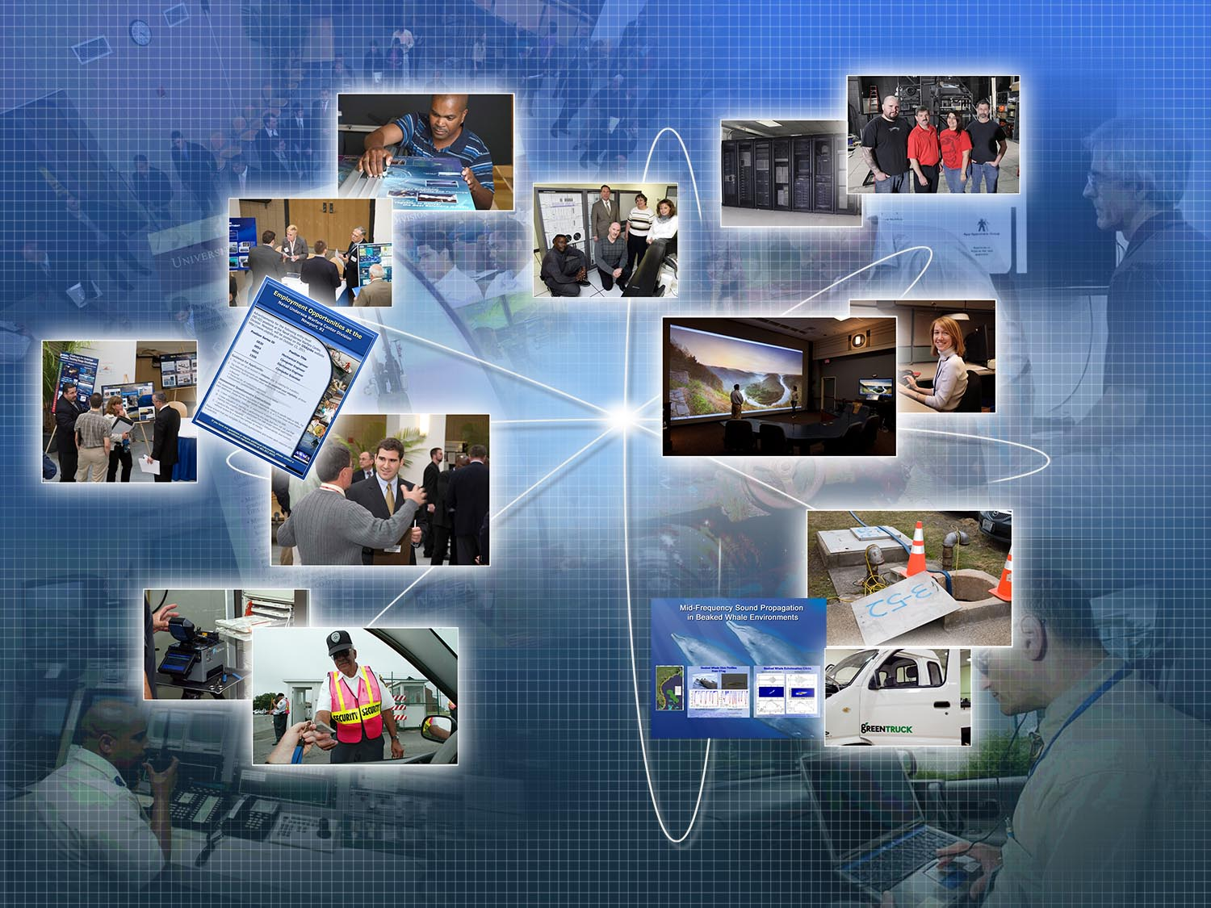



Department at a Glance-
Cyber Security
Information Technology Systems
  Development & Engineering
  Client Support Services
  Scientific Data Systems Administration and Hosting
  Advanced Scientific and Engineering Computation (ASECC)
  IA Remediation, Sustainment, & Compliance
  Cyber Security Workforce (CSWF)
Security
  Policy and Programs
  Emergency Management
  Special Programs
Corporate Business Office
  Planning and Policy
  Records Management
  Continuous Process Improvement
  Management Internal Control (MIC)
  Navy ERP Role Management
Property Management
  Purchase Requisition Creation and Support
  Supply
  General Equipment
A Diverse Organization
300 government employees 276 contractors
Divisions: 7
Branches: 24
Government Employees: 300
On-site Contractors: 276
Human Resources
Internal Customers: Product lines
External Customers: USFF, BOEM, USGC, NAVSEA, OPNAV, CPF
Data Analytics
Business Office Support Staff
  Financial Management
  Contract Management Support
Human Resources
  Planning, Policy, and Analysis
  Internship and Outreach
  Employee Relations
  Staffing and Classification
  Workforce Development
Physical Operations & Support
  Facilities Project Management
  Utilities
  Environmental Management
  Safety
Public and Congressional Affairs
  Tech Pubs, Public Affairs
  Media Arts/Graphics
  Technical Library
  Classified Inventory
Property Management
Corporate Research and Information Center
Distribution Statement A: Approved for Public Release; Distribution is Unlimited
2
Notes:
Degrees
Demographics by skill, age, etc…

Slide 3
Our People
2024 Department Profile
We are a diverse organization consisting of an experienced workforce with a variety of disciplines consisting of 300 government employees and 276 on-site contractors.
OUR WORKFORCE
OUR EXPERIENCE
211
9
80
81
Admin/Tech
Clerical
S&E
Advanced Degrees
  A solid foundation enabling the Command to achieve excellence in its technical capabilities and ability to achieve the mission
Distribution Statement A: Approved for Public Release; Distribution is Unlimited
3
Notes:
Degrees
Demographics by skill, age, etc…

Slide 4
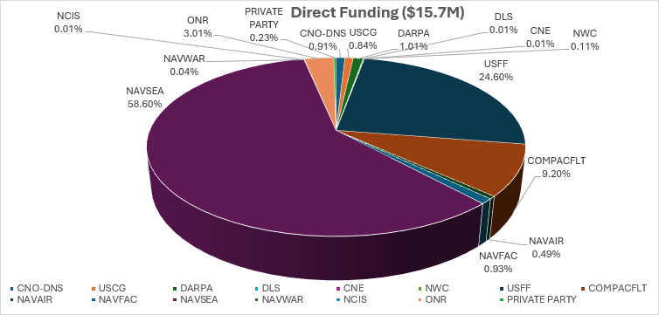
Funds Profile
FY24 funds profile consists primarily of G&A, Service Cost Center (SCC) with Direct program funding.
37% of Corporate Operations funding in FY25 are contract supported.
  Corporate Operations manages $210M in funds for Division Newport
Distribution Statement A: Approved for Public Release; Distribution is Unlimited
4

Slide 5
Examples of CTR Supported Projects
  Library Research Services
  Facilities/Infrastructure Design and Maintenance
  Minor construction (MINCON) projects in support of laboratory sustainment, restoration and modernization
  Property Management and Purchasing
  Warehousing, Supply, General Equipment
  Support Services
  Cybersecurity, Safety, Security, Chief Information Officer (CIO), Records Management, HAZMAT, Human Resources
  Information Technology
  Development & Engineering
  NMCI Client Support Services
  Scientific Data Systems Administration and Hosting
  Advanced Scientific and
  Engineering Computation (ASECC)
  IA Remediation, Sustainment, & Compliance
  Cloud Migration
Environmental Planning, Energy and Environmental Readiness
  Environmental planning services; development of compliance strategies for at-sea and ashore activities; development of biological effects analyses, mitigation plans, and implementation; monitoring programs; at-sea support; Geographic Information Systems mapping.
Distribution Statement A: Approved for Public Release; Distribution is Unlimited
5

Slide 6
Projected Contract Funding
Corporate Operations contracting is predominately supporting services and maintenance.
  FY25 Projected Service/Maintenance Contracts - $36.5M
  FY25 Projected Material/Equipment Contracts - $4.0M
276 WYs Projected for FY25
Public and Congressional Affairs
  Technical Library
  Classified Inventory
Information Technology Systems
  CSWF
Security
  Special Security
Property Management
  Workflow/Process Automation
Areas of anticipated contract growth
Distribution Statement A: Approved for Public Release; Distribution is Unlimited
6
Notes:
Projected $22.8M (FY12/13)

Slide 7

Projected Contracts (FY25-26)
Code 10 – IT/NMCI/Network Support
Summary of Contract Scope: IT Support, NMCI Support, Network Management, Phones
Contracting Method: Seaport
Anticipated Period of Performance: 03 March 2026 – 31 March 2031
Acquisition Strategy: TBD
Level of Effort: 38 FTE, est.72,000 hours
Anticipated work location: Govt Site - 55%, Alternate Site - 45%
Contract Type: CPFF/FFP
Unique Characteristics:
  Facility requirements - Secret
  Key Personnel requirements
  Secret security clearance required
Follow on: 22 – Rite Solutions
  N00178-04-D-8424/ N66604-21-F-3003
Does OCOI clause apply: Yes
Expected RFP release: Q2/FY25
Distribution Statement A: Approved for Public Release; Distribution is Unlimited
7

Slide 8
Projected Contracts (FY25-26)
Code 10 – Business Support Services
Summary of Contract Scope: Administrative, Business and Technical Services including data gathering and analysis; technical writing, graphics materials; data entry
Contracting Method: Seaport
Anticipated Period of Performance: 1 Oct 2027 – 30 Sept 2032
Acquisition Strategy: TBD
Level of Effort: 36 FTE, est. 73,000 hours
Anticipated work location: Govt. site – 60%, Alternate Site – 40%
Contract Type: CPFF
Unique Characteristics:
  Key Personnel requirements
  Secret security clearance required
Follow on: Yes - INDUS Technology Inc.
  N66604-22-F-3015
Does OCOI clause apply: Yes
Expected RFP release: Q2/FY26
Distribution Statement A: Approved for Public Release; Distribution is Unlimited
8

Slide 9
Projected Contracts (FY25-26)
Code 10 – Security Monitoring Center
Summary of Contract Scope: Security Monitoring Center’s security system monitoring, recording, reporting and compliance checks
Contracting Method: SAP
Anticipated Period of Performance: 01 July 2025 – 30 June 2030
Acquisition Strategy: Small Business Set Aside
Level of Effort: 9 FTE, 24/7/365 days a year support
Anticipated work location: Govt. Site –100%, Alternate Site - 0%
Contract Type: FFP
Unique Characteristics
  Secret Security Clearance required
  Key Personnel
  Vehicle Operations
Follow on: Yes – Shiloh Services Inc.
  N66604-20-P-0127
Does OCOI clause apply: Yes
Expected RFP release: Q2/FY25
Distribution Statement A: Approved for Public Release; Distribution is Unlimited
9

Slide 10
Projected Contracts (FY25-26)
Code 10 – LENEL Intrusion Detection System
Summary of Contract Scope: Provide Lenel certified technicians for NUWCDIVNPT and Detachments. Provide Lenel Installation, Maintenance and repair, After-Hours Emergency services
Contracting Method: SAP
Anticipated Period of Performance: 1 Oct 2026 – 30 Sept 2031
Acquisition Strategy: TBD
Level of Effort: 2 FTE, Hours - TBD
Anticipated work location: Govt. site - 50%, Alternate Site – 50%
Contract Type: CPFF & FFP
Unique Characteristics:
  Key personnel requirements
  Lenel certified technicians
  Travel or coordination for services at detachments
  Secret security clearance requirement
Follow on: Yes – Trofholz Technology Inc.
  N66604-21-D-R100
Does OCOI clause apply: Yes
Expected RFP release: Q4/FY25
Distribution Statement A: Approved for Public Release; Distribution is Unlimited
10

Slide 11
Projected Contracts - Construction
Projected Contracts (FY25-26)
Authority granted to execute architectural and engineering, planning, and construction projects locally:
FY24: Awarded 21 critical infrastructure projects (~$33.4M inclusive of SAPs):
  19 Sustainment, Restoration, and Modernization (SRM) and facility services (~$1.9M)
  3 Critical equipment installation
  3 SRM project awarded over Simplified Acquisition Threshold (SAT) (~$1.6M)
  5 year MACC contract award for $30M
FY25: Anticipate 27 critical infrastructure projects (~$23.6M inclusive of SAPs):
  17 Sustainment, Restoration, and Modernization (SRM) and facility services (~$1.8M)
  5 Critical equipment installation
  9 SRM projects to be submitted over Simplified Acquisition Threshold (SAT) (~$21.8M)
6 Projects Awarded in 2024 over SAT
        B1302 Second Floor Renovation
        B13 Buoy Upgrade
        MACC for Construction
        B1258 Replace 5 AHUS
        B104 Data Resiliency Upgrades
        B1319 Corridor Renovation
Distribution Statement A: Approved for Public Release; Distribution is Unlimited
11

Slide 12
Corporate Operations
Thank You
Questions?
Functional Mailbox
NUWC_NPT_Code10_info@navy.mil
12
Distribution Statement A: Approved for Public Release; Distribution is Unlimited

