Slide 1
Code 25 Industry Day Brief
16 October 2024
DISTRIBUTION STATEMENT A. Approved for public release.

Slide 2
USW Combat Systems Department
USW Combat Systems
Department Head
25
Director of
Cybersecurity USW
25X
Program Management
Office
259
Deputy Department Head
25B
Chief Engineer
259
Technology and Strategy
25T
Business Operations Office
2501
Chief Architect
259
Combat Systems Acquisition
Division
251
Platform Acquisition
Division
252
Product Development
Division
253
Interoperability & Networks
Division
254
Cybersecurity
Division
255
Combat Systems Requirements
and Analysis
2511
Combat Systems Requirements
and Analysis
2511
VIRGINIA Class Platform
Engineering
2521
Combat Systems Trainers
2531
Network Development Branch
2541
Security Engineering
2551
Combat Systems Engineering
2512
Combat Systems Engineering
2512
SSBN and In-Service Platform
Engineering
2522
Trainer Technology Development
2532
Network Installation and
Support
2542
Tactical Systems
2552
Combat Systems Integration
and Test
2513
Combat Systems Integration
and Test
2513
Platform Systems Engineering
and Evaluation
2523
Information Management Systems
2533
USW Command and Control
2543
Cybersecurity Test
and Evaluation
2553
Deployed Systems
2514
Deployed Systems
2514
Waterfront Onsite Branch
2524
USW Technology Development
2534
Security Management
and Monitoring
2554
Combat Systems Future
Capabilities
2515
Combat Systems Future
Capabilities
2515
MILDET
251M
MILDET
251M
DISTRIBUTION STATEMENT A. Approved for public release.

Slide 3
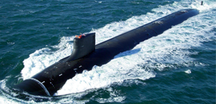
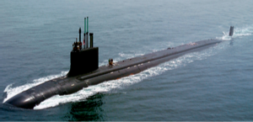
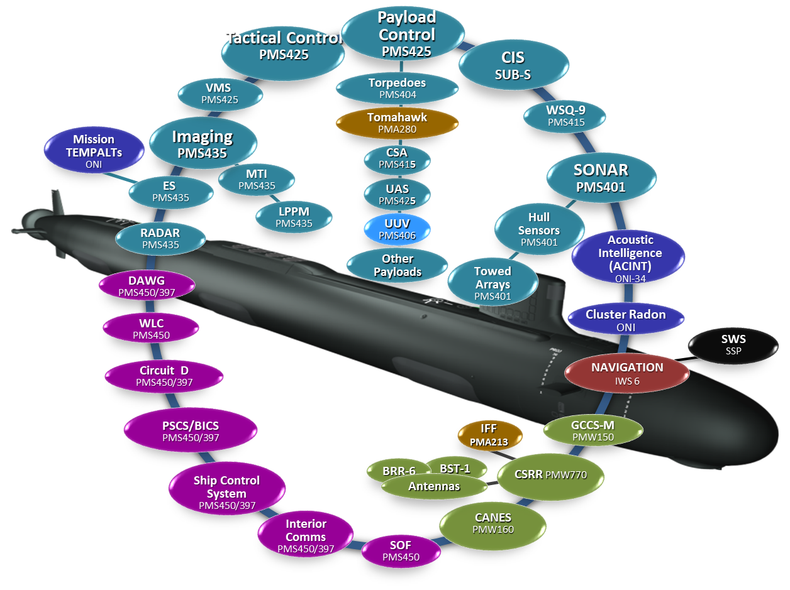
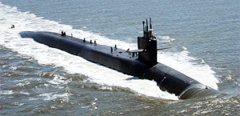
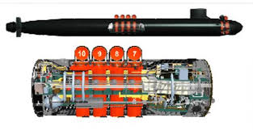
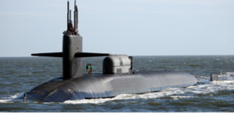
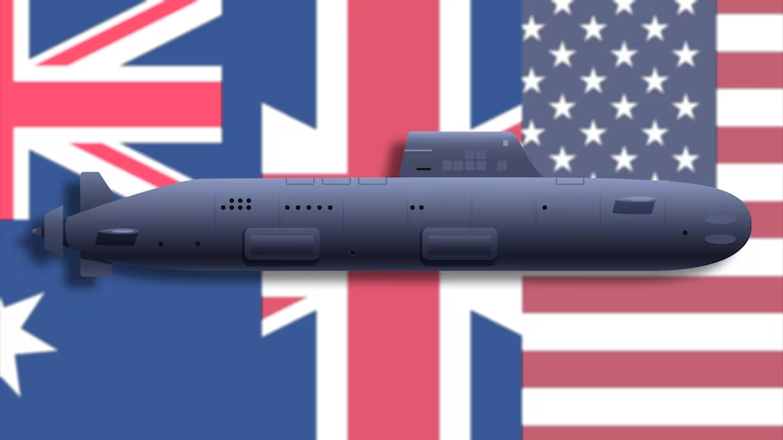
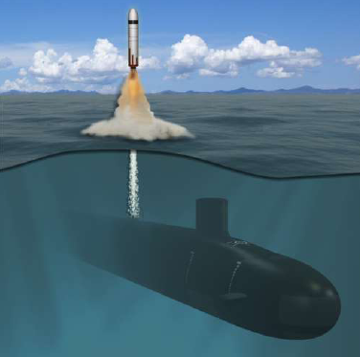
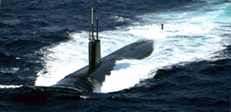
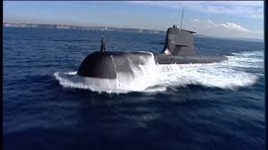
System of Systems (SoS) Engineering Expertise
SSN 688i
SSN 774 (Virginia)
SSN 688i (Los Angeles)
SSN 784-801 (Virginia Block III/IV)
SSBN 730 (Ohio)
SSN 802 (Virginia Block V)
SSN(X)
SSGN 726 (Ohio)
PEO SUB
PEO IWS
PEO C4I
ONI
SSN-AUKUS
PEO SUB (PMS 450)
NAVAIR
PEO LCS
COLUMBIA
SSN 21 (Seawolf)
Collins
Executing Technical Authority Across Programs, Platforms, and System of Systems
DISTRIBUTION STATEMENT A. Approved for public release.

Slide 4
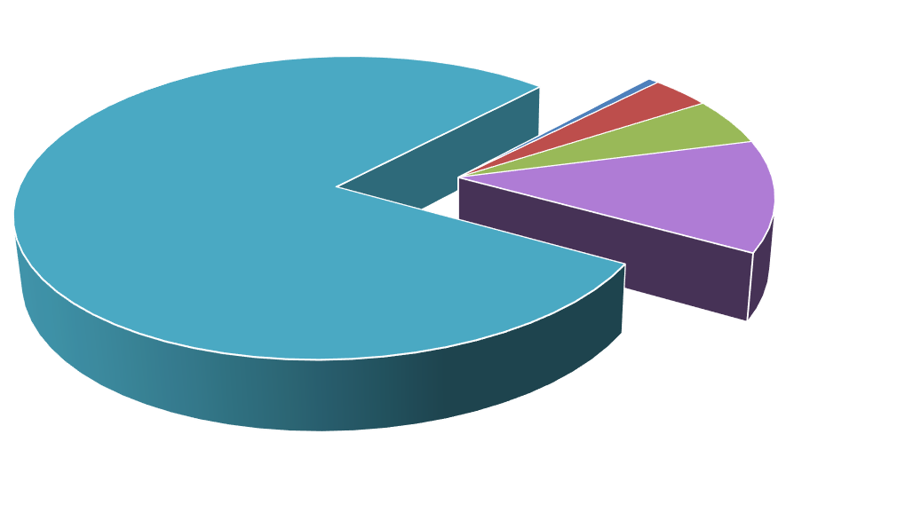
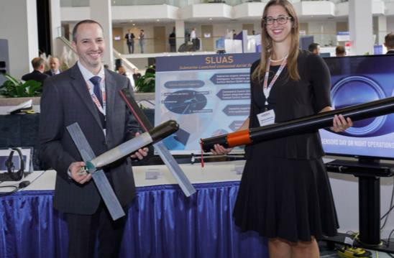
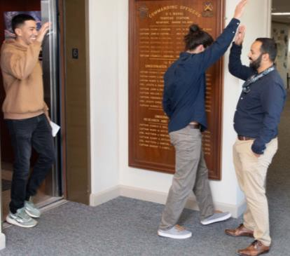
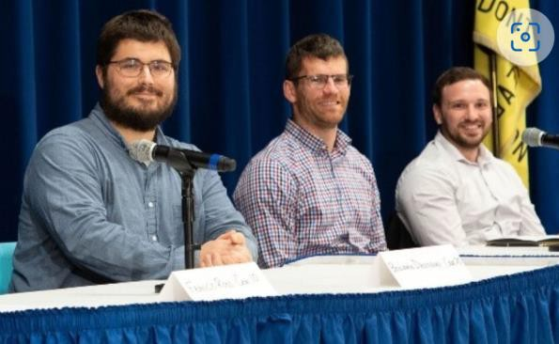
Our People – Skilled Workforce
Development Opportunities
Academic Degree Program: 20
Naval Postgraduate School: 5
Fellowship: 1 (FY23)
New Professional 219 Projects: 9
DATA, 0.20%
STUDENT
ADMIN SPCL 3%
S & E TECH 5%
1%
MECH, 12.78%
COMP, 13.59%
ELE, 30.83%
CS, 37.73%
Education Profile
PHYS, 1.22%
S & E 79%
INFOSEC 12%
MTH, 3.85%
DISTRIBUTION STATEMENT A. Approved for public release.

Slide 5
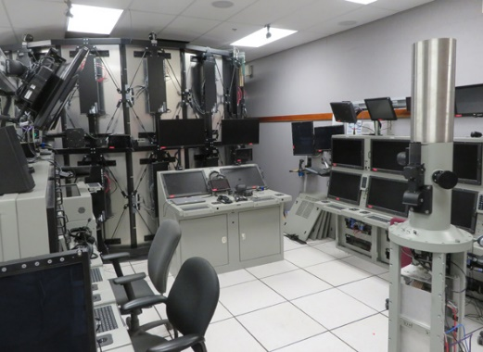
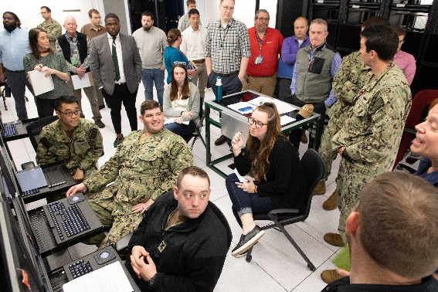
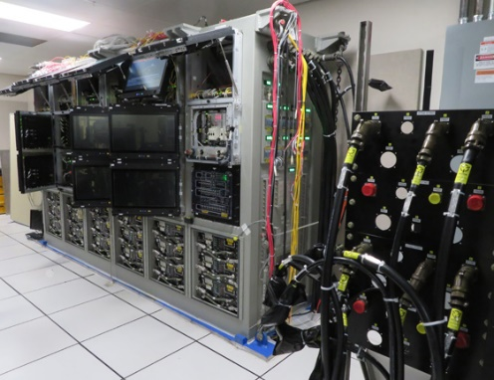
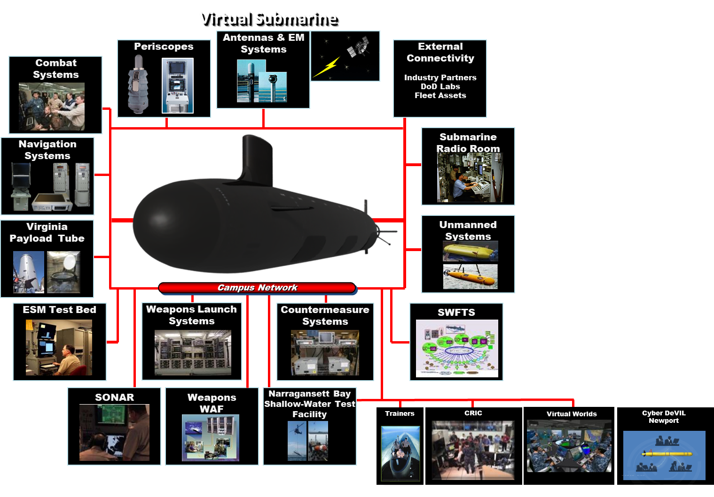
World-Class Laboratories
Powerful technical resource enabling prototyping, experimentation, development, integration and test, training, assessment, & certification
Complement to workforce expertise
Product lifecycle support for over 20 projects
External linkages via Wide Area Integration Facility (WAIF) to facilitate industry partnerships and promote efficient development and integration of new capabilities
Core component of Virtual Submarine – Campus-wide connectivity of Division Newport facilities
DISTRIBUTION STATEMENT A. Approved for public release.

Slide 6
USW Combat Systems Programs
Our Value
Bridge to the Fleet
Diverse Set of Customers Across SYSCOMs, ONR and the Fleet
SSN(X) Concept Definition/Exploration
Naval Tactical Cloud
UxS Common Control System
ONR Decision Superiority
ONR Integrated Naval Prototypes
Human Factors Engineering
Cyber Security (Zero Trust and Multi Level Security)
Combat Systems Hardware/Software/Network Architectures
Combat System Arrangements
Virginia Block VI/VII, SSN(X) and SSN AUKUS
Combat Systems Virtualization
SWFTS Re-architecture
Live/Virtual/Constructive (LVC)
Third Party Targeting and Cueing (3PT/C)
Unmanned Aerial Systems Family of Vehicles (Small/Medium)
Undersea Dominance Payload Prototyping
AN/BYG-1 CI/CID Pipeline
Cyber Security Systems Engineering
VA MOD SSW (Mission Electronic Systems)
Undersea Constellation
AN/BYG-1
TTWCS
Conventional Prompt Strike (CPS)
Virginia
Columbia/Ohio
Trainers (SMMTT, SBT)
SWFTS
Submarine CANES
USW Strike
International Programs
Cybersecurity
USW DSS
Project Overmatch
SSN AUKUS
Submarine Combat Systems ISEA
Ohio/Seawolf ISEA
Tomahawk Logistics and Fleet Support
SSGN Attack Weapon Control System
Operational Documentation
Trainer On Site Agents
GCCS-M
NTMPS
SEAWARE-LMS/SOBT
Wartime Readiness
Cyber Accreditation
DISTRIBUTION STATEMENT A. Approved for public release.

Slide 7
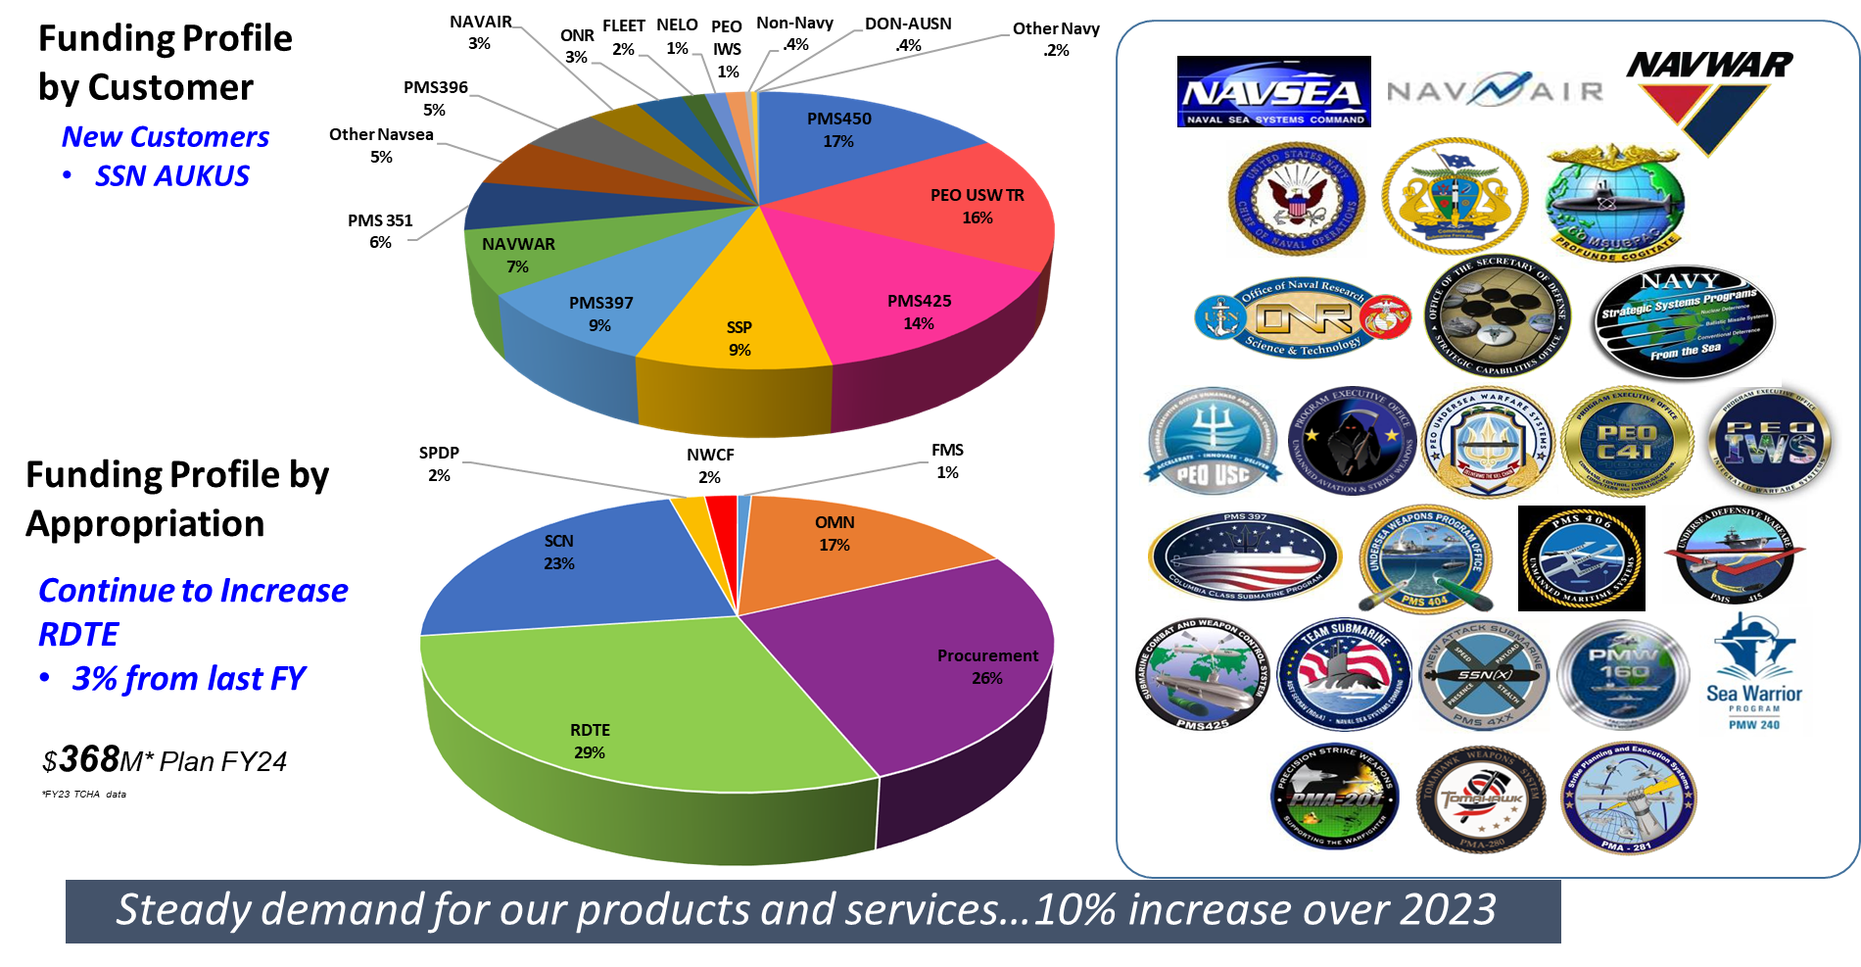
Combat System Funding
$388M* Plan for FY25
*FY24 TCHA data
Steady demand for our products and services…9% increase over 2024
DISTRIBUTION STATEMENT A. Approved for public release.

Slide 8
Projected Code 25 Contracts (FY25)
Task Description | Estimated Level of Effort | Anticipated Strategy | Action Type | Current Contract # | Incumbent | Anticipated RFP Release FY QTR
Submarine On-Board Training (SOBT) Support Services | 144,000 hours & $135,000 ODCs | Small Business Set-Aside | Seaport | N00178-19-D-8631-N66604-20-F-3005 | SRM | 2025 QTR 2
Code 25 In-Service Engineering Support | 630,500 hours & $7,878,000 ODCs | Unrestricted | Seaport | N00178-19-D-8623-N66604-20-F-3006 | SEACORP | 2025 QTR 2
Trainer Development Support | 688,065 hours & $4,928,000 ODCs | Unrestricted | Seaport | N00178-19-D-8194-N66604-20-F-3007 | Northrop Grumman | 2025 QTR 2
Lab/Advanced Interactive Management Technology Center (AIMTC) Support | 95,000 hours (+FFP) & $250,000 ODCs | Small Business Set-Aside | Seaport | N00178-19-D-8122-N66604-21-F-3004 | MIKEL | 2025 QTR 4
Code 25 Combat Control Systems Support | 598,000 hours & $2,300,000 ODCs | TBD | Seaport | N00178-19-D-8424-N66604-22-F-3014 | Rite-Solutions, Inc. | 2025 QTR 4
DISTRIBUTION STATEMENT A. Approved for public release.
8

Slide 9
Projected Code 25 Contracts (FY26)
Task Description | Estimated Level of Effort | Anticipated Strategy | Action Type | Current Contract # | Incumbent | Anticipated RFP Release FY QTR
Data Acquisition and Retrieval System (DARTS) SBIR Phase III | 258,000 hours & $1,500,000 ODCs | Sole Source | IDIQ | N66604-21-D-H100 | GDMS | 2026 QTR 1
BYG-1 Payload Control System (PCS) SBIR Phase III | 142,000 hours & $2,000,000 ODCs | Sole Source | IDIQ | N66604-21-D-E100 | SEACORP | 2026 QTR 1
Consolidated Afloat Networks and Enterprise Services (CANES) Development | 350,000 hours & $2,000,000 ODCs | TBD | Seaport | N00178-19-D-8424-N66604-21-F-3008 | Rite-Solutions, Inc | 2026 QTR 1
Consolidated Afloat Networks and Enterprise Services (CANES) Services | 95,000 hours & $350,000 ODCs | TBD | Seaport | N00178-19-D-7675-N66604-22-F-3001 | G2 Software Systems | 2026 QTR 3
DISTRIBUTION STATEMENT A. Approved for public release.
9

Slide 10
Submarine On-Board Training (SOBT) Support Services
Summary of Contract Scope: Support services for the successful SOBT Office Support efforts in the functional areas of Project Management, Software Design, Engineering Support, Configuration Management, Computer Programming, Administrative Support, and LAN Administration/Analysis Support
Contracting Method: SeaPort NxG
Anticipated Period of Performance: 08/29/2025 – 08/28/2030
Acquisition Strategy: Small Business Set-Aside (SBSA)
Level of Effort: Estimated 144,000 hours & $135,000 ODCs
Anticipated work location: 99% Government Site (Submarine Learning Center, Groton CT), 1% Contractor Site
Contract Type: CPFF
Unique Characteristics:
Key Personnel requirements: Minimum 5 Key Personnel (inclusive of the STR) Covering Areas of Expertise
Facility Security Clearance: Secret
Required Certifications/Designations: Cyber Workforce (CWF)
If large ODCs provide any details: ODCs primarily for travel
Follow on? Yes, follow-on to N00178-19-D-8631-N66604-20-F-3005, SRM, Acquisition Strategy was Small Business Set-Aside
Does OCOI clause apply? Yes
Expected RFP release: FY25 QTR 2
DISTRIBUTION STATEMENT A. Approved for public release.

Slide 11
Code 25 In-Service Engineering Support
Summary of Contract Scope: Technical services pertaining to the development, integration, test and evaluation, modernization, and sustainment of the In-Service LOS ANGELES, OHIO, SEAWOLF, VIRGINIA, COLUMBIA, VANGUARD, and DREADNOUGHT Class Fleet. The services shall be provided to SSN, SSBN, and SSGN Non-Propulsion Electronics Systems (NPES), associated subsystems, and Hull, Mechanical and Electrical components.
Contracting Method: SeaPort NxG
Anticipated Period of Performance: 09/21/2025 – 09/20/2030
Acquisition Strategy: Unrestricted
Level of Effort: Estimated 630,500 hours & $7,878,000 ODCs
Anticipated work location: 70% Government Site, 30% Contractor Site
Contract Type: CPFF
Unique Characteristics:
Key Personnel requirements: Minimum 8 Key Personnel (inclusive of the STR) Covering Areas of Expertise
Facility Security Clearance: Top Secret
Required Certifications/Designations: Cyber Workforce (CWF)
If large ODCs provide any details: ODCs for incidental materials for repair services and travel
Follow on? Yes, follow-on to N00178-19-D-8623-N66604-20-F-3006, SEACORP, Acquisition Strategy was Unrestricted
Does OCOI clause apply? Yes
Expected RFP release: FY25 QTR 2
DISTRIBUTION STATEMENT A. Approved for public release.

Slide 12
Trainer Development Support
Summary of Contract Scope: Develop, design, and integrate applications and systems that contribute substantially toward submarine combat system, submarine navigation, and surface ship trainer evolution.
Services shall include requirements analysis, development, software and
hardware integration, testing and installation.
Contracting Method: SeaPort NxG
Anticipated Period of Performance: 09/25/2025 – 09/24/2030
Acquisition Strategy: Unrestricted
Level of Effort: Estimated 688,065 hours & $4,928,000 ODCs
Anticipated work location: 90% Government Site, 10% Contractor Site
Contract Type: CPFF
Unique Characteristics:
Key Personnel requirements: TBD Key Personnel (inclusive of the STR) Covering Areas of Expertise
Facility Security Clearance: Secret
Required Certifications/Designations: Cyber Workforce (CWF)
If large ODCs provide any details: ODCs primarily for travel
Follow on? Yes, follow-on to N00178-19-D-8194-N66604-20-F-3007, Northrup Grumman, Acquisition Strategy was Unrestricted
Does OCOI clause apply? Yes
Expected RFP release: FY25 QTR 2
DISTRIBUTION STATEMENT A. Approved for public release.

Slide 13
Code 25 Lab/Advanced Interactive Management Technology Center (AIMTC) Support
Summary of Contract Scope: Operational, technical and engineering services in support of the infrastructure, systems and laboratories assigned to the Undersea Warfare Combat Systems Department, Code 25, including AIMTC Operations, Maintenance, and Help Desk support.
Contracting Method: SeaPort NxG
Anticipated Period of Performance: 05/01/2026 – 04/30/2031
Acquisition Strategy: TBD
Level of Effort: Estimated 95,000 hours & $250,000 ODCs
Anticipated work location: 99% Government Site, 1% Contractor Site
Contract Type: CPFF and FFP
Unique Characteristics:
Key Personnel requirements: TBD Key Personnel (inclusive of the STR) Covering Areas of Expertise
Facility Security Clearance: Secret
Required Certifications/Designations: Cyber Workforce (CWF)
If large ODCs provide any details: ODCs primarily for travel and maintenance items
Follow on? Yes, follow-on to N00178-19-D-8122-N66604-21-F-3004, Mikel, Inc., Acquisition Strategy was Small Business Set-Aside
Does OCOI clause apply? Yes
Expected RFP release: FY25 QTR 4
DISTRIBUTION STATEMENT A. Approved for public release.

Slide 14
Code 25 Combat Control Systems Support
Summary of Contract Scope: Engineering, technical expertise, and administrative services in support of NUWCDIVNPT Undersea Warfare Combat Systems Acquisition Division (Code 251) projects and program customers. This includes advance development, experimentation, hardware and software engineering, systems engineering, system integration and test, fleet support, lab support and administrative services for Combat Control Systems.
Contracting Method: SeaPort NxG
Anticipated Period of Performance: 05/23/2026 – 05/22/2031
Acquisition Strategy: TBD
Level of Effort: Estimated 598,000 hours & $2,300,000 ODCs
Anticipated work location: 35% Government Site, 65% Contractor Site
Contract Type: CPFF
Unique Characteristics:
Key Personnel requirements: TBD Key Personnel (inclusive of the STR) Covering Areas of Expertise
Facility Security Clearance: Secret
Required Certifications/Designations: Cyber Workforce (CWF)
If large ODCs provide any details: ODCs primarily for incidental materials required for tasking and travel
Follow on? Yes, follow-on to N00178-19-D-8424-N66604-22-F-3014, Rite-Solutions, Inc., Acquisition Strategy was Small Business Set-Aside
Does OCOI clause apply? Yes
Expected RFP release: FY25 QTR 4
DISTRIBUTION STATEMENT A. Approved for public release.

Slide 15
Data Acquisition and Retrieval System (DARTS) SBIR Phase III Contract
Summary of Contract Scope: Apply the DARTS and associated processes to collect and analyze platform, NPES, and C3I data for the NUWC Test Program. The scope includes tailoring the DARTS to the needs of the individual test events and to provide DARTS installation and removal services and operational support for test events.
Contracting Method: D-Type Contract
Anticipated Period of Performance: 05/10/2026 – 05/09/2031
Acquisition Strategy: Sole Source
Level of Effort: Estimated 258,000 hours & $1,500,000 ODCs
Anticipated work location: 20% Government Site, 80% Contractor Site
Contract Type: CPFF
Unique Characteristics:
Key Personnel requirements: TBD Key Personnel (inclusive of the STR) Covering Areas of Expertise
Facility Security Clearance: Top Secret
Required Certifications/Designations: Cyber Workforce (CWF)
If large ODCs provide any details: ODCs primarily for travel with some incidental materials for test support
Follow on? Yes, follow-on to N66604-21-D-H100, Progeny, Acquisition Strategy was Sole Source (SBIR Phase III)
Does OCOI clause apply? Yes
Expected RFP release: FY26 QTR 1
DISTRIBUTION STATEMENT A. Approved for public release.

Slide 16
BYG-1 Payload Control System (PCS)
SBIR Phase III Contract
Summary of Contract Scope: Modify the payload control system (PCS) technology to adapt the combat control system (CCS) to new payload interfaces planned for submarine introduction. The effort includes architecture development, software development, software integration and testing to enable payload integration prototypes.
Contracting Method: D-Type Contract
Anticipated Period of Performance: 05/14/2026 – 05/13/2031
Acquisition Strategy: Sole Source
Level of Effort: Estimated 142,000 hours & $2,000,000 ODCs
Anticipated work location: 50% Government Site, 50% Contractor Site
Contract Type: CPFF
Unique Characteristics:
Key Personnel requirements: TBD Key Personnel (inclusive of the STR) Covering Areas of Expertise
Facility Security Clearance: Secret
Required Certifications/Designations: Cyber Workforce (CWF)
If large ODCs provide any details: ODCs primarily for materials for prototypes with some travel
Follow on? Yes, follow-on to N66604-21-D-E100, SEACORP, Acquisition Strategy was Sole Source (SBIR Phase III)
Does OCOI clause apply? Yes
Expected RFP release: FY26 QTR 1
DISTRIBUTION STATEMENT A. Approved for public release.

Slide 17
Consolidated Afloat Networks and Enterprise Services (CANES) Development
Summary of Contract Scope: Engineering and technical services to support the evolution and deployment of PEO (Program Executive Office) C4I (command, control, communications, computers, and intelligence) networks to all U.S. Navy submarines under the cognizance of NUWCDIVNPT Code 25.
Contracting Method: SeaPort NxG
Anticipated Period of Performance: 08/01/2026 – 07/31/2031
Acquisition Strategy: TBD
Level of Effort: Estimated 350,000 hours & $2,000,000 ODCs
Anticipated work location: 90% Government Site, 10% Contractor Site
Contract Type: CPFF
Unique Characteristics:
Key Personnel requirements: TBD Key Personnel (inclusive of the STR) Covering Areas of Expertise
Facility Security Clearance: Top Secret
Required Certifications/Designations: TBD
If large ODCs provide any details: ODCs primarily for travel
Follow on? Yes, follow-on to N00178-19-D-8424-N66604-21-F-3008, Rite-Solutions, Inc., Acquisition Strategy was Unrestricted
Does OCOI clause apply? Yes
Expected RFP release: FY26 QTR 1
DISTRIBUTION STATEMENT A. Approved for public release.

Slide 18
Consolidated Afloat Networks and Enterprise Services (CANES) Services
Summary of Contract Scope: Systems engineering, managing, and tracking engineering change request processes which include engineering, testing, logistics and platform integration for submarine networks; PMW 160 Design Engineering working groups, and cognizant engineering teams to prepare the engineering changes for fielding and; acting as technical point of contact (TPOC) for the applicable applications and subsystems being integrated to the PEO C4I PMW 160 submarine network.
Contracting Method: SeaPort NxG
Anticipated Period of Performance: 12/01/2026 – 11/30/2031
Acquisition Strategy: TBD
Level of Effort: Estimated 95,000 hours & $350,000 ODCs
Anticipated work location: 35% Government Site (NAVWAR San Diego, CA), 65% Contractor Site
Contract Type: CPFF
Unique Characteristics:
Key Personnel requirements: TBD Key Personnel (inclusive of the STR) Covering Areas of Expertise
Facility Security Clearance: Secret
Required Certifications/Designations: TBD
If large ODCs provide any details: ODCs primarily for travel
Follow on? Yes, follow-on to N00178-19-D-7675-N66604-22-F-3001, G2 Software Systems, Acquisition Strategy was Small Business Set-Aside
Does OCOI clause apply? Yes
Expected RFP release: FY26 QTR 3
DISTRIBUTION STATEMENT A. Approved for public release.

