Slide 1
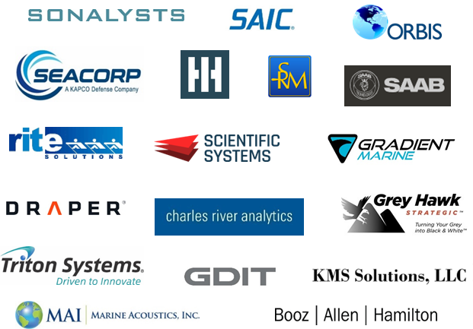
Overview Highlights:
Non-traditional business
76! Years Experience Working with DOD/Navy
Main office: Aquidneck Office Park, Middletown, RI
NIST SP 800-171 Compliant
SPRS Registered
NAVSEA AIT Quality Assurance
Authorization to Operate (ATO) for Classified Material Processing
Customers/ Major Team Mates:
NAVSEA WFC Headquarters
NUWC Division Newport
NUWC Division Keyport
NSWC Division Corona
NSWC Division Crane
NSWC Division Port Hueneme
Discriminators:
Undersea Weapons and Launcher Systems
UUV Engineering & Support
Wet End Sensors
Undersea Warfare Analysis
Ocean Engineering support
Temp Alt TDP development
Level 3 Drawing & GD&T
Core Competencies / Capabilities:
Engineering Services
Program Management support
Product Life Cycle Management
Technical Services
Information Technology
Information Assurance
Corporate Operations Support
Communication
Graphic Design
Infrastructure Support

