Slide 1
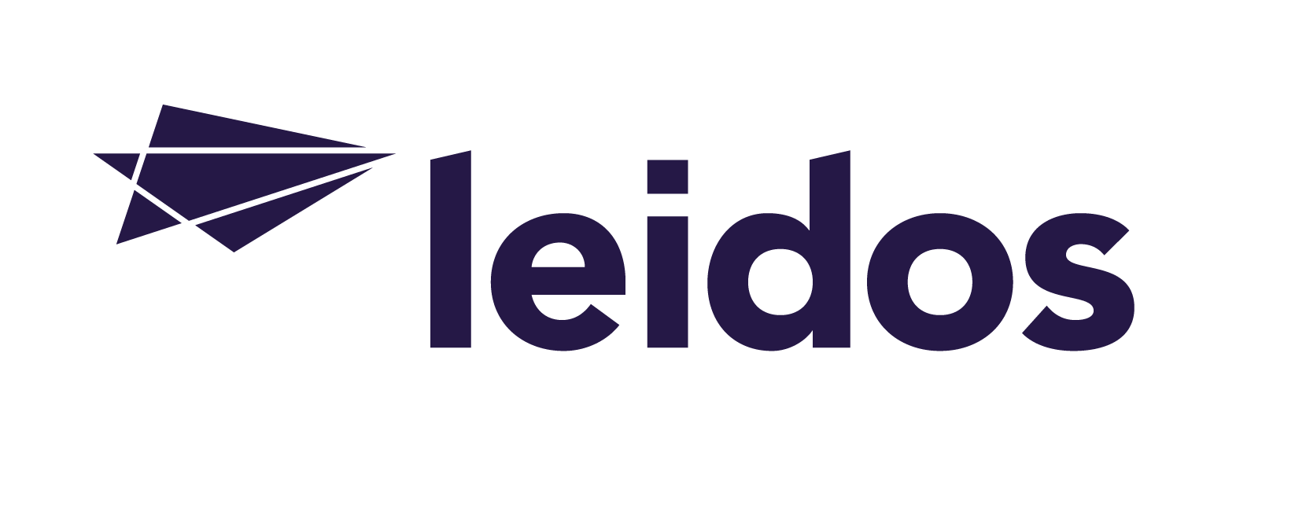
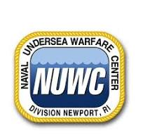
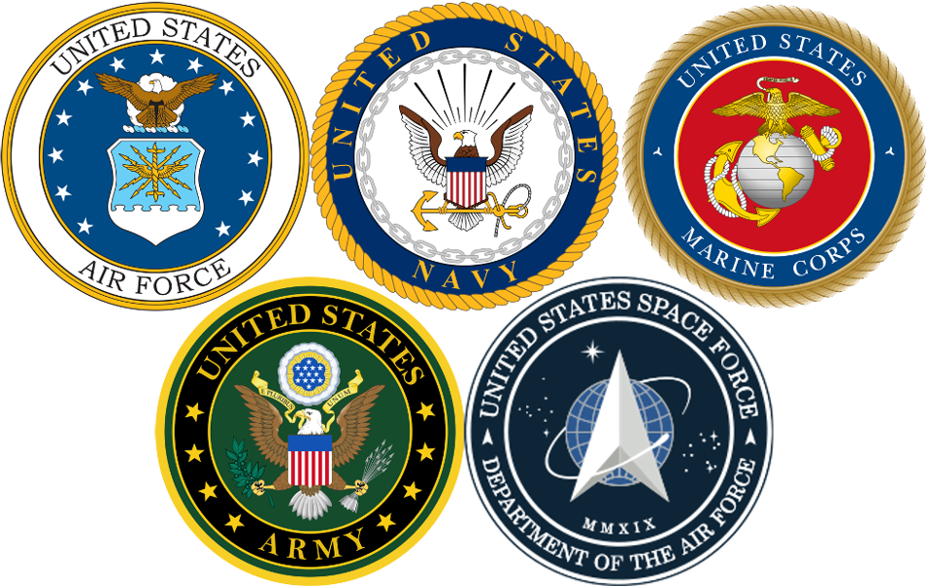
Leidos is an innovation company rapidly addressing the world’s most vexing challenges in national security and health. We collaborate to create smarter technology solutions for customers in heavily regulated industries.
Corporate Capabilities:
NUWC Newport Capabilities
DIGITAL MODERNIZATION Resilient enterprise IT solutions and managed services that leverage trusted mission AI and full-spectrum cyber to decrease burdens and vulnerabilities in complex IT operations.
FULL-SPECTRUM CYBER Cyber solutions that protect and defend the nation’s largest and most attacked mission-critical networks and cyber-physical systems.
TRUSTED MISSION AI Mission-focused AI and machine learning solutions that are trusted and valued by customers and built on deep experience and partnerships.
SECURE SOFTWARE Secure, mission quality software built on disciplined processes, common tools, reusable frameworks, automation, collaboration, and domain expertise and delivered at Silicon Valley speed.
SIGNAL PROCESSING Highly digitized, multi-channel radar, seeker, and sensing systems using advanced concepts to provide accurate target detection and tracking in the most challenging radio frequency environments.
Towed Systems Supported:
Submarine Fatline:
TB-16E/F/G & TB-34/34A
Submarine Thinline:
TB-29A/C
Surveillance: TL-29A
Surface Ship:
TB-37/37A (FY25) & SQR-19
Our NUWC Programs:
TA-IMA
NATSC
IWS5
SURTASS

