Slide 1

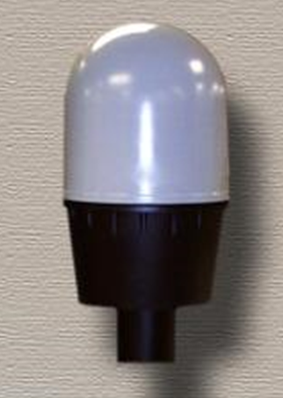
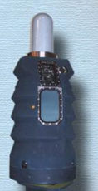
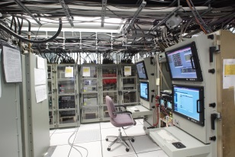
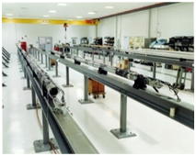
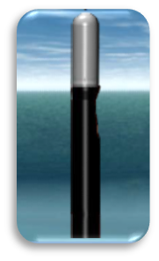
Undersea Warfare (USW)
Electromagnetic Systems Department (Code 34) Overview
Darlene Sullivan
Department Head, USW Electromagnetic Systems
NUWCDIVNPT Code 34
(401) 832 – 5463 (Office)
Darlene.n.sullivan.civ@us.navy.mil
George A. Nichols, III
Technical Department Acquisition Advocate (TDAA)
NUWCDIVNPT Code 34B
(401) 832.5429 (Office)
George.A.Nichols12.CIV@US.Navy.Mil
Distribution A – Approved for Public Release

Slide 2
USW Electromagnetic Systems
Mission/Purpose
Serve as the Navy’s principal activity for developing, acquiring, installing, modernizing and maintaining the world’s most capable USW Electromagnetic systems including Antennas, Periscopes, Electronic Warfare, Communications, Electro-Optics Systems, and Electromagnetic Compatibility
Vision
Dominance of Electromagnetic Spectrum
USW Electromagnetic Systems Department Description​​​​​​​
​​​​​​​The Undersea Warfare Electromagnetic Systems Department (Code 34) serves as the U.S. Navy’s principle research, development, test and evaluation (RDT&E) agent and conducts and manages a full spectrum program for undersea warfare communications and electromagnetic systems. This includes antennas, periscopes, electronic/information warfare, electro-optics systems, and electromagnetic compatibility for submarines, unmanned vehicles, undersea warfare networks and distributed undersea warfare systems and sensors.
2

Slide 3
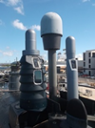
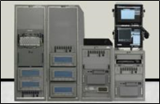
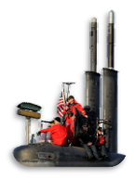
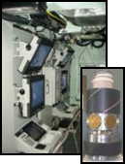

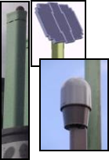

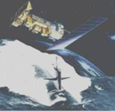
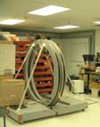
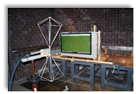
Product Areas & Roles
ELECTRONIC WARFARE (AEA, TDA, ISEA, ATD)
AN/BLQ-10
RADAR
Surveillance Sensors
Signature Reduction
Periscope & Imaging Mast Automatic Direction Finders
UxS Sensors
Information Warfare
Special Projects
Advanced Development
IMAGING (AEA, TDA, ISEA)
Integrated Submarine Imaging Systems (ISIS)
MTI Photonics Mast (PMP, PMV)
  Low Profile Photonics Mast (LPPM)
  Hull Penetrators/Dip Loops
  National Maintenance
  Imaging and Sensor Development
COMMUNICATIONS (LSI, AEA, TDA)
Common Submarine Radio Room Integration & Test
Communications at Depth
Submarine SATCOM
Submarine ADNS SE (IP WAN)
UUV & Sensor Communications
Interior Communications Systems
Submarine Comms & Antenna TDA
Special Projects & Assessments
COMMUNICATIONS ANTENNAS (AEA, ISEA, TDA)
Multifunction Mast (OE-538)
SubHDR (OE-562A)
Periscope EHF Antenna (OE-499)
Submarine Antenna Technology
Towed Buoys/ Buoyant Cable
Off-Board Sensors
Special Projects
Expendable/Tethered Buoys
ELECTROMAGNETIC ENVIRONMENTAL EFFECTS (E3)
Electromagnetic Compatibility
EMI Assessments/Testing
3

Slide 4
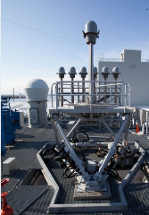
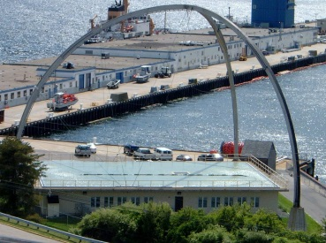

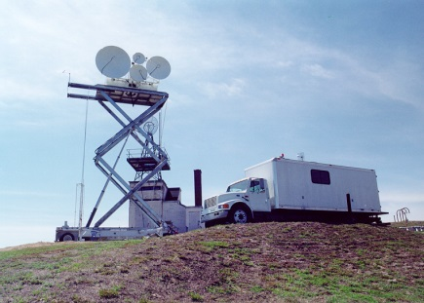
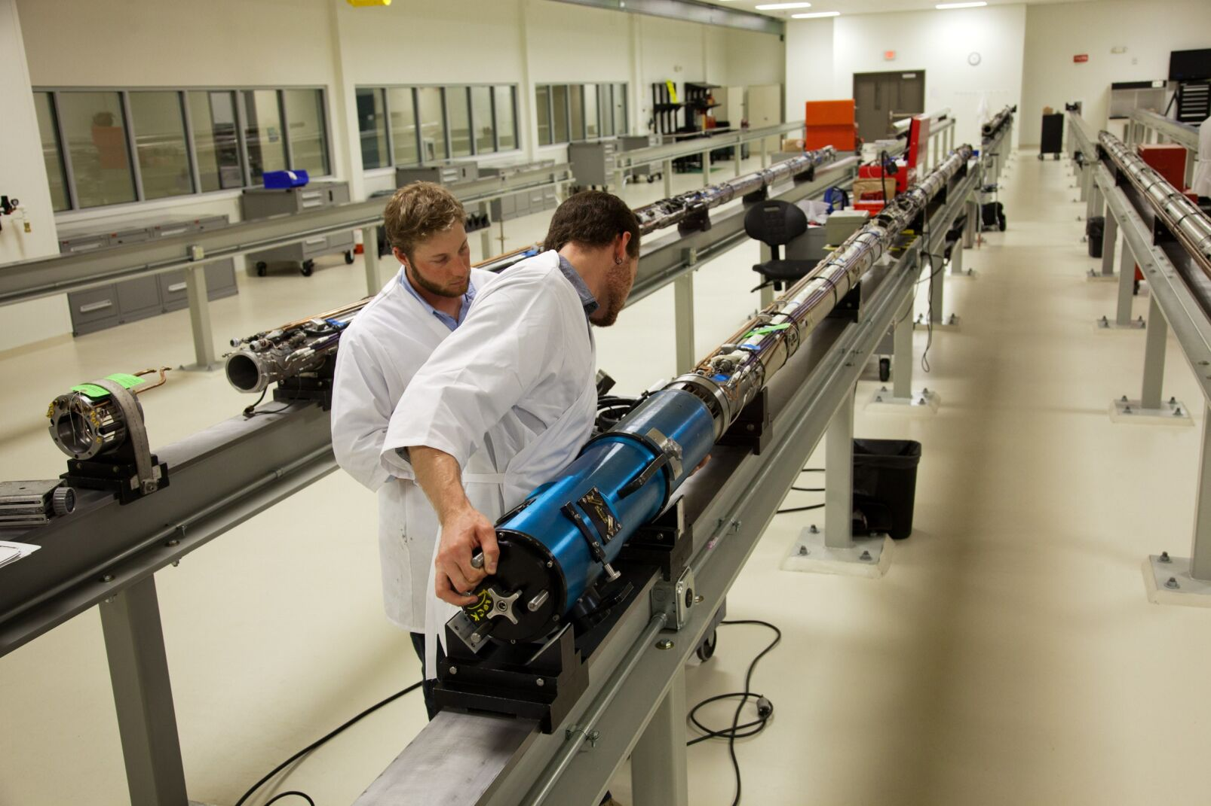
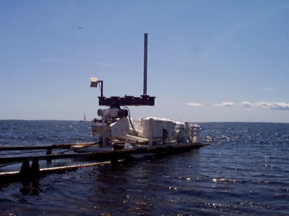
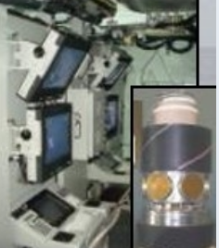
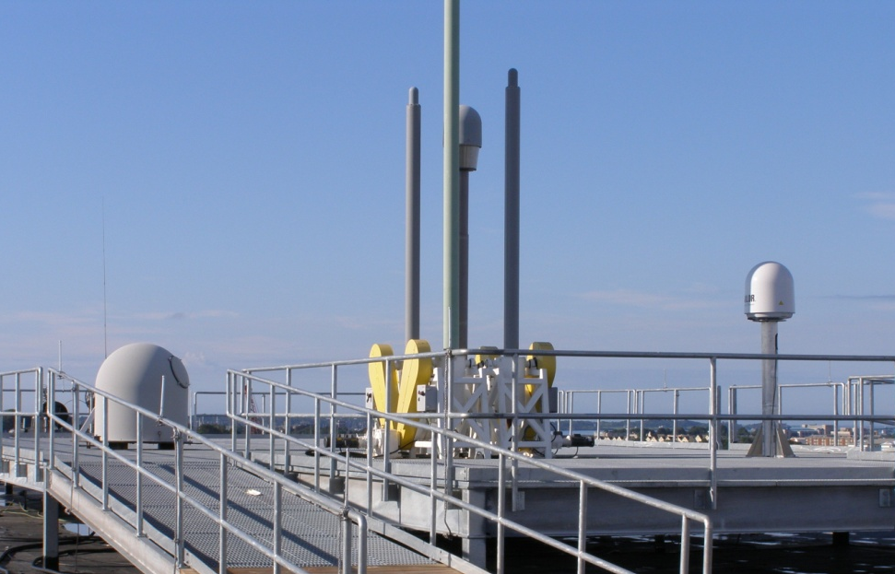
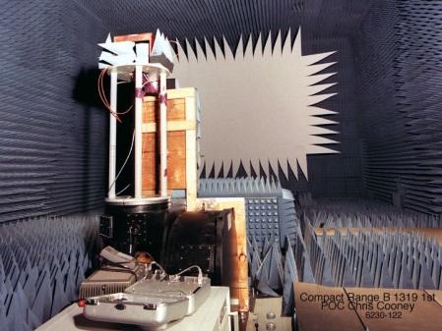
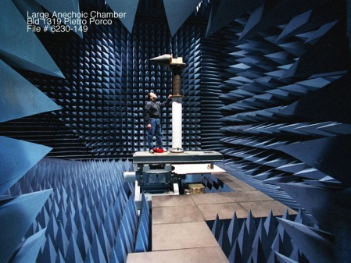
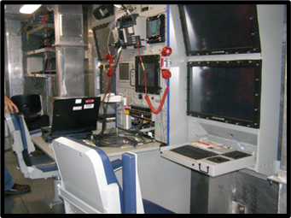
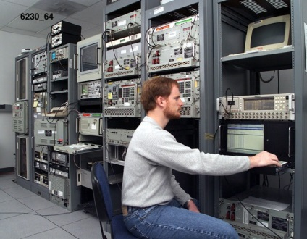
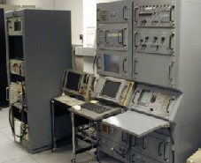
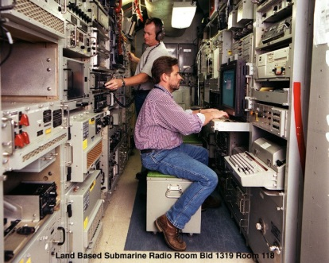
    Major Facilities
Electromagnetic Sensor Facility
Fishers Island, NY
Overwater Sled
Overwater Arch
Submarine Radio Rooms
RF Test Chambers
EW Test
Facilities
4

Slide 5
Code 34 Business Profile
USW Electromagnetic Systems
Our FY24 Customers
$~300M
Total workforce of 444 personnel (FY24 & FY25)
  95% of the workforce are scientists, engineers and technicians with 112 advanced degrees
~ 53% of total program funding is outsourced
Demand signal is strong and is projected to continue to increase
NAVSUP
4%
ONR
3%
Other DoD
9%
Reimbursable
(Internal)
Direct Cite
(Outsourced)
$145M
47%
$155M
53%
FTE=444
FTE=496
Code 34 maintains a strong business partnership with industry
to provide best value to our customers
5
Notes:
We perform $1,076 million in tasking annually,
99% of our work is for the Navy. The largest single customer is NAVSEA.
NUWC Newport is a Navy Working Capital Fund (NWCF) activity, meaning we operate like a business minus a profit motive. We are funded by the project to perform specific tasking.
We are funded only for the work we do therefore must run efficiently to keep costs low and competitive.
Our customers define their requirements, evaluate and approve likely proposals, and provide funding for specific projects and products, purchasing our expertise on a per-project basis.
Our customers are appreciate our efforts, 94.2% of respondents to our 2014 Customer Survey reported being satisfied or very satisfied overall.

Slide 6
USW Electromagnetic
Systems Department
DEPARTMENT HEAD
DEPUTY DEPARTMENT HEAD
DIRECTOR OF PROGRAMS
OFFICE OF TECHNICAL
PROJECT MANAGEMENT
CUSTOMER ADVOCATE
EW ADVANCED
TECHNOLOGY
DEVELOPMENT
BUSINESS OPERATIONS
OFFICE
TECHNICAL DIRECTION AGENTS
IMAGING
IN-SERVICE ENGINEERING
AGENT
EM SPECIAL PROGRAMS
OFFICE OF SCIENCE & TECHNOLOGY
COMMUNICATIONS
SYSTEMS & ANTENNAS
TDA
IMAGING
TDA
IMAGING AEA
TECHNICAL DEPARTMENT
ACQUISITION
ADVOCATE
COMMUNICATIONS
ANTENNAS SYSTEMS
EW SYSTEMS
TDA
CHIEF ENGINEER
MARITIME SPECIAL
PROGRAMS
COMMON SUBMARINE
RADIO ROOM
USW COMMS &
NETWORKING
ELECTRONIC WARFARE SYSTEMS
COMMS & EM MANEUVER WARFARE DIV
IMAGING & ELECTRONIC WARFARE SYSTEMS DIV
ENGINEERING AND FLEET SUPPORT DIV
SATCOM SYSTEMS
COMMON SUBMARINE RADIO ROOM BRANCH
RF
COMMUNICA-TION SYSTEMS
BRANCH
RF ANTENNAS AND SWITCHING BRANCH
NETWORKING & INFORMATION SYSTEMS BRANCH
EMW ADVANCED DEVELOP-MENT BRANCH
ELECTRONIC WARFARE SYSTEMS BRANCH
ELECTRO-OPTIC
SYSTEMS
BRANCH
I&EW IN-SERVICE ENG-INEERING BRANCH
EM WARFARE SPECIAL PROJECTS BRANCH
I&EW
SENSORS BRANCH
EM ENVIRON- MENTAL EFFECTS
BRANCH
LOGISTICS, QUALITY & MATERIALS MGMT BRANCH
MECHANICAL DESIGN & TESTING BRANCH
NATIONAL MAINTEN-ANCE FLEET SUPPORT BRANCH
Notes:
Slide demonstrates unique mission, roles & responsibilities of Warfare Centers.
We perform vital, inherently governmental functions across the warfare system life-cycle, are stewards of technical capabilities and critical knowledge, and fill a vital role in bridging the gap between military problems and technical feasibility.
We bridge the early research and concept development with technology development, transition and ISE support to the fleet.
We fulfill our role of smart buyer role by applying necessary end-to-end analysis, development science and engineering support, TDA functions and T&E.

Slide 7
Contract Portfolio
Portfolio is Program Centric
  Primarily buy services
  Contracts are mostly aligned with 34 Programs AORs
  Scopes are Program/Systems Engineering and Technical Services
  Mostly Seaport NXG
We do have several Department wide Services Contracts (none this cycle)
  Scopes are not Program/Systems specific
  Broad use across Department and mostly non-Engineering
We have a few ‘self contained’ Program/Project contracts
  These are driven by higher classification levels (TS/SCI) and Fleet support
  These are special projects and usually have significant GFP (shipsets)
We have a number of IDIQ production, spares and repair contracts
  Most are sole source to the OEM in support of our Repair Facilities
  We are increasing our BPAs and IDIQs to provide BTP/TTS parts
EVERYTHING PRESENTED IS PRELIMINARY!! THE RFP IS WHAT THE OFFICIAL REQUIREMENTS FOR THESE WILL BE!!

Slide 8
LRAE Overview
Title | RFP Release (Planned) | Current Contract/TO# | Last RFP# | Est. Ceiling $
Ant RFDACS Spares IDIQ (FO) | FY25 Q1 | N6660420DR000 | N6660420R0339 | ~$55M (MAC)
EW Lab Svcs (FO) | FY25 Q2 | N0017819D8361 N6660421F3012 | N6660420R3013 | ~$10M
SP NIT Eng & Fleet Svcs (FO) | FY25 Q3 | N0017819D8361 N6660421F3011 | N6660420R3019 | ~$50M
SatCom Eng & Tech Svcs (FO) | FY25 Q3 | N0017819D8498 N6660421F3007 | N6660421R3001 | ~$60M
I&EW Eng & Tech Svcs (FO) | FY25 Q3 | N0017819D8424 N6660424F3004 | N6660423R3008 | ~$150M (5yr)
Ant Eng & Tech Svcs (FO) | FY25 Q3 | N0017819D8411 N6660422F3000 | N6660420R3015 | ~$55M
SP EM Eng & Fleet Svcs (FO) | FY26 Q1 | N0017819D8623 N6660422F3011 | N6660422R3002 | ~$55M
Comms Eng & Tech Svcs (FO) | FY26 Q1 | N0017819D8690 N6660422F3016 | N6660421R3015 | ~$45M

Slide 9
Ant RFDACS Production/Spares (FO)
Antenna Radio Frequency Distribution and Control System (RFDACS). Build to Print (BTP) and Test to Specification (TTS) for Level III Technical Data Package (TDP) for new shipsets and spare parts. Multiple ECPs anticipated during ordering period due to COTS obsolescence and Fleet requirement changes.
MAC IDIQ / 5yr ordering period / Unrestricted / $55M
Primarily FFP Systems-Spares w/ some CPFF Eng Svcs for NRE
Unique Characteristics
  Manufacturing capabilities (at Ktr facilities)
  Strong DMSMS capabilities (COTS obsolescence)
  Multiple ECP/NORs agility during production run
  Proactive Supply Chain Management experience
Follow on to N66604-20-D-R000 (SERCO)
  Awarded Contract Solicitation Number: N66604-20-R-0339
Expected RFP release FY25 QTR 1

Slide 10
EW Lab Svcs (FO)
Fixed and Mobile (Electronic Warfare) EW Lab operations support; System Admin, Lab CM, Calibration, Mobile Lab maintenance, Test Coordination and Readiness, Equipment tracking and shipment, Test Event support, Disaster Recovery and Contingency Operations. “Keep the lights on and the labs ready to support testing”
Seaport NXG / 5yr POP / Small Biz / 40K hrs
FFP/CPFF / $10M / 15% ODC/Labor
Unique Characteristics
  Info Assurance Techs (IAT)
  CDL Drivers to drive the Mobile Labs (Vans)
  Equipment CM tracking, calibration, event scheduling & coordination
Follow on to N00178-19-D-8361 / N66604-21-F-3012 (Purvis)
  Awarded Contract Solicitation Number: N66604-20-R-3013
Expected RFP release FY25 QTR 2

Slide 11
SP NIT Eng & Fleet Svcs (FO)
Engineering and Fleet Services for the Special Projects (SP) Network and Information Technology (NIT) programs. Lifecycle support of NIT shipboard equipment including TEMPALTs, Carry-On augmentation equipment, SOVT and cyber security accreditations.
Seaport NXG / 5yr POP / Unrestricted / 350K hrs
CPFF / $50M / 100% ODC/Labor
Unique Characteristics
  Cyber Security workforce
  TEMPALT and Fleet support of NIT shipsets and carry-on equipment
  Extensive Shipset GFP with maintenance and upgrade tasking
  Extensive TDY and CAP->GFP ODC efforts
Follow on to N00178-19-D-8361 / N66604-21-F-3011 (Purvis)
  Awarded Contract Solicitation Number: N66604-20-R-3019
Expected RFP release FY25 QTR 3

Slide 12
SatCom Eng & Tech Svcs (FO)
Engineering and Technical Services for the Satellite Communications (SatCom) programs. SubHDR National Maintenance Center (NMC), SatCom Integration Facility (SESIF), Submarine Mast Motion Table (SMMT) and broad spectrum SatCom Engineering and Technical services support.
Seaport NXG / 5yr POP / Unrestricted / 450K hrs
CPFF / $60M / 20% ODC/Labor
Unique Characteristics
  NMC, SESIF & SMMT repair and test facility expertise
  Fleet SatCom Engineering and Technical support
  NMC Inventory management
Follow on to N00178-19-D-8498 N66604-21-F-3007 (Serco)
  Awarded Contract Solicitation Number: N66604-21-R-3001
Expected RFP release FY25 QTR 3

Slide 13
I&EW Eng & Tech Svcs (FO)
Engineering and Technical Services for the Imaging, Electronic Warfare (EW) programs (I&EW). There will be added scope and LOE for RADAR and EW ATD programs/projects. Support across TDA, AEA and ISEA areas of responsibility.
Seaport NXG / 5yr POP / Unrestricted / 1,500K hrs
CPFF / $150M / 30% ODC/Labor
Unique Characteristics
  Multiple key personnel w/ exp in Imaging, EW and RADAR systems
  Prototyping and Moderation Facilities
  Integrated I&EW/RADAR systems expertise
Follow on to N00178-19-D-8424 / N66604-24-F-3004 (Rite-Solutions)
  Awarded Contract Solicitation Number: N66604-23-R-3008
OCOI may apply to subsequent Sponsor Production Contracts
Expected RFP release FY25 QTR 3

Slide 14
Ant Eng & Tech Svcs (FO)
Engineering and Technical Services for the Antenna programs. Broad scope from experimental design and test, development, production support, in service and overhaul. Support across S&T, ATD, TDA, AEA and ISEA areas of responsibility.
Seaport NXG / 5yr POP / Unrestricted / 450K hrs
CPFF / $55M / 25% ODC/Labor
Unique Characteristics
  Multiple key personnel w/ exp across a range of Antenna technologies
  Challenging tasking fitting lots a performance in small volume
  Experimental S&T, RDT&E, AEA, ISEA and Repair Facility SMEs
Follow on to N00178-19-D-8411 / N66604-22-F-3000 (RDSI)
  Awarded Contract Solicitation Number: N66604-22-R-3015
Expected RFP release FY25 QTR 3

Slide 15
SP EM Eng & Fleet Svcs (FO)
Engineering and Fleet Services for the Special Projects (SP) Electronic Warfare (EW) and augmentation systems supporting Fleet TEMPALT systems and carry-on equipment, UAVs and Buoy Systems. Broad spectrum support from development, test, installation, repair, maintenance, upgrade and fleet technical support.
Seaport NXG / 5yr POP / Unrestricted / 300K hrs
CPFF / $55M / 75% ODC/Labor
Unique Characteristics
  TEMPALT and Fleet support of shipsets and carry-on equipment
  Extensive Shipset GFP with maintenance and upgrade tasking
  Extensive TDY and CAP->GFP ODC efforts
Follow on to N00178-19-D-8623 / N66604-22-F-3011 (SeaCorp)
  Awarded Contract Solicitation Number: N66604-22-R-3002
Expected RFP release FY26 QTR 1

Slide 16
Comms Eng & Tech Svcs (FO)
Engineering and Technical Services for the Communication (Comms) programs. These include Exterior, Internal and Undersea Comms systems for the Design Agent (DA), TDA and AEA and various ATD and Special Projects.
Seaport NXG / 5yr POP / Unrestricted / 450K hrs
CPFF / $45M / 15% ODC/Labor
Unique Characteristics
  Key personnel with KSA in Submarine Radio Rooms and Networks
  DA Radio Room build, test and baseline for multiple versions
  Tech Assists to AEA, ISEA and Fleet support Activities
Follow on to N00178-19-D-8690 / N66604-22-F-3016 (TCI)
  Awarded Contract Solicitation Number: N66604-21-R-3015
Expected RFP release FY26 QTR 1

Slide 17
TDAA Closing Comments
34’s Portfolio is mature and we are doing follow-ons with similar scope, similar LOE, similar ceilings.
The new RFPs are very likely to be similar to the last RFP
  Get the last RFP
  Read the last RFP
  Be Ready for a similar RFP
The SSEB Teams will (just like your capture teams)
  Read the RFP and create a list all the RFP questions
  Evaluated whether your bid answered the questions
  Please answer the questions the RFP asks
34 is a heavily leveraged Department and depends on our contractors to provide a considerable amount of Engineering, Technical and Fleet services for our multiple programs.
  We have complex missions to deliver to the Fleet
  We can’t do it without our Contractor Partners
  Bid, win and join the 34 Team

